Slide 1

Notes:
8 billion people inhabit this earth. 362 million of those reside in the United States and Canada.
We have before us the largest mission field the world has ever seen.

Slide 2


Supporting cross-cultural and
diaspora (people group) ministry,
the Pastoral Studies Institute (PSI) and
WELS Mission Journeys
Give thanks to the Lord!
WELS JOINT MISSIONS
Notes:
WELS Joint Missions supports mission opportunities that are the responsibility of Home Missions, World Missions, and Ministerial Education. Much of this work centers around diaspora (people group) ministries, where immigrants who have joined our fellowship in the United States and Canada are able to take the gospel back to friends and family in their country of origin. Joint Missions administers the work of the Pastoral Studies Institute (PSI) and assists in other cross-cultural outreach efforts and new programs like WELS Mission Journeys.

Slide 3
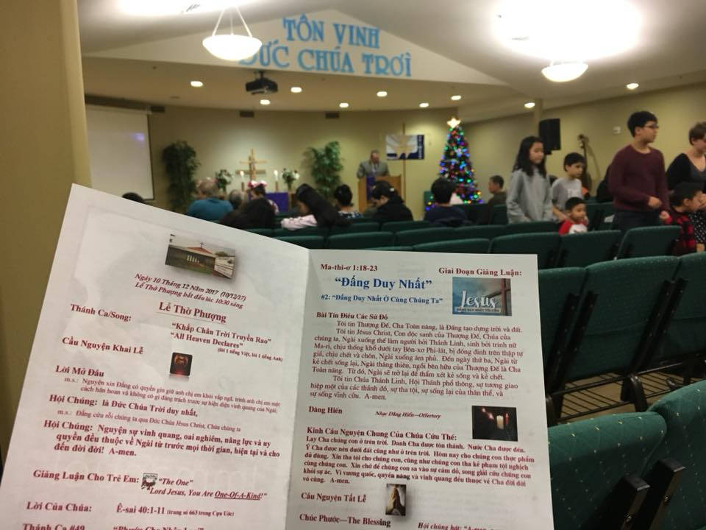
Joint Mission Council (JMC)
Diaspora (people group) ministries supported by JMC:
Chinese
Hispanic
Hmong
Korean
Liberian
South Asian
Sudanese
Vietnamese
Peace in Jesus Vietnamese LC – Boise, ID
Notes:
Joint Mission Council:
The Joint Mission Council (JMC) facilitates the mission work of WELS Joint Missions. The JMC is made up of called and lay member representatives from Home Missions, World Missions, and Ministerial Education (specifically Wisconsin Lutheran Seminary).
Diaspora (people group) Ministry = Connecting people with the same language and culture (I.e. Sudanese Lutherans reaching out to other Sudanese people in various locations at home and abroad)
Cross-Cultural Ministry = Outreach from one culture to another (I.e. Anglo Lutherans reaching out to the Sudanese or Hmong people, etc.)

Slide 4
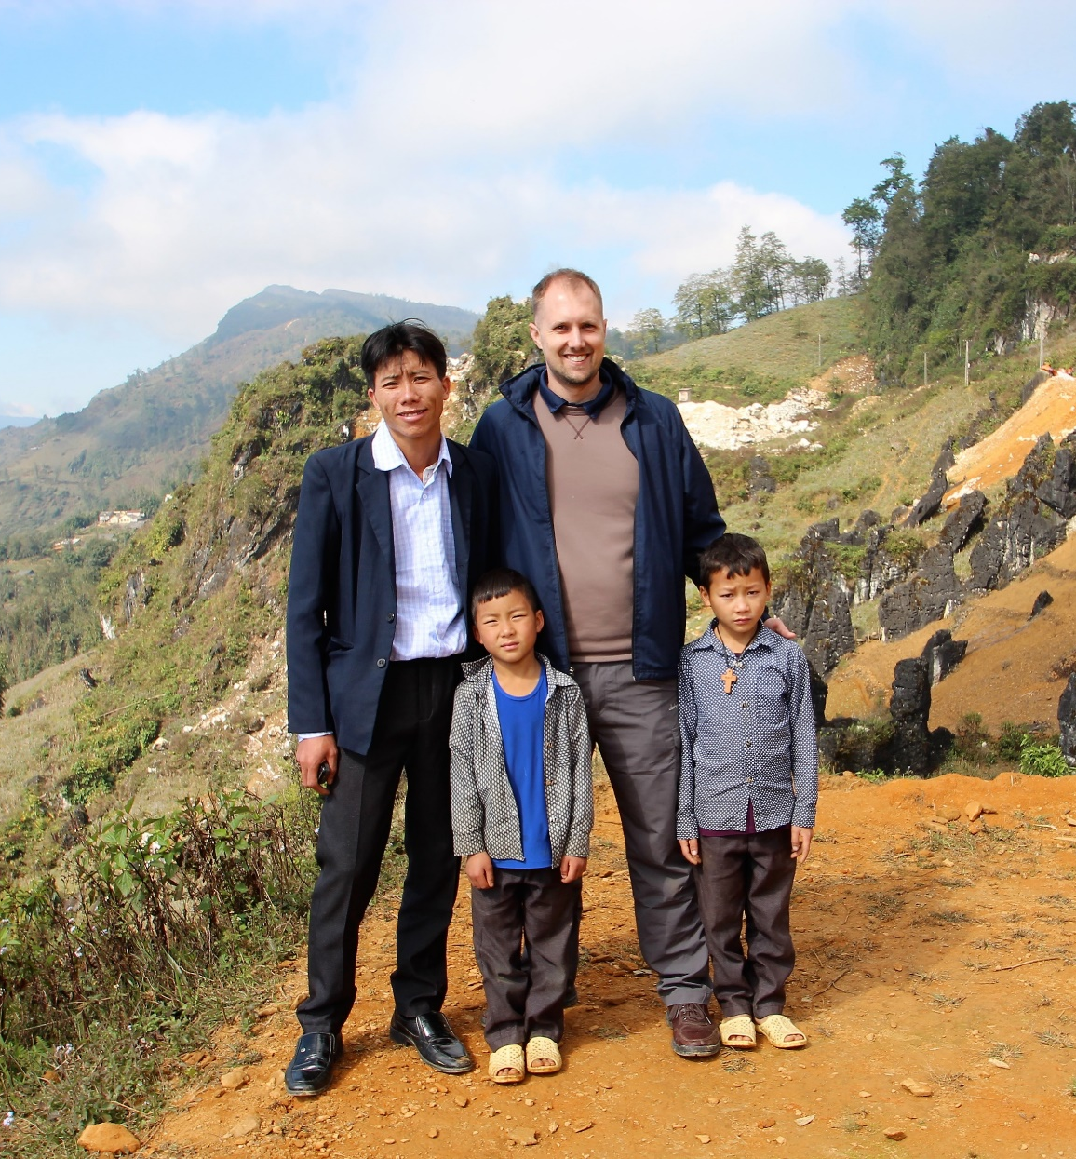
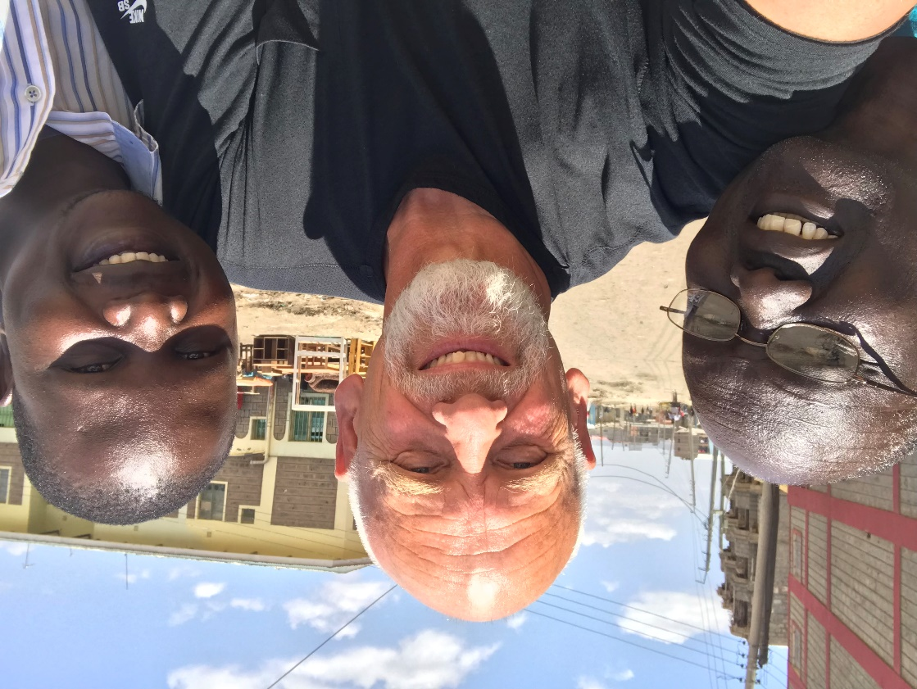
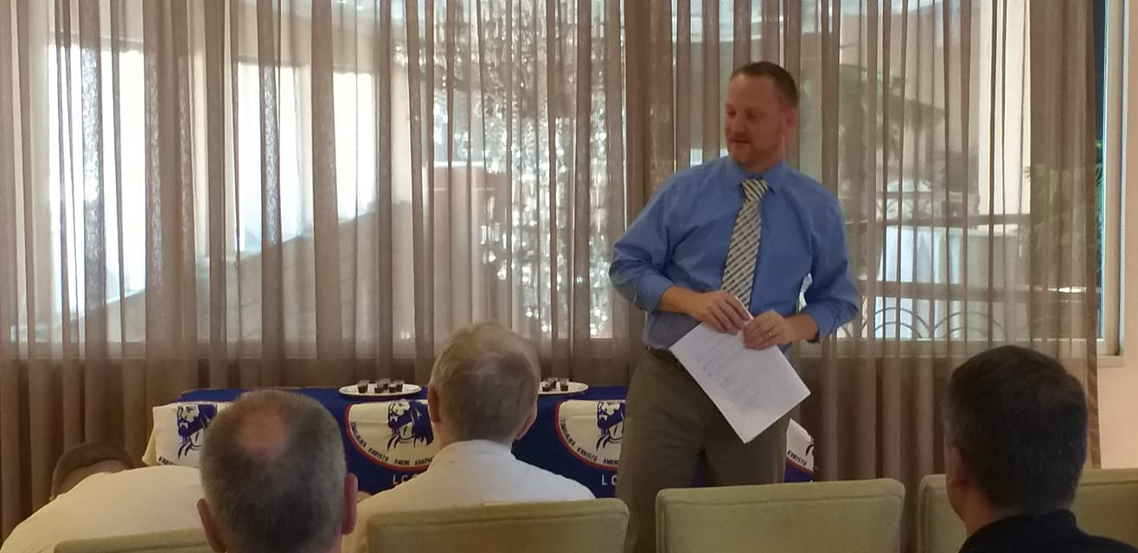

PSI trains spiritual
leaders around the world
Notes:
Photos: Rev. E. Allen Sorum, PSI Professor (top right), Rev. David Bivens, PSI Professor (bottom right), Rev. Jon Bare, PSI Director (left)
Rev. Jon Bare has since accepted a call to be the next President of Asia Lutheran Seminary and will start in that new role in 2023. Calls are currently being made to replace him.
In partnership with WELS Joint Missions, Wisconsin Lutheran Seminary’s Pastoral Studies Institute provides pre-seminary and seminary training to North American students from a variety of countries and cultures. As WELS congregations reach out to refugees and immigrants with support and the gospel, candidates for pastoral ministry are introduced to the PSI Team. Training is provided at the local level, where a candidate’s local WELS pastor serves as his PSI Supervising Pastor. In many cases this training leads to international opportunities as well, since many of these spiritual leaders want training both for themselves and for church leaders in their countries of origin.
In addition, around the world Christians looking for gospel training contact the regional WELS World Missions teams and other churches in our fellowship. Many of these individuals, churches, or synods are seeking support, training, and connection to a church body that shares the truth of God’s word and the good news of salvation through Christ. PSI stands ready to assist regional missions teams in the evaluation process and to provide consultation and support in the area of theological education leading to fellowship.
For seminaries and Bible institutes of our fellowship throughout the world, the PSI Team provides consultation on curriculum and educational practices. Upon request, PSI coordinates advanced degree programs for pastors of these church bodies. PSI arranged visiting professors serve the various needs of these programs. Since the program began, faculty members have taught in Apacheland, Bulgaria, Colombia, East Asia, Ethiopia, Germany, Hong Kong, India, Indonesia, Japan, Kenya, Liberia, Malawi, Mexico, Nepal, Nigeria, the Philippines, Portugal, Russia, Sweden, Ukraine, and Zambia. Each year they serve hundreds of students.
PSI is directly involved in many of the people-group ministries supported through the WELS Joint Missions Council. Learn more about their involvement in the upcoming slides.
Learn more at wels.net/psi/

Slide 5
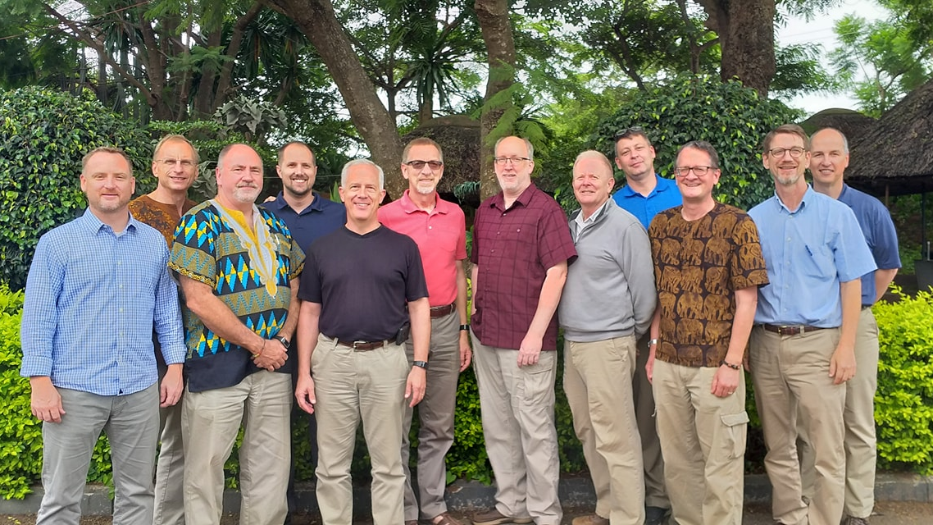
Newest PSI professor
Prof. David Bivens (far left)
Notes:
In Rev. David Bivens accepted the call to serve as professor of New Testament and Homiletics at Wisconsin Lutheran Seminary in 2020. He then accepted the call to serve as half time PSI professor, half time New Testament and Homiletics professor in October 2021.
Prof. Bivens served as a missionary to Brazil in Gravatai, Rio Grande do Sul, for six years and as pastor of Christ the Lord, Houston, and Divine Savior, Sienna, Texas for 11 years. Divine Savior began as a second campus of Christ the Lord and officially became a separate daughter congregation in 2018. Prof. Bivens has also served as chairman of the Administrative Committee for African Missions since 2017. Bivens, a 2003 WLS graduate, and his wife, Brandi, have three children.

Slide 6
Serving 2,450 Hispanic souls with the gospel
in 140 WELS congregations
Hispanic Ministry
Notes:
Hispanic Ministry: Currently 140 WELS congregations serve a Hispanic population in some form (Bilingual or Spanish worship services, Spanish Bible classes, ESL classes, etc.) Many of these congregations are also working with the Latin America missions team to bring the gospel back to their country of origin. Learn more at wels.net/hispanic/

Slide 7
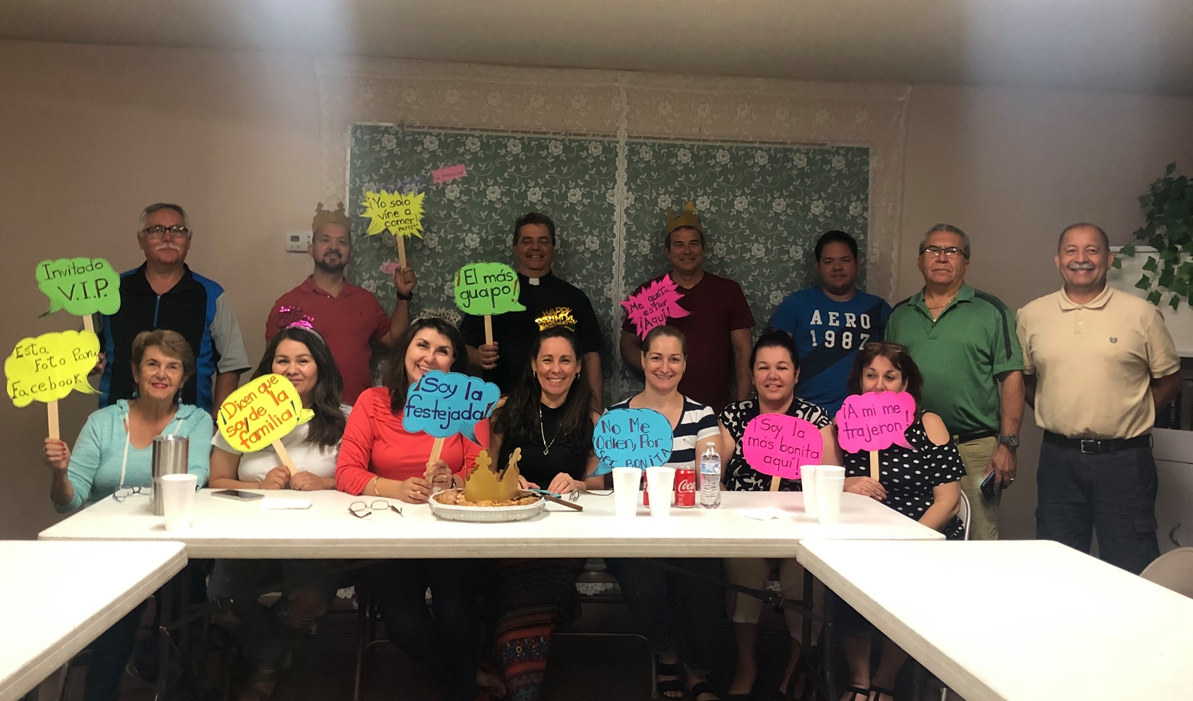

Hispanic Ministry – Santo Tomas, Phoenix, AZ
140 WELS churches serve Hispanic people
Notes:
Pictured: Celebrating Cumpleaños en Cristo (Jesus Birthday) at Santo Tomas in Phoenix, AZ. Santo Tomas is served by a bilingual Anglo pastor (Thomas Zimdars) and a Hispanic pastor (Francisco Cossio)
Hispanic Ministry – Stats:
Hispanic Souls: 2,450
Congregations serving Hispanic people: 140
Spanish worship services held every weekend: 18
Weekly Spanish Bible classes (in congregations that do not have Spanish worship): 15
Congregations with bilingual vicars: 2
Congregations receiving Hispanic outreach assistance from students at Wisconsin Lutheran Seminary: 2
Congregations receiving Home Missions financial subsidy for Hispanic outreach: 7

Slide 8
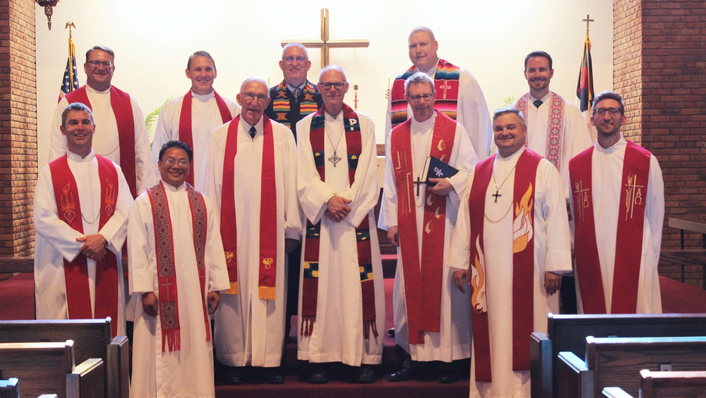
New Hispanic ministry approved at
St. John’s in St. Paul, MN
Notes:
Rev. Timothy Otto (center) was installed as bi-lingual pastor at St. John in St. Paul, MN on June 19, 2022. St. John was approved to receive financial support in April 2022 to serve the sizable Hispanic population in the area. The church is located right next to the Mexican Consulate, a portion of their facility is being rented by a Latino service organization, and there is already a Spanish women’s Bible study being led by a pastor’s wife who also works for a pregnancy resource center that’s housed there.

Slide 9
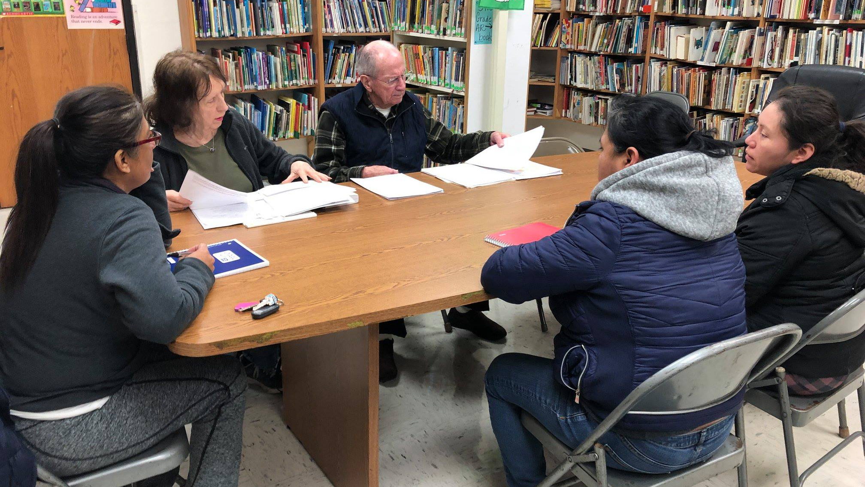

English Improvement Opportunity class
Immanuel Lutheran Church – Waukegan, IL
Notes:
Many Hispanic ministries end up being approved as Home Missions enhancements, which means they are granted funding to enhance their current church’s ministry. For Hispanic ministry specifically, funding is often granted for three years to call a bilingual or Hispanic pastor to lead the ministry, with the hopes that the church takes over financial support in three years when subsidy runs out.
Pictured: EIO (English Improvement Opportunity) class at Immanuel in Waukegan, IL. They were granted Home Missions status in 2017 as an enhancement in order to call their current bilingual pastor. They became self-supporting in 2020.

Slide 10
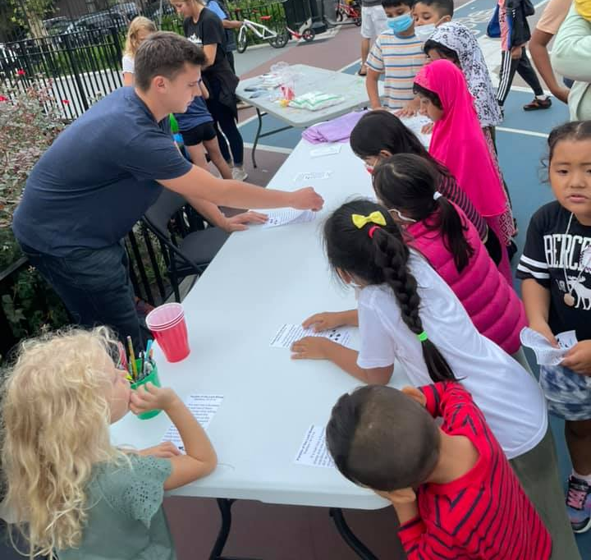
Sure Foundation
Serving the world's most diverse community in Woodside, Queens, N.Y.
Notes:
Sure Foundation serves an incredibly diverse community, including a large Hispanic population. They offer Spanish worship and Bible study weekly.
Sure Foundation in Woodside, NY, offered Art in the Park this fall. The kids did crafts, played some games and heard stories of Jesus. Their families were then invited to join their Kids Bible Club and participate in their kickoff event, “Rally Sunday”.

Slide 11
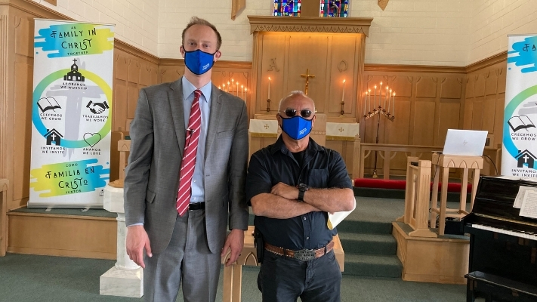

Hispanic Ministry in Detroit, MI
Faces of Faith - Roy
Notes:
Roy Mendoza was born in Detroit, one of 10 children. From an early age, his parents tried to get rid of him. Twice they took him to Mexico and left him there. They took him to California and other states and purposefully left him behind. He always managed to find his way back, but his distrust and hatred grew.
He soon began to take lives. People in Southwest Detroit called him a vigilante. Neighbors would ask him to take out an abuser, a thief, or some other untouchable, and he would. He became good at killing—he boasted about it—and he didn’t think twice about doing it. He felt no remorse, until he accidentally took the life of his own son.
Shortly after that horrific event, Roy landed in prison. He didn’t want to hear anything about God or forgiveness because he’d killed his own son. But then he heard a verse from Luke where Jesus said, “They will be divided—father against son and son against father.” By the Spirit’s power alone, these words piqued his interest, since he had been wrestling with guilt for the first time in his life. Within months of being in prison, God grabbed hold of his heart through his Word, and Roy cried. Tough guys weren’t supposed to cry, but Roy did. . . and it felt good.
As he reflects on the 25 years he spent behind bars for his life of crime, Roy says, “I didn’t go to prison. I went to school—God’s school.” He hadn’t known how to read, but he somehow started to learn by reading an old King James Bible someone gave him. He poured over Scripture day and night. At one point, he taught 14 men the Bible every day—many of whom had worked to destroy his own family because of things he’d done against their families on the outside. Roy came to know Christ and God’s grace for him, and with a humble, penitent spirit, he brought the gospel to his own enemies.
Since 2017, Roy has been out of prison—by God’s grace, a changed man. One fall day in 2020, after church, a member of Palabra de Vida bumped into him on the sidewalk and told him to check out our church. He did. He walked inside, and I met him. He’s been coming faithfully to worship and Bible study ever since. After studying with me in Bible information class, he was received into membership. Now, Roy is training to be a leader at Palabra de Vida. He encourages others who are just starting out in their faith. He applies the Word to hurting hearts. We pray that God continue to use Roy to give life to others—a big change from a few decades ago! All thanks to the Holy Spirit.
In awe of God’s mercy, Roy sees the famous hymn as his own: “Amazing grace, how sweet the sound—that saved a wretch like me. I once was lost, but now am found—was blind, but now I see.”
Written by Rev. Ryan Kolander, home missionary at Palabra de Vida in Detroit, MI (pictured left)

Slide 12
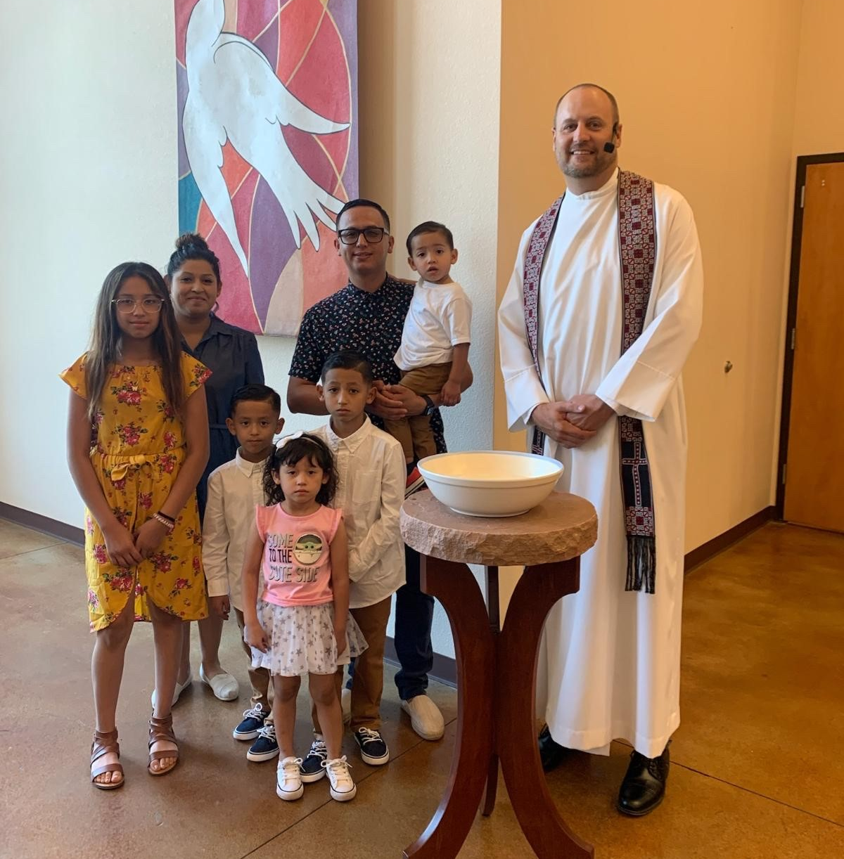
Academia Cristo connections in the United States: Denver, CO
Notes:
Christ Lutheran Church (Iglesia luterana Cristo) in Denver served a largely Hispanic population. A bilingual Anglo pastor, Rev. Paul Biedenbender, offers worship in both English and Spanish every week.
A Hispanic man from Denver, CO, (pictured here with his family) began studying with Academia Cristo. He wanted to find a local congregation that taught what Academia Cristo taught, and he came across Christ Lutheran Church, a Hispanic home mission congregation in Denver. Pastor Paul Biedenbender let him know that they did in fact teach the same thing as Academia Cristo. His children were recently baptized, the family is attending worship regularly, and he is actively training to become a leader in the church.

Slide 13
Five Hmong congregations reaching back to their home countries with the gospel
Hmong Ministry
Notes:
The Global Hmong Committee facilitates mission work to the Hmong people in the U.S. and Southeast Asia. Five Hmong congregations in Alaska, California, Kansas, Minnesota, and Wisconsin are all served by Hmong American pastors. These U.S. based ministries have also opened doors to world mission work in Thailand, Vietnam, and Laos. WELS Hmong leaders throughout the U.S. are very connected with these missions, working through the Global Hmong Committee to share resources, ideas, and assistance. Learn more at wels.net/hmong/

Slide 14
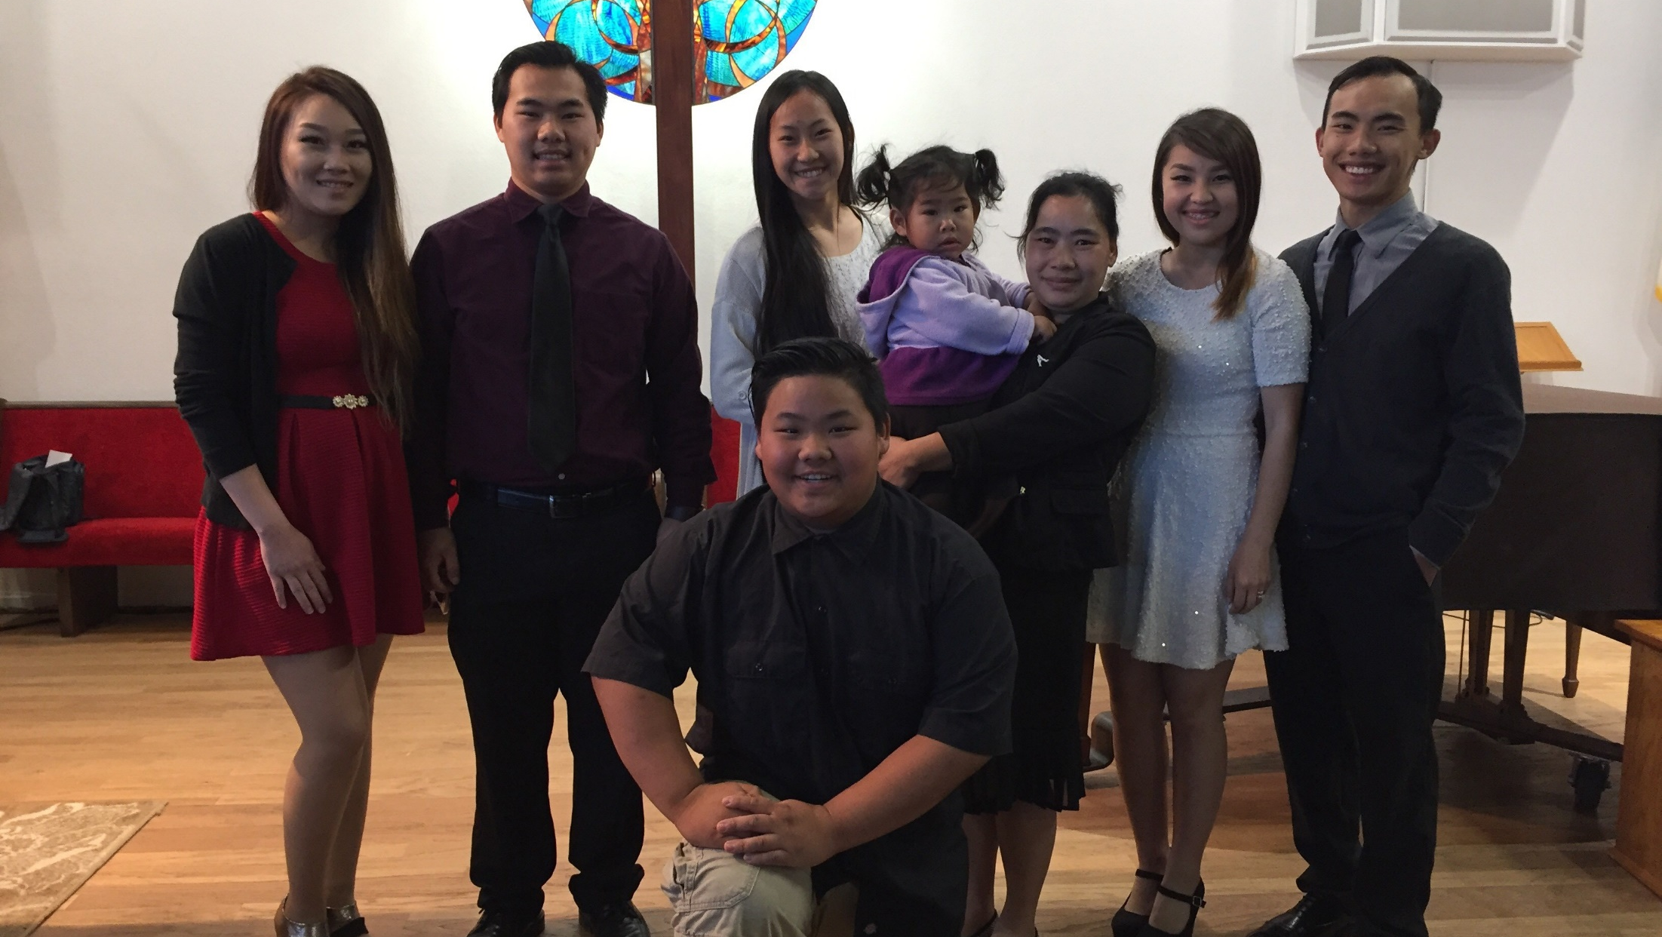
5 Hmong congregations led by Hmong Americans
Family Hmong – Fresno, CA
Notes:
There are currently five Hmong congregations in the United States that are all served by Hmong Americans:
Faith Hmong Lutheran Church – Anchorage, AK (Rev. Pao Moua)
Family Hmong Lutheran Church – Fresno, CA (Rev. Xing Xang)
Grace Hmong Lutheran Church – Kansas City, KS (Rev. Ger Lor)
Immanuel Hmong Lutheran Church – St. Paul, MN (Rev. Pheng Moua)
Trinity Hmong Lutheran Church – Manitowoc, WI (Rev. Daniel Lor)

Slide 15
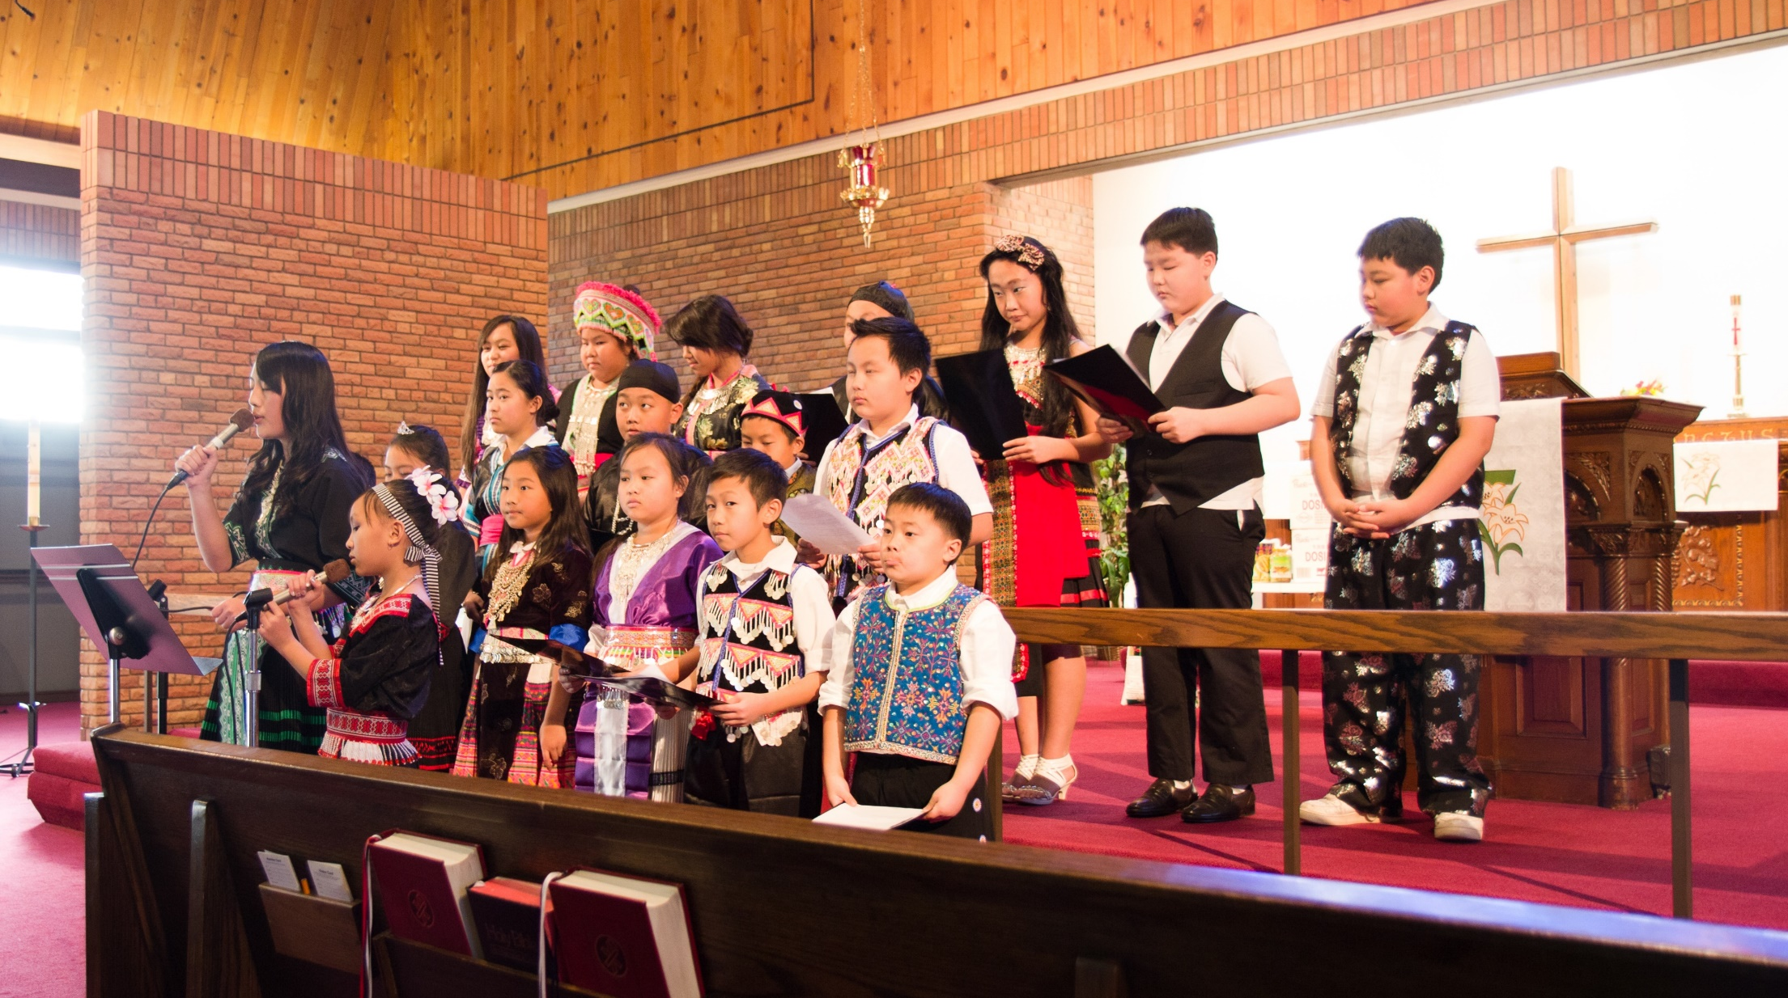
Immanuel Hmong – St. Paul, MN
Notes:
Pictured: Immanuel Hmong Lutheran Church in St. Paul, Minn. Pastor Pheng Moua serves this church.
The Global Hmong Committee (GHC) was established by the WELS Joint Mission Council to facilitate mission work to the Hmong people in the United States and Southeast Asia. Hmong ministry in the United States has also opened doors to world mission work to the Hmong people in countries throughout Southeast Asia such as Thailand, Vietnam, and Laos. WELS Hmong leaders throughout the United States are very connected with these missions, working through the Global Hmong Committee to share resources, ideas, and assistance.

Slide 16
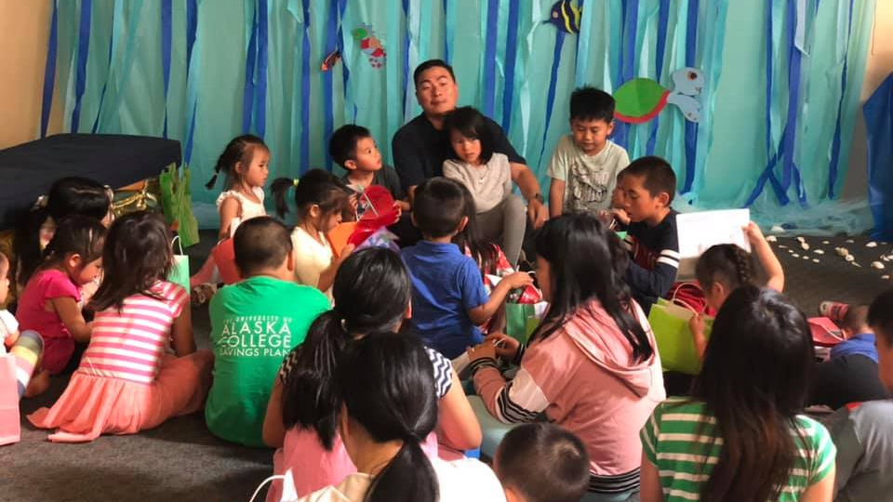
Vacation Bible School
Faith Hmong Lutheran Church – Anchorage, AK
Notes:
Pictured: Pastor Pao Moua leads a children’s devotion at their annual Vacation Bible School program
Faith Lutheran Church in Anchorage, AK, is unique and has ministry conducted in English, Hispanic, and Hmong.

Slide 17
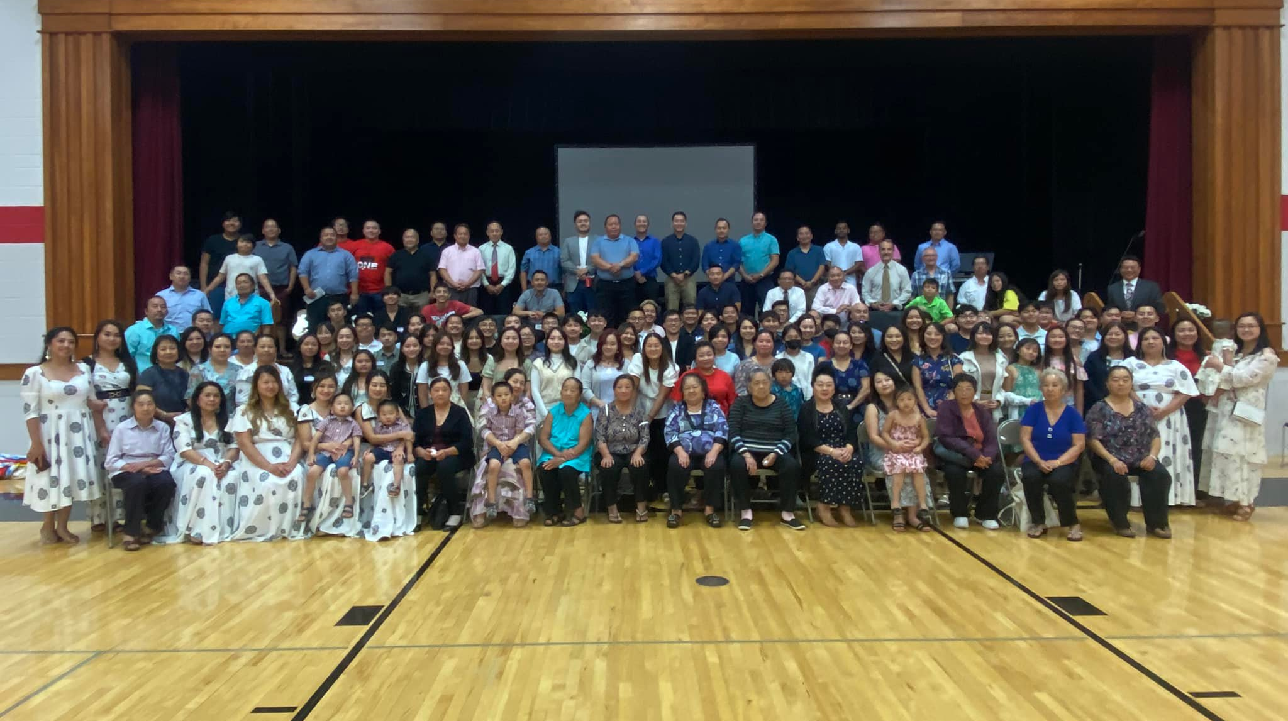
One Faith, One Family.
Hmong National Conference 2022
Notes:
170 Hmong members from five different congregations across the United States gathered at Manitowoc Lutheran High School in Manitowoc, WI, under the theme "One Faith, One Family“ for the Hmong National Conference from July 29-31, 2022. Separate breakout sessions were held in English for the teens and in Hmong for the adults.
Pastor Sam Lor of St. John’s, Minneapolis, Minn., led about 50 teens through the topic, “Cultural Identity through Baptismal Identity.” Why this subject? Pastoral Studies Institute (PSI) student and cohost, Semson Lor, said, “In the world today you can identify so many different ways. We wanted teens to see who they are in Christ.”
At the same time the teens met, Pastor Pheng Moua of Immanuel Hmong in St. Paul, Minn., was leading the adults in the Bible Study, “How to Encourage One Another.”
Pastor Joel Nitz was also in attendance for the first time since he took the call to serve the Hmong in Vietnam. He reflected, “I had a wonderful experience as I connected with our WELS Hmong members in the U.S., worshiped and learned with them, and practiced my Hmong language skills.”
The next Hmong National Conference is scheduled for 2024 in Fresno, Calif.

Slide 18
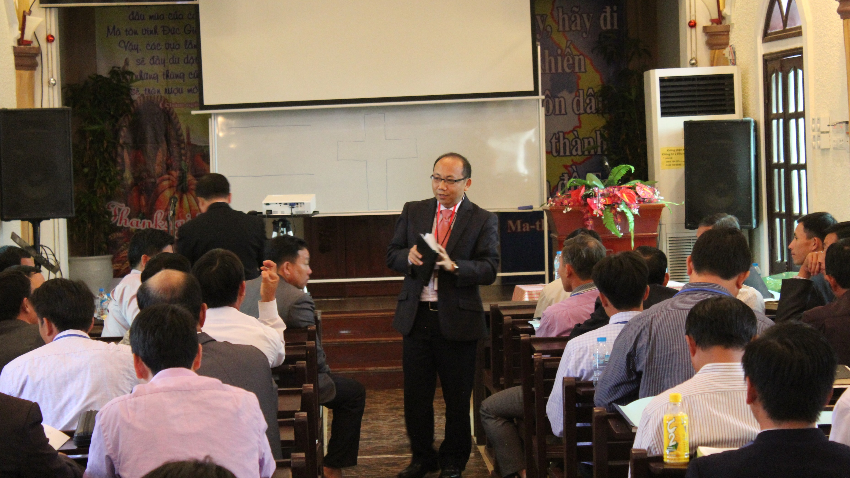

Rev. Bounkeo Lor – Hmong Asia ministry coordinator and leader of Hmong outreach in Vietnam
Notes:
Rev. Lor originally began his ministry at Grace Hmong Lutheran Church in Kansas City, KS. Leaders of the Hmong Fellowship Church in Vietnam reached out to him for theological education after seeing his sermons posted online. After working directly with the Hmong Fellowship Church for 3 years and making about 4 trips per year to train HFC leaders, Lor reached out to WELS Missions and they began providing full financial support for the outreach effort in 2015. In 2017, Lor was called to serve full-time as Hmong Asia ministry coordinator. The HFC has grown from 55,000 to 135,000 members in years WELS has been providing training through Pastor Lor and the PSI program. 50-60 top HFC leaders attend training whenever it is offered and then take it back to the other 250 pastors.
In 2017, God’s grace opened doors to an unprecedented mission opportunity in communist Vietnam. The Vietnamese government invited WELS to build a theological training facility in the capital city of Hanoi to train leaders of the Hmong Fellowship Church (HFC) in Lutheran doctrine and practice. To take full advantage of this incredible mission opportunity, WELS collected a special offering called Grace--Hmong outreach in Vietnam and raised $2 million to fund the land purchase, building construction, and the first two years of operational costs for the theological training facility.

Slide 19
Outreach opportunities to Chinese, Korean, and Vietnamese people-groups
North American Asian Ministry
Notes:
The Joint Mission Council assists WELS congregations and schools as they build relationships with various Asian people-groups throughout North America. Rev. Neil Birkholz serves as the North American Asian Ministry Consultant after previously serving in East Asia. The Joint Mission Council helps to promote, train, guide and advocate for outreach among the North American Asian population.
Regular worship and Bible study takes place each week in Chinese, Korean, and Vietnamese in established WELS groups in North America. These ministry efforts are often supported by Asian leadership trained by Wisconsin Lutheran Seminary in both the traditional program and by the Pastoral Studies Institutes (PSI).
Additionally, many of our WELS high schools enroll international students from Asia. In partnership with WELS campus ministries, the Joint Mission Council is actively connecting with these international students. The hope is to serve these international students during their educational years as well as equip them to take the gospel back to their country of origin.

Slide 20
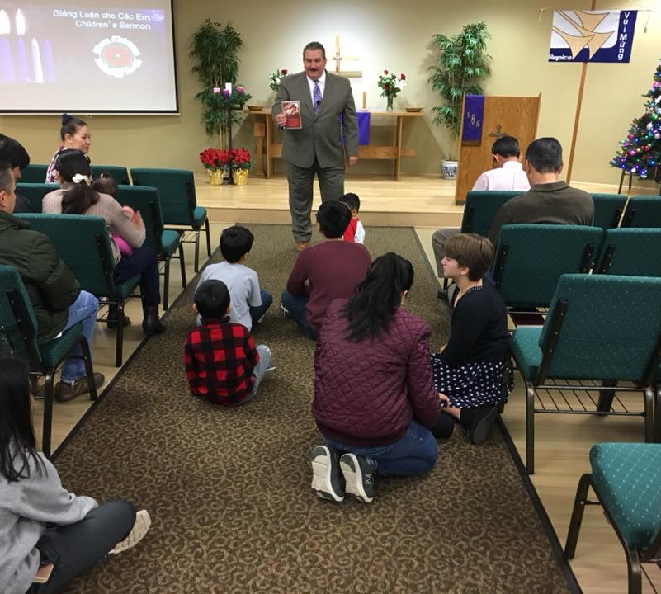
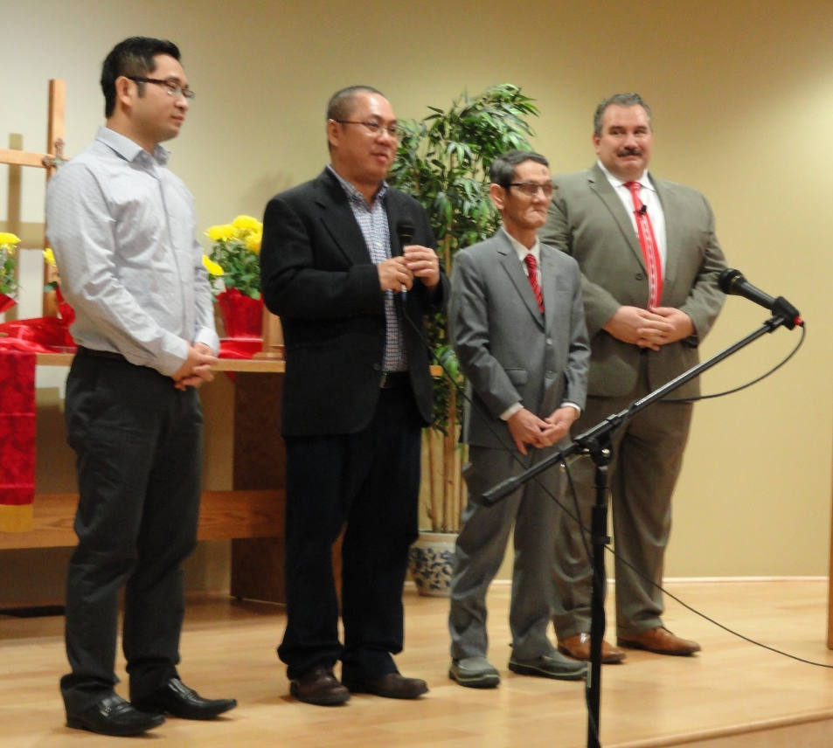
Vietnamese Ministry
Peace in Jesus Vietnamese – Boise, ID
Notes:
Members from Messiah in Nampa, Idaho, and Cross of Christ in Boise, Idaho, began reaching out to Vietnamese immigrants in their community in 1992. Today, Peace in Jesus Vietnamese Lutheran Church has their own facility and continues to reach out through Bible information classes and worship services in Vietnamese and English. Pastor Dan Kramer (left photo) leads this congregation in fluent Vietnamese. Two Vietnamese leaders of the congregation are taking classes through the Pastoral Studies Institute (PSI) to become pastors.
Tao Nguyen (left) and Huu Trung Le (second from left) are studying to be pastors through the Pastoral Studies Institute. They are expected to graduate in May 2023.

Slide 21
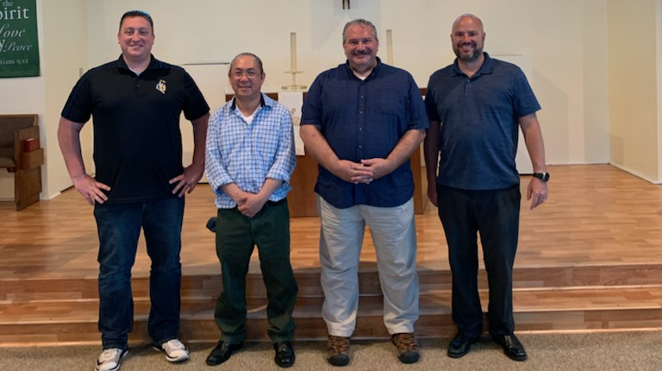
North American Asian Ministry
Potential Vietnamese outreach in CA
Notes:
Pictured: Hưu-Trung Lê on his visit to King of Kings, Garden Grove, CA – (L to R): Neil Birkholz, WELS’ Asian ministry consultant; Trung; Dan Kramer, pastor at Peace in Jesus in Boise, ID; and Brian Doebler, pastor at King of Kings.
Hưu-Trung Lê is a member at home mission congregation Peace in Jesus Lutheran Church in Boise, Idaho, and is studying to become a pastor through the Pastoral Studies Institute (PSI). Hear how he came to know Christ as his Savior in this article from the September edition of Forward in Christ: https://forwardinchrist.net/huu-trung-le/
In May 2021, Pastor Kramer and Hưu-Trung Lê had the opportunity to visit King of Kings Lutheran Church in Garden Grove, California, to counsel on reaching out to the Vietnamese community in southern California, specifically the city of Garden Grove. They visit Little Saigon, a Vietnamese hub in the area, and gave a presentation at King of Kings on Vietnamese culture to 42 members. Many of them have not had much experience with Vietnam, and they were excited to learn about Vietnamese culture so they could share the good news with the Vietnamese community.

Slide 22
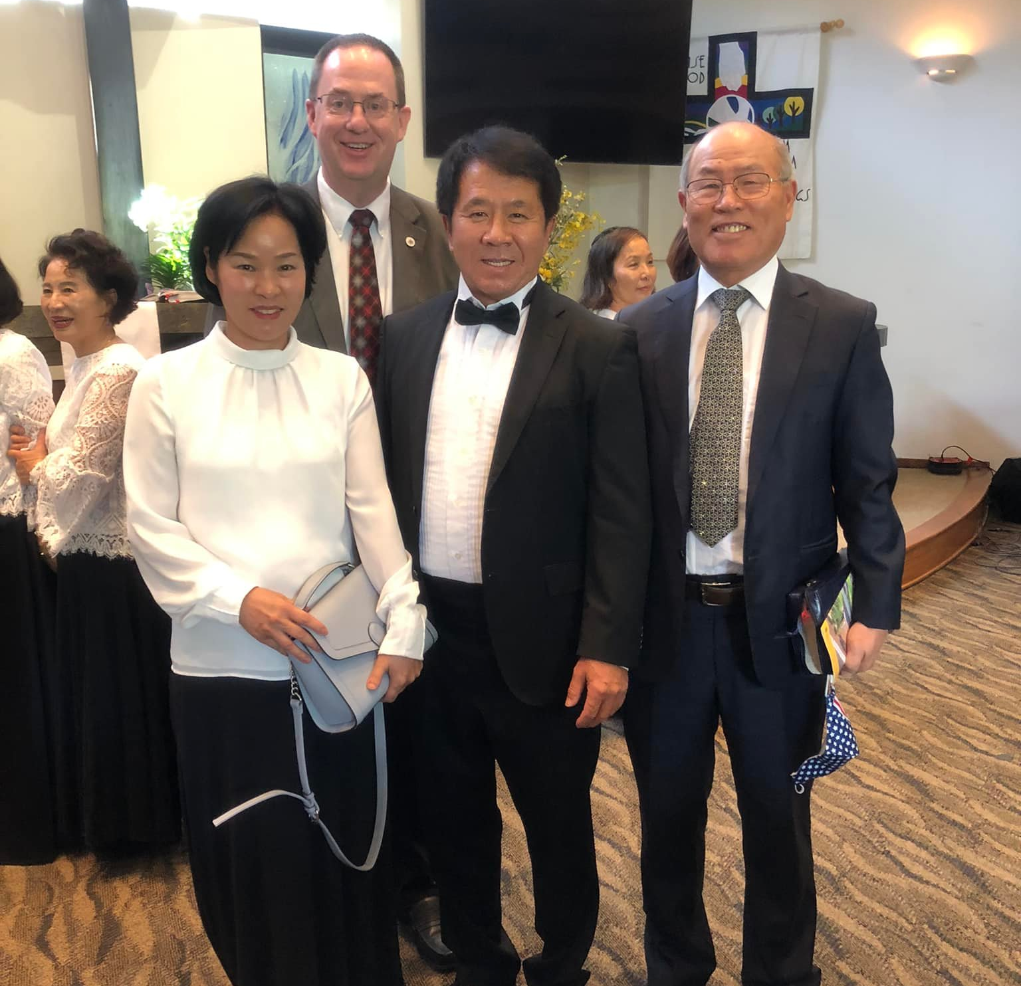
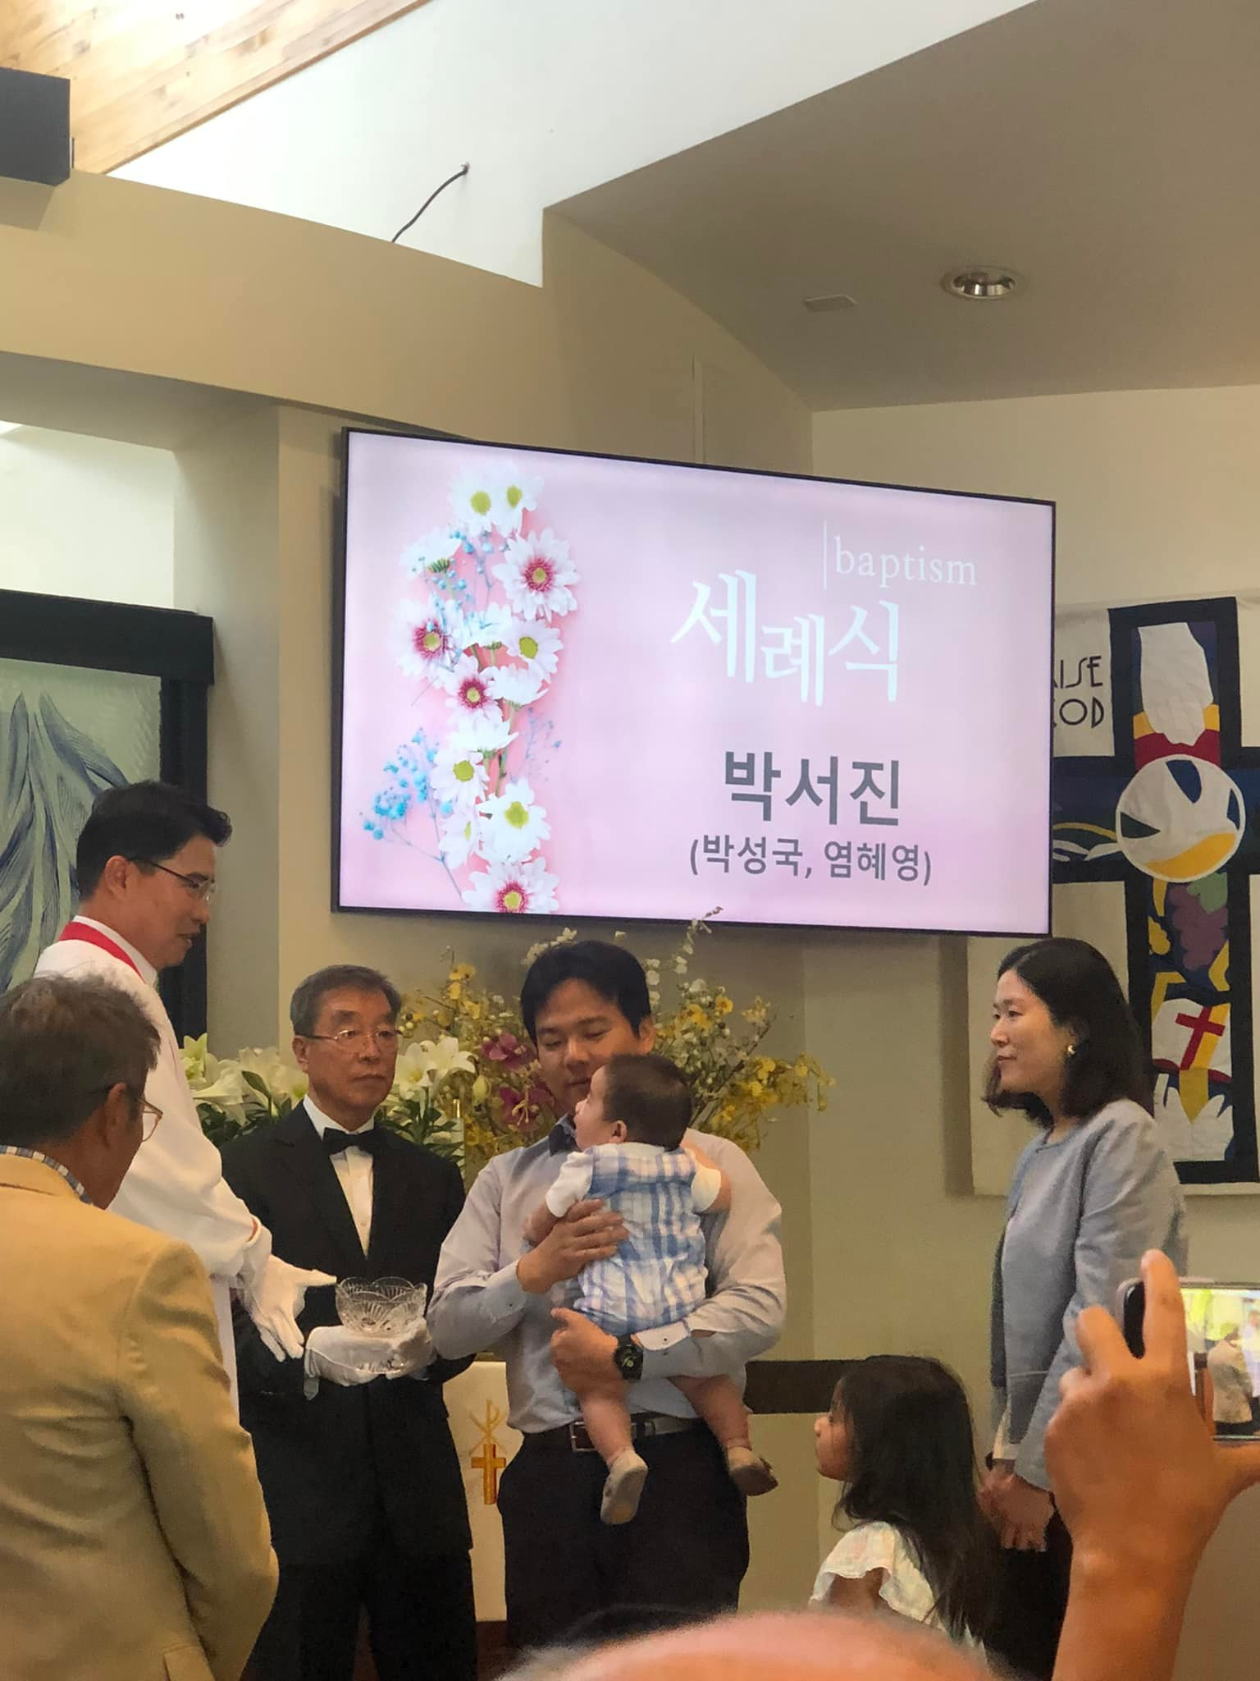
Korean Ministry Enhancement – Las Vegas, NV
Notes:
Pictured Left: Joint Mission Council Chairman Rev. Paul Prange (back) pictured with members from the Korean Fellowship Lutheran Church and Rev. Youngha Kim (right)
Pictured Right: Korean Pastor Taesang Kim baptizes a baby on Easter Sunday (April 2022)
Mission Enhancement—Las Vegas, Nev.
The Korean Fellowship Lutheran Church, served by Korean Pastor Rev. Taesang Kim, is self-supporting and shares a campus with Water of Life, Las Vegas, Nev. Recently, Rev. Youngha Kim and his wife, Margaret, retired to the Las Vegas area. Youngha Kim was trained at Bethany Lutheran Seminary (Evangelical Lutheran Synod’s seminary) and has previously served in Korean ministry in the U.S. and in South Korea. Funding will allow the Korean Fellowship Lutheran Church to call Youngha Kim to reconnect with the elderly and retirees after the pandemic, freeing up Taesang Kim’s time to engage with Korean teenagers and young professionals.

Slide 23
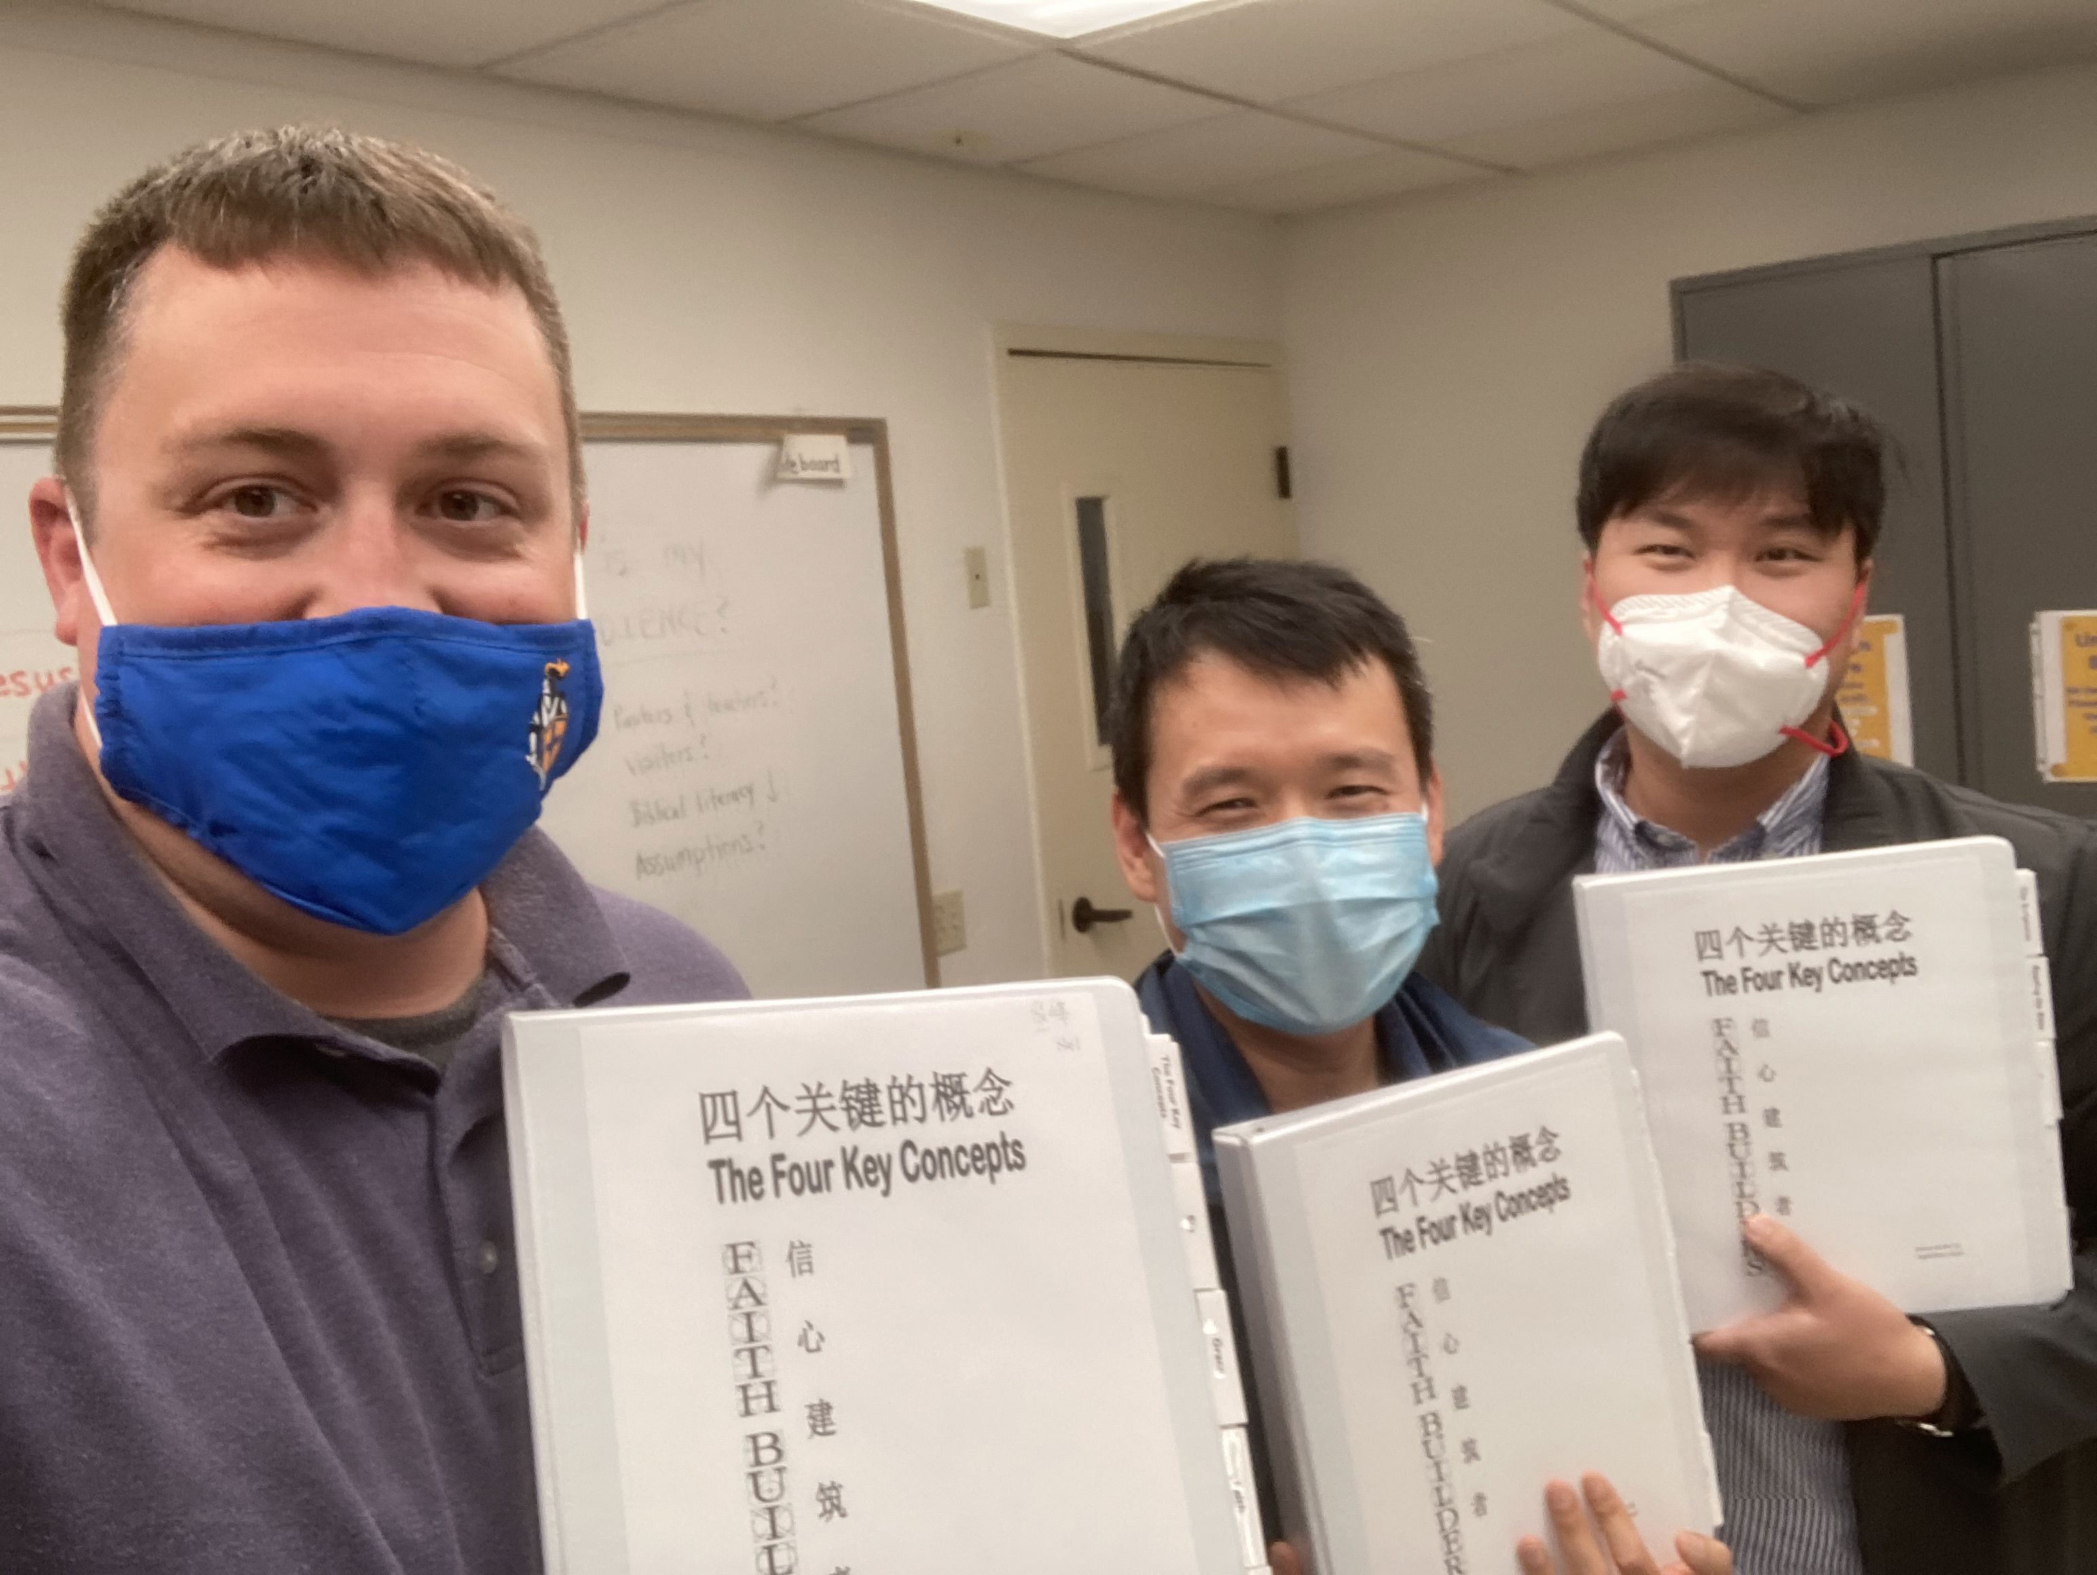
Chinese ministry in San Diego, CA
Notes:
There are eight active outreach locations to North American Chinese.
When Mark Jiang (center) first came to Reformation Lutheran Church in San Diego, CA, he was interested in the school. But soon, he joined the congregation and thought about becoming a pastor himself. That’s when he met David Choi (right), an Evangelical Lutheran Synod seminary student who served as a vicar at Reformation. Choi, who also grew up in China, encouraged Mark to pursue the public ministry.
Mark began taking courses in 2020 through Wisconsin Lutheran Seminary’s Pastoral Studies Institute (PSI), which provides seminary training to students from a variety of countries and cultures. He and Choi studied together throughout the year.
“It was a very good chance for me to learn with Vicar Choi,” says Mark. “He helped teach me the Foundations 101 class in Mandarin, then we went through again and reviewed it in English. It was good for us to look into the English verse or Greek verse and use different languages to help us gather the meaning of the Bible.”
Mark appreciates that he is able to complete some of his seminary training in person with the pastors at Reformation, in addition to taking courses with Wisconsin Lutheran Seminary professors via Zoom.
“It is a pleasure for me to learn God’s Word,” Mark says. “I am very thankful to my teachers for giving me the right teaching from God, and I am happy I can put what I learn into practice and share the good news with other brothers and sisters. I hope to have many chances to serve and help people, and I hope God gives me the strength to do this.”

Slide 24
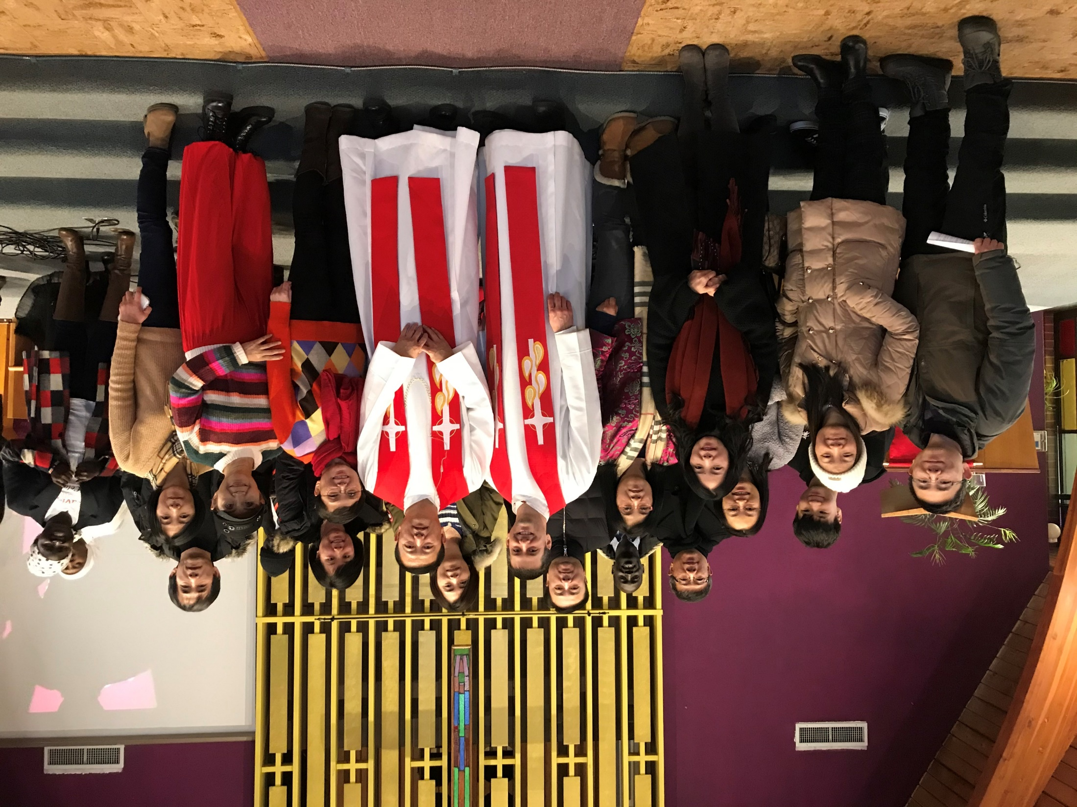
Abiding Love Chinese Mission in Coquitlam, BC - Pastor Qiang Wang
Notes:
Pictured: On January 18, 2020, after 4 intensive years of study, Qiang Wang was ordained into ministry and was commissioned as mission pastor to Abiding Love Chinese Mission in Coquitlam, BC (near Vancouver). Back in 2014, Home Missions started a mission in Vancouver. Pastor Geoff Cortright (pictured) has been the first pastor of this mission.
Thanks to funding from WELS Joint Mission Council and WELS Canada, Qiang has funding for 3 years to do outreach ministry in Coquitlam.

Slide 25
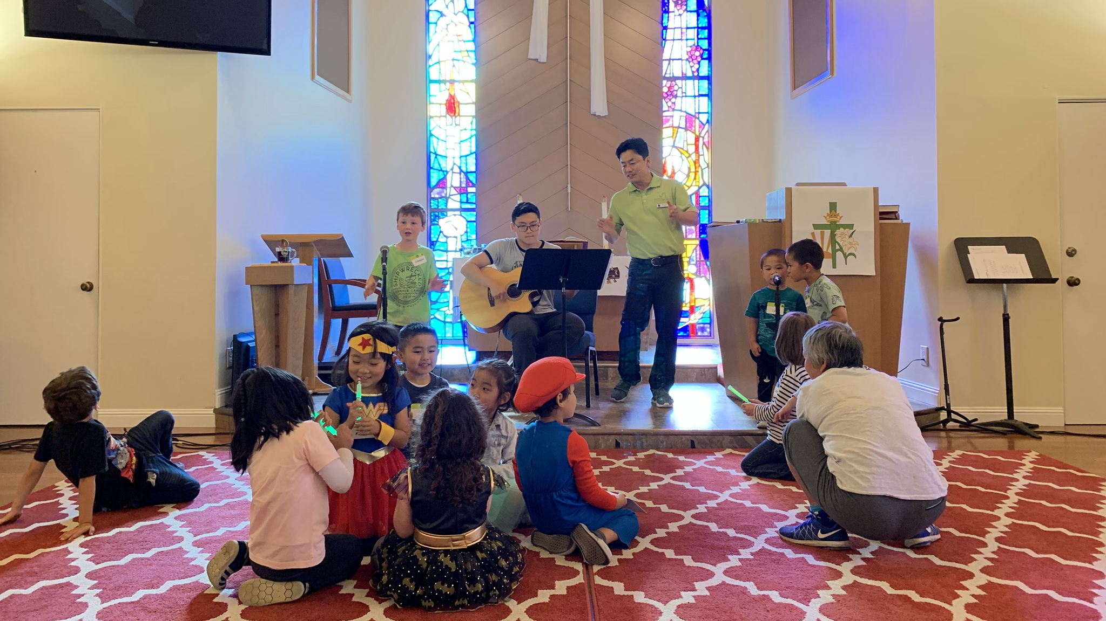

Peace in Santa Clara, CA
Korean and Chinese outreach
Notes:
Rev. Joon Ho "Paul" Chung is the pastor at Peace Lutheran Church in Santa Clara, CA. Pastor Chung is Korean and graduated from the Pastoral Studies Institute (PSI) program. Pastor Chung is actively reaching out to the Korean AND Chinese people in the Santa Clara community through ESL classes, Chinese Bible studies, and Peace Children’s Night (Pictured)

Slide 26
Reaching out with the gospel
to South Asian neighbors in the U.S.
and back in South Asia
South Asian Ministry

Slide 27
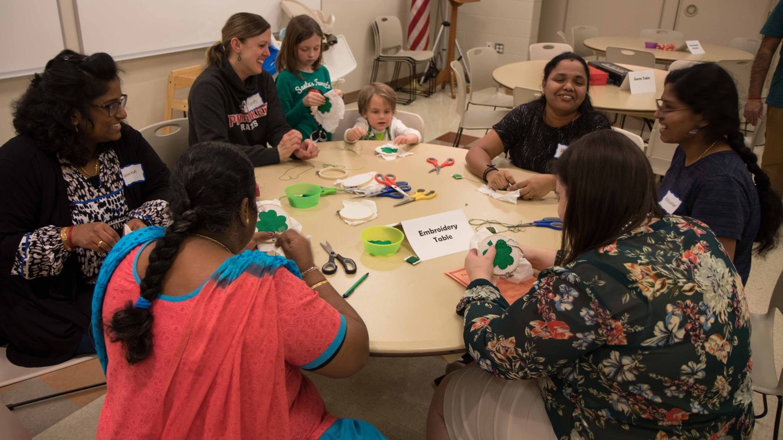
International Friendship Center – Pewaukee, WI
Notes:
Pictured: Family Fun Night at the International Friendship Center
In 2017, the WELS Joint Mission Council began a new South Asian Ministry focused on reaching out to South Asians residing in North America.
The first location for South Asian ministry is in Pewaukee, Wisconsin. Pastor Paul serves in this location as South Asian ministry coordinator. He and his wife Aneela are South Asian natives who were forced to flee their home country. He graduated from Wisconsin Lutheran Seminary in 2017 after completing classes through the Pastoral Studies Institute program. Christ Lutheran Church in Pewaukee serves as the host of an International Friendship Center, which provides programs and activities to engage internationals in the community by meeting any needs they may have. Pastor Paul and Aneela regularly visit Hindu temples to meet new people and invite them to events and activities. They also frequently invite their South Asian friends to their home for dinners and Bible studies.

Slide 28
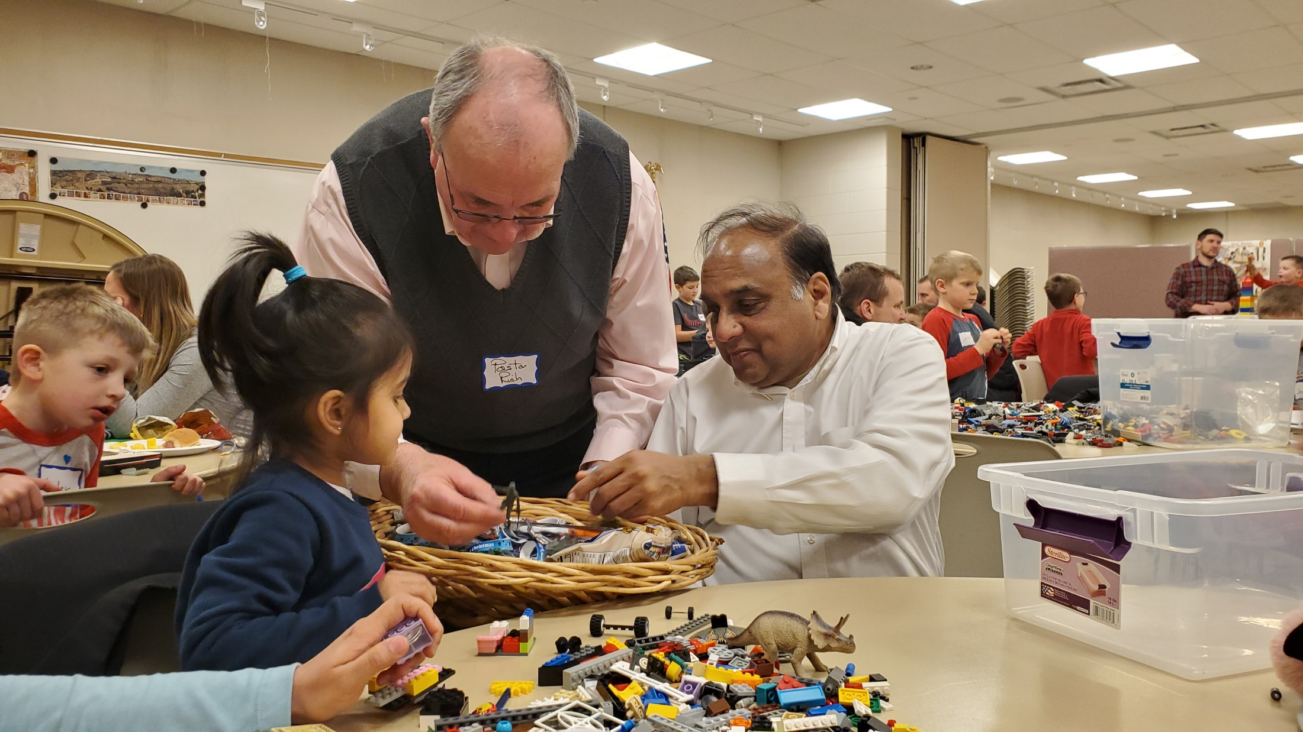
Faces of Faith – Dia
Notes:
On February 14, 2020, we hosted a Lego Night event at Christ Lutheran Church in Pewaukee, Wis. My wife Aneela and I were there to welcome any South Asian souls who might be in attendance. I didn’t see any South Asians when we got there. I was feeling a little disappointed, since no South Asians came to the last Lego Night. Suddenly I saw one South Asian father and his daughter enter. We greeted them and invited them to sit with us. Pastor Warnecke came by with a basket of small toys, and she chose a dinosaur. Soon after, we saw another Hindu family walk in. We knew this family well because we invited them to our home for dinner. I began playing with the Legos with their daughter Dia, and a few minutes later Pastor Warnecke stopped by again with the basket of toys. He offered his suggestion, but she still wasn’t sure what to choose. Finally, she picked up something which shook me from top to bottom: a small green cross. I was stunned for few seconds. When I asked her mother about it, she told me that she prays every day, calling Jesus “Jai Jai”. I also asked how she came to learn about Jesus, which I discovered was through our Lambs of Christ preschool.
Many in Pakistan began believing in Christ through school ministries such as these, and some have been killed for their faith. Please pray for the persecuted Christians all over in the world and thank God that Dia lives in a country where there seed of the gospel that has been sown in her heart can continue to grow!
From Pastor Paul, South Asia ministry coordinator for WELS Joint Missions

Slide 29
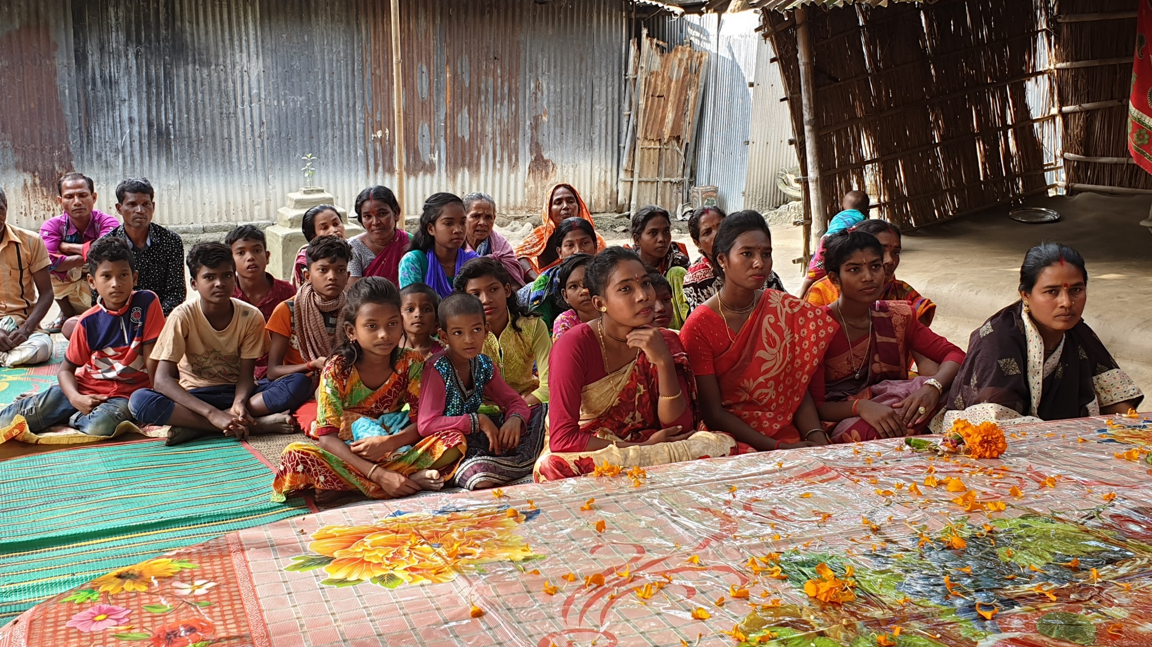
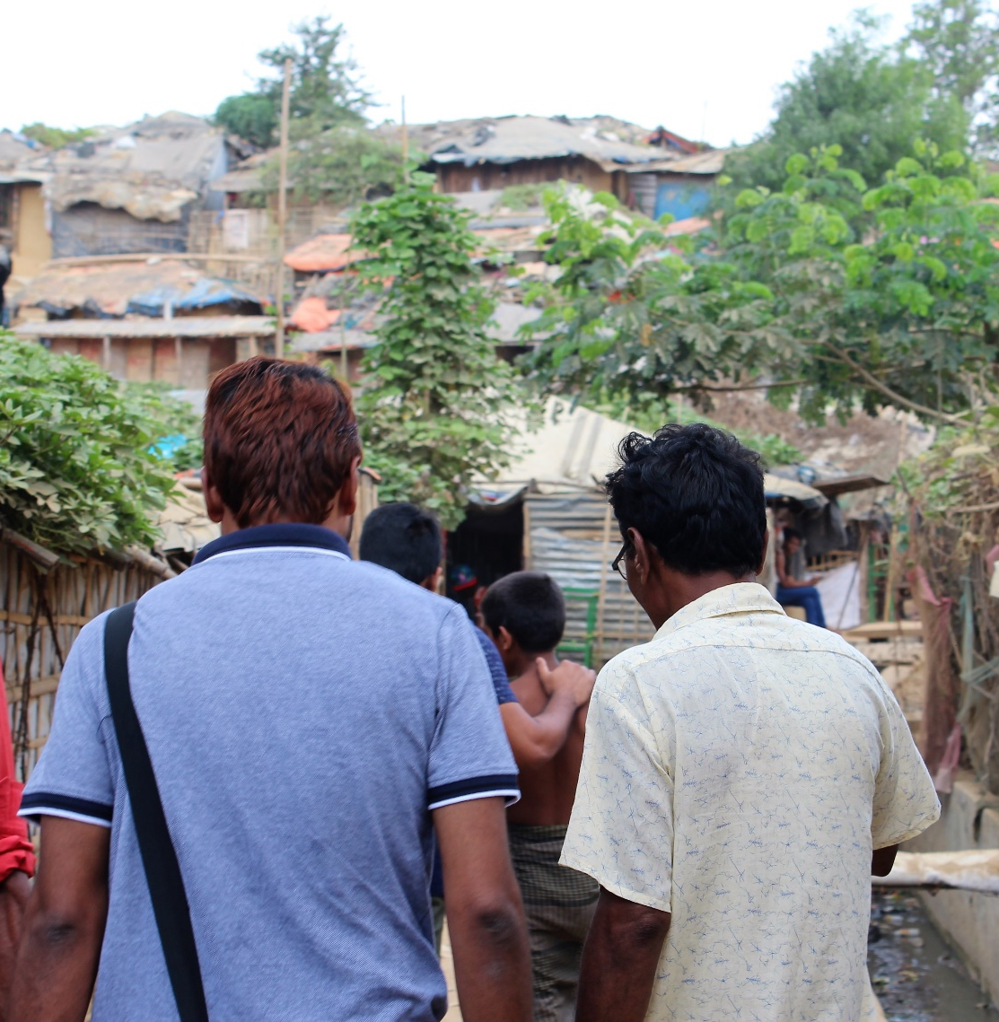
A new mission opportunity in Bangladesh and the Midwest through Haris*
Notes:
Haris* (name changed for his protection), a Christian young man from Bangladesh, came into contact with the pastor of a WELS congregation in a large Midwest city. Haris has a passion for outreach to Muslims and before meeting this pastor had already gathered six study groups and one worship group of Muslim-background believers. This man and his wife went through an instruction course and became members of this congregation and WELS.
Haris expressed the desire to share the gospel with more Muslims, both in his new city in America and in his homeland. With his pastor’s help, he enrolled in our synod’s Pastoral Studies Institute. Close to this time, Haris’ father passed away. He converted from Islam to Christianity many years ago and became a strong evangelist, founding and overseeing two Bible schools for the training of evangelists in Bangladesh. According to their culture, Haris now oversees the two Bible schools his father started. He has asked WELS to provide solid scriptural training for the teachers and the students.
Since then, WELS representatives made three visits Bangladesh in 2019 and are hoping to provide training for the teachers and the students in the Bible schools. The schools have a long list of graduates who are eager for more training as well.
In addition, Haris and his wife invite Muslim friends from the neighborhood for monthly outreach events. There are two international friendship centers that they use for outreach – one in Haris’ hometown in the Midwest, and one across the border in a neighboring Canadian town.
Read more at https://forwardinchrist.net/mission-opportunities

Slide 30
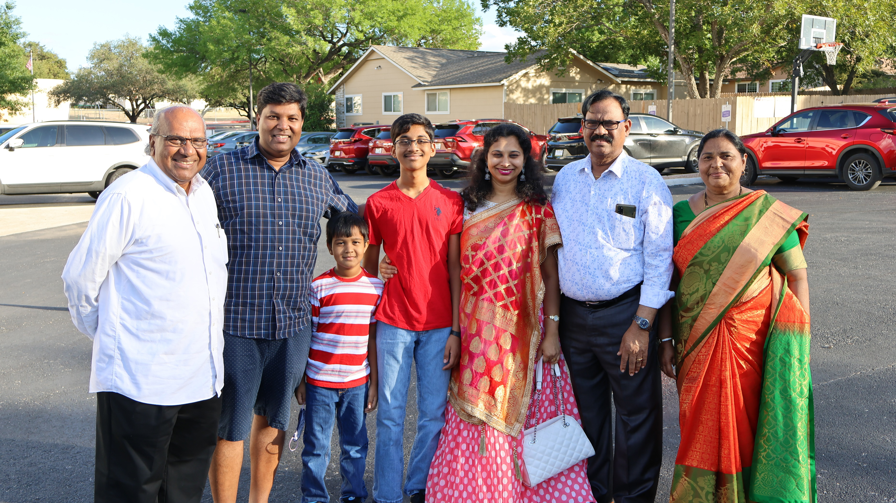
Indian outreach in San Antonio, TX
Notes:
God planted a cross-cultural mission field right outside the doors of Our Savior, San Antonio, Texas.
Across the highway from the congregation is the USAA insurance complex, which has drawn many people from India for technology jobs. The Lord had plans using the varied membership of Our Savior, which includes a former friendly counselor to India; a former Pastoral Studies Institute (PSI) instructor; and John R., an Indian immigrant who is currently going through the PSI program to become a pastor.
Nathan Sutton, pastor at Our Savior, says the congregation has been seeing more and more young Indian families participating in the congregation’s annual community outreach events. Two of Our Savior’s more popular events are a basketball camp and an Easter event. The basketball camp draws many non-members in addition to the Indian immigrant families. The families spend time on campus watching their children, which gives members an opportunity to get to know them and demonstrate Christ’s love. In 2022, more than 250 people attended the family Easter event, with close to 100 being from India.
In August 2022, for the first time, the congregation—spearheaded by John R.—held an event specifically for the Indian community: India Independence Day (pictured). Approximately 120 Indians attended.
“They couldn’t understand why a congregation of Christians, largely comprised of non-Indians, would invite them to come to a program celebrating India Independence Day,” explains Sutton. “We were able to get to know some of these Indian neighbors in a more personal way. I know that it opened doors so that I could ask them questions not only about where they are from and what they miss about being in India, but I could also ask them about what religion they practice. I pray they will give John, me, and others at Our Savior the chance to follow up and ask even more questions, so we get the chance to share the hope we have in Christ alone.”
Looking ahead, the congregation hopes to offer more opportunities to reach Indian families in their area, including Indian language classes for the children in the families to learn the language. Sutton says, “The goal is to hold monthly classes in our school building so that Our Savior can continue to build bridges to the Indian community.”

Slide 31
Showing Christ’s love to Sudanese refugees
in eight cities across North America and
three countries in Africa
Sudanese Ministry

Slide 32
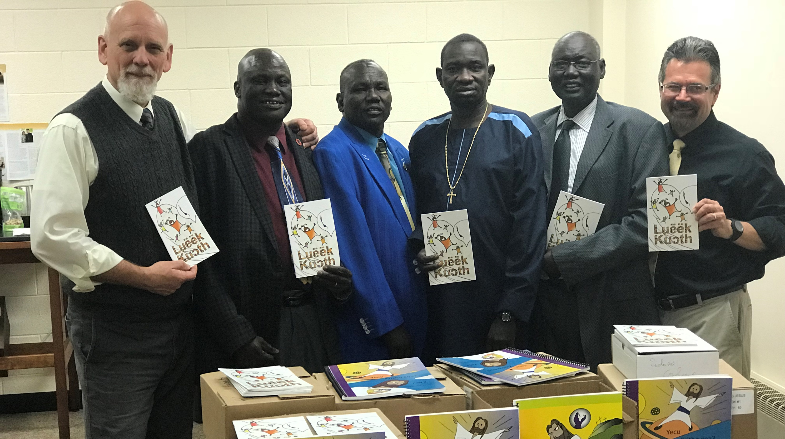
South Sudanese Ministry
10 locations across the U.S. and Canada
Notes:
Due to civil unrest in the country of Sudan, many refugees were forced to flee their country. WELS congregations in North America have provided a spiritual home for some of these refugees since 2006. One refugee, Peter Bur, came to Omaha, Nebr., and began worshiping at Good Shepherd Lutheran Church in 2010. He enrolled in the Pastoral Studies Institute (PSI), graduated in 2015, and was assigned to serve as a Sudanese ministry coordinator for WELS Joint Missions. In this role, Rev. Bur began to coordinate pastoral training of South Sudanese leaders in North America and also in refugee camps in Ethiopia, Kenya, and Uganda. He is presently being joined in the coordination effort by other South Sudanese leaders, various district mission boards in the United States, and the WELS One Africa Team in Africa.
Fast Facts:
Congregations in Gambella, Ethiopia, wanting Lutheran training for their leaders: 16
South Sudanese men who have received Lutheran training in Kakuma, Kenya: 17
North American congregations with Sudanese ministries: 10
South Sudanese pastors graduated from the Pastoral Studies Institute (PSI) program: 2
South Sudanese men currently in the PSI program: 3

Slide 33
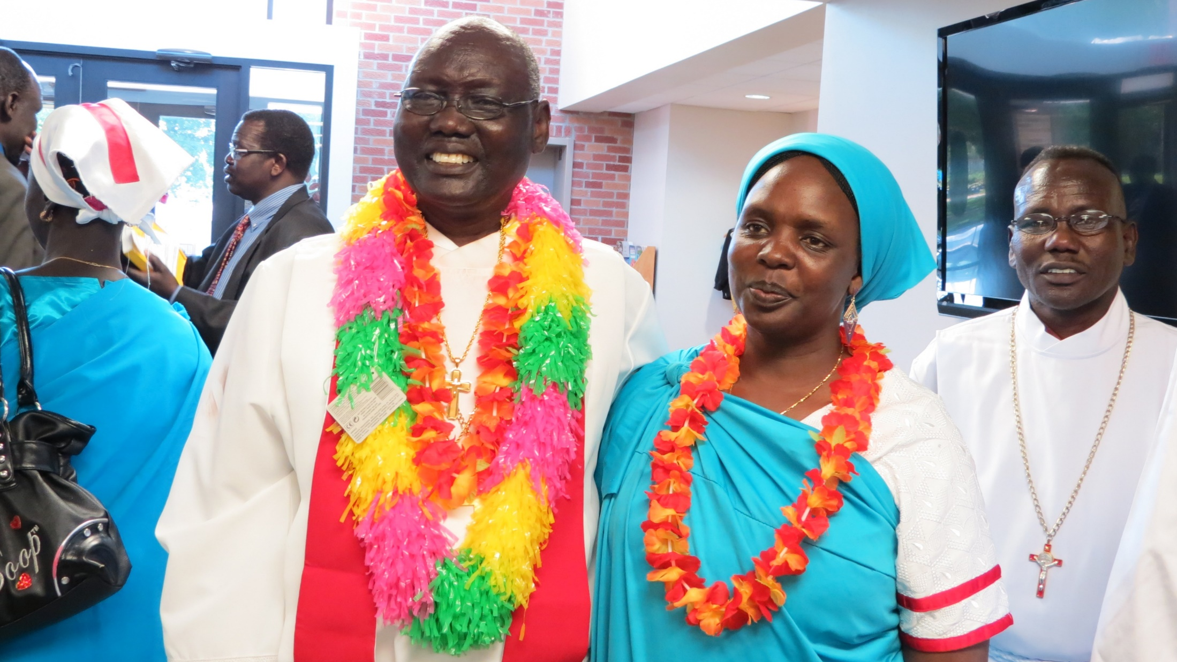
South Sudanese Ministry Coordinator
Rev. Peter Bur
Notes:
One refugee, Peter Bur, came to Omaha, Nebraska and began worshiping at Good Shepherd Lutheran Church in 2010. He enrolled in the Pastoral Studies Institute (PSI), of Wisconsin Lutheran Seminary in partnership with the WELS Joint Mission Council. He graduated in 2015 and was assigned to serve as Sudanese Ministry Coordinator for WELS Joint Missions. In this role, Rev. Bur coordinates the pastoral training of South Sudanese leaders in North America and also in refugee camps in Ethiopia, Kenya, and Uganda.

Slide 34
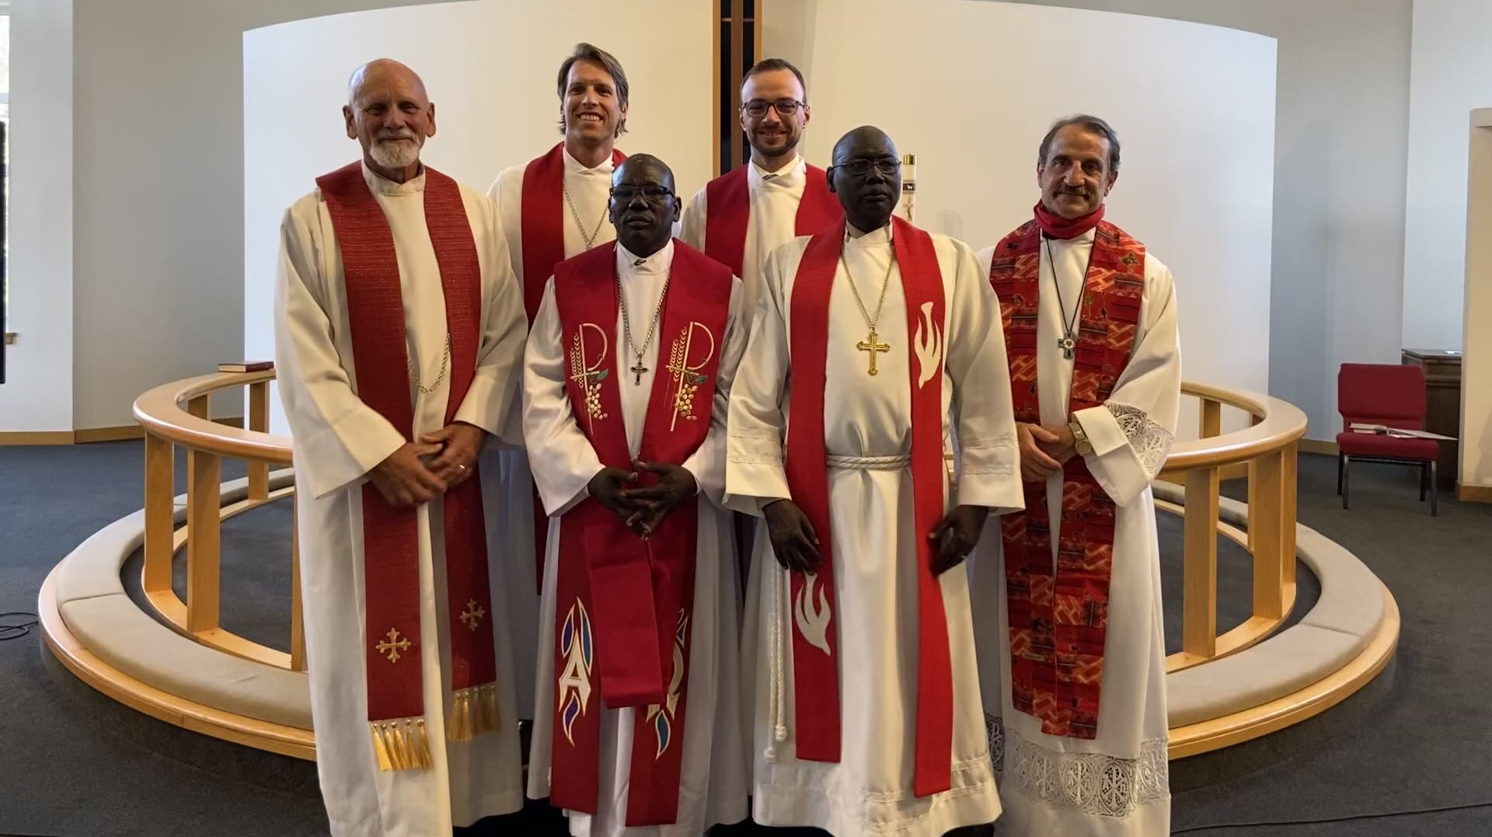
South Sudanese Ministry
Second Sudanese pastor ordained in WA
Notes:
Photo: Simon Duoth (middle, left) graduated in May 2020 and became the second South Sudanese man to become a WELS-trained pastor through the Pastoral Studies Institute (PSI).

Slide 35
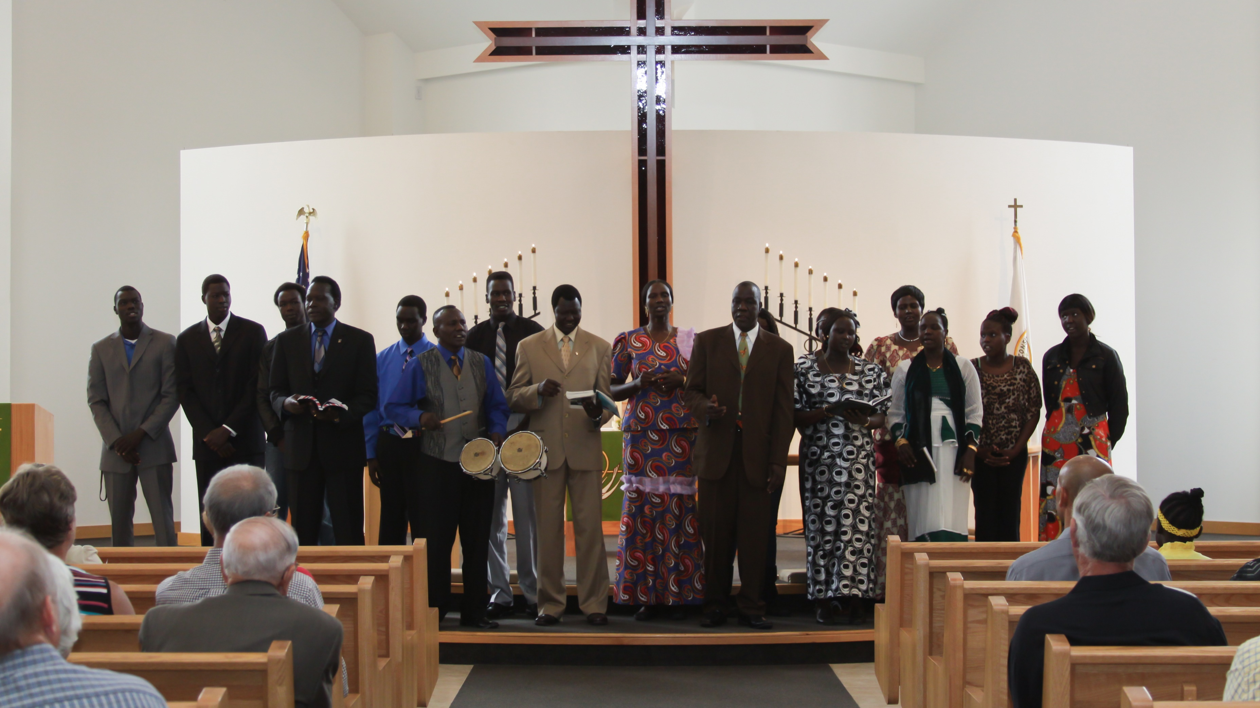
Renton, WA
Sudanese group
Growth in WELS Joint Missions
Notes:
In Spring 2022, the Joint Mission Council approved financial support for a new Sudanese mission in Phoenix, AZ.
In 2020, Rev. Simon Duoth graduated from the Pastoral Studies Institute and was assigned to conduct Sudanese outreach full time in the Pacific Northwest District. When unforeseen family circumstances forced the Duoth family to move to Phoenix, Ariz., conversations began between the Pacific Northwest and the Arizona-California district mission boards about the opportunity to plant a new Sudanese ministry in the area. Research shows that 4,000 Sudanese people live in the city. It was then discovered that a WELS church, Emmaus, was only four blocks away from a Sudanese cultural center. Emmaus’ church leadership is willing and excited to offer its church as a worship center as Duoth begins outreach.
God is also continuing to provide for Sudanese outreach in the Pacific Northwest. A member and longtime evangelist in the current Sudanese congregation located at Divine Peace in Renton, Wash., is stepping up to serve as leader of the church. He will begin training in the Pastoral Studies Institute as he leads Sudanese ministry in the area.

Slide 36
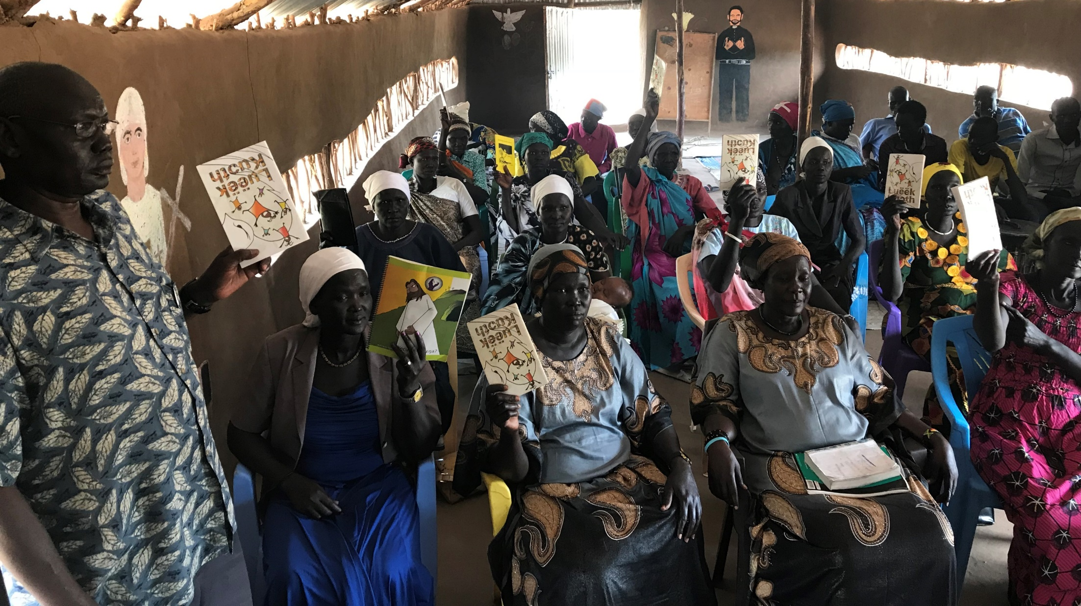
Reaching back to South Sudanese refugee camps in Ethiopia, Kenya, and Uganda
Notes:
International Sudanese work is currently focusing on training spiritual leaders in the refugee camps of Gambella, Ethiopia, and Kakuma, Kenya. WELS sister churches, the Lutheran Church of Ethiopia (LCE) and the LCMC-Kenya, are instrumental partners in providing confessional Lutheran training to the refugee camps.

Slide 37
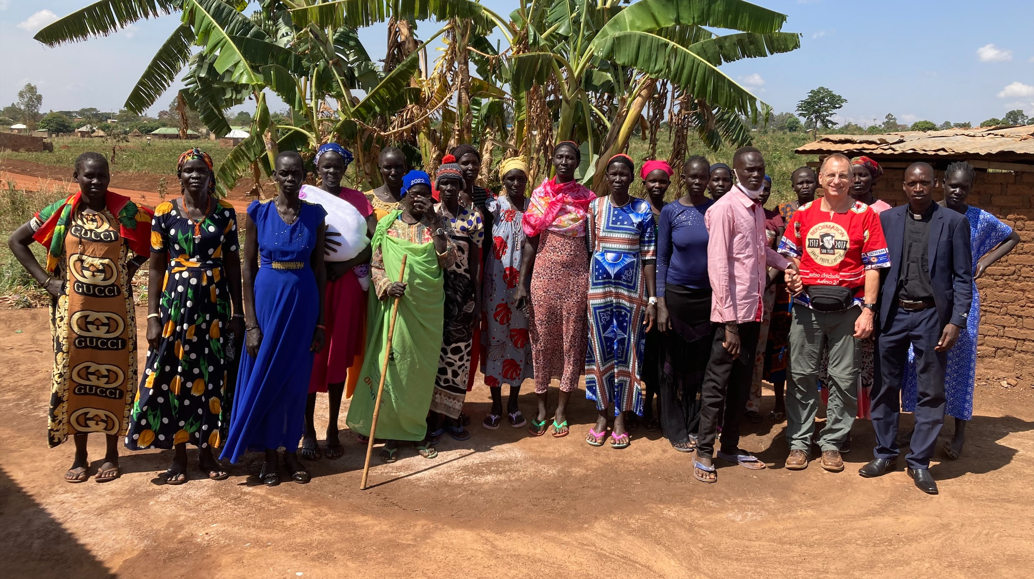
Recent work at a South Sudanese refugee camp in Uganda
Notes:
Missionaries Howard Mohlke and John Holtz from the One Africa Team were in Uganda February 28-March 18, 2022, meeting with brothers and sisters in Christ at the Kiryandongo South Sudanese refugee camp. Internet connectivity is poor in this area, so in person discussions about partnering in gospel outreach are very important.
Obadiah Lutheran Church in Uganda recently drafted a request for doctrinal unity/fellowship with WELS, which includes a summary of doctrine and practice and a report describing the relationship between their synod and WELS/One Africa Team. The prayer is that they will be brought into fellowship at the 2023 Synod Convention. This soon-to-be partner of WELS is and will continue to support the South Sudanese work in the Kiryandongo South Sudanese refugee camp alongside WELS.

Slide 38

Notes:
The COVID-19 pandemic disrupted many of the short-term mission trips coordinated through Mission Journeys, but the program is back up and running! Domestic mission trips are now available, and international mission trips will begin soon. Apply today and consider how your church, campus ministry, or other group might be able to walk together in the Great Commission through a short-term mission trip.
Mission Journeys is also looking for additional host congregations! If your congregations would be interested in hosting a Mission Journeys team, you can fill out an application form online.
Learn more, read FAQs, and sign up to host or send a team at wels.net/missionjourneys/

Slide 39
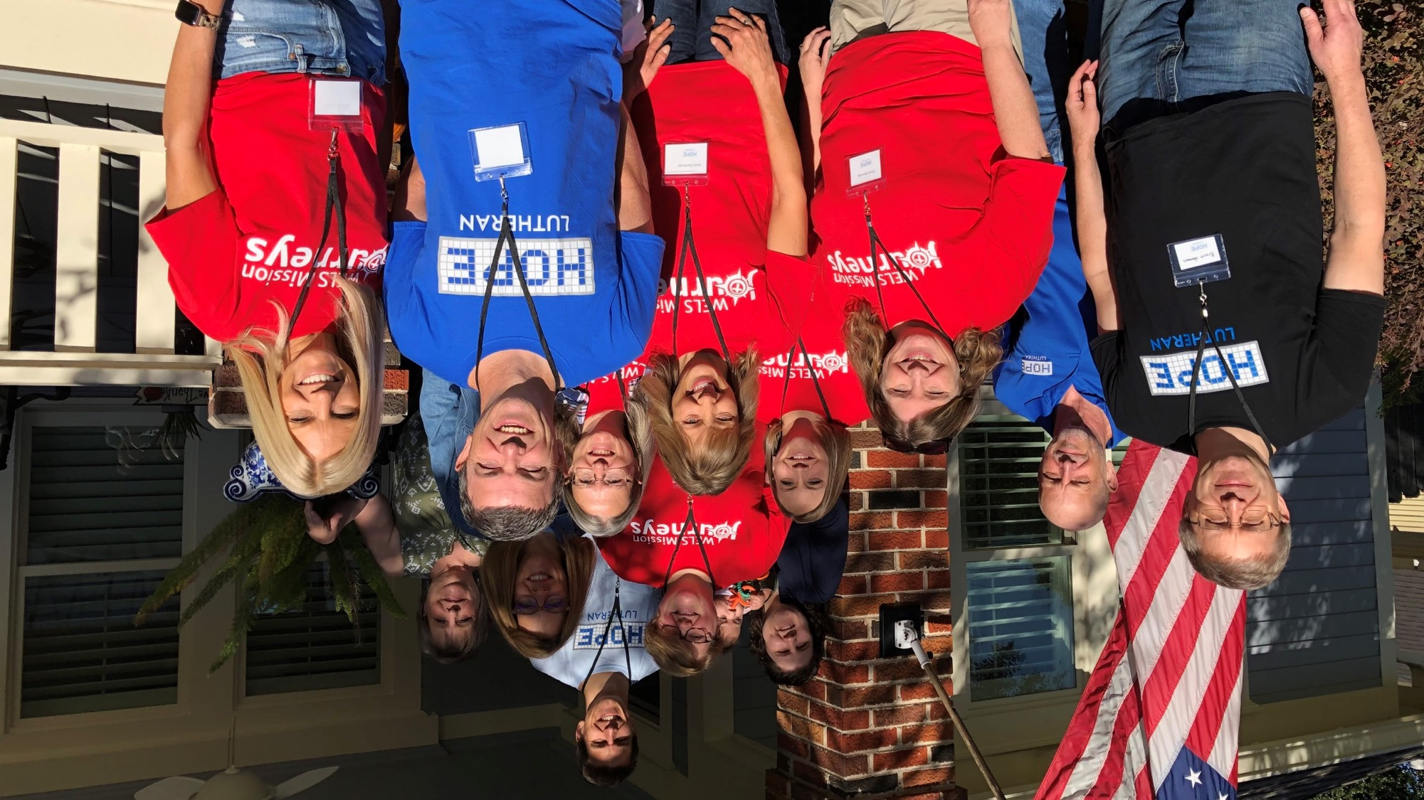
St. Matthew’s,
Oconomowoc, WI,
to Houston, TX
Domestic mission trips are up and running!
Notes:
A WELS Mission Journeys team from St. Matthew's Lutheran Church & School in Oconomowoc, WI, traveled to Hope in the Heights, a WELS home mission congregation in Houston, TX, to assist in their outreach efforts in November 2021. Praise and Proclaim Ministries led evangelism training on Friday night, and the group put what they learned into practice on Saturday by sharing the Good News of Jesus around the community.

Slide 40
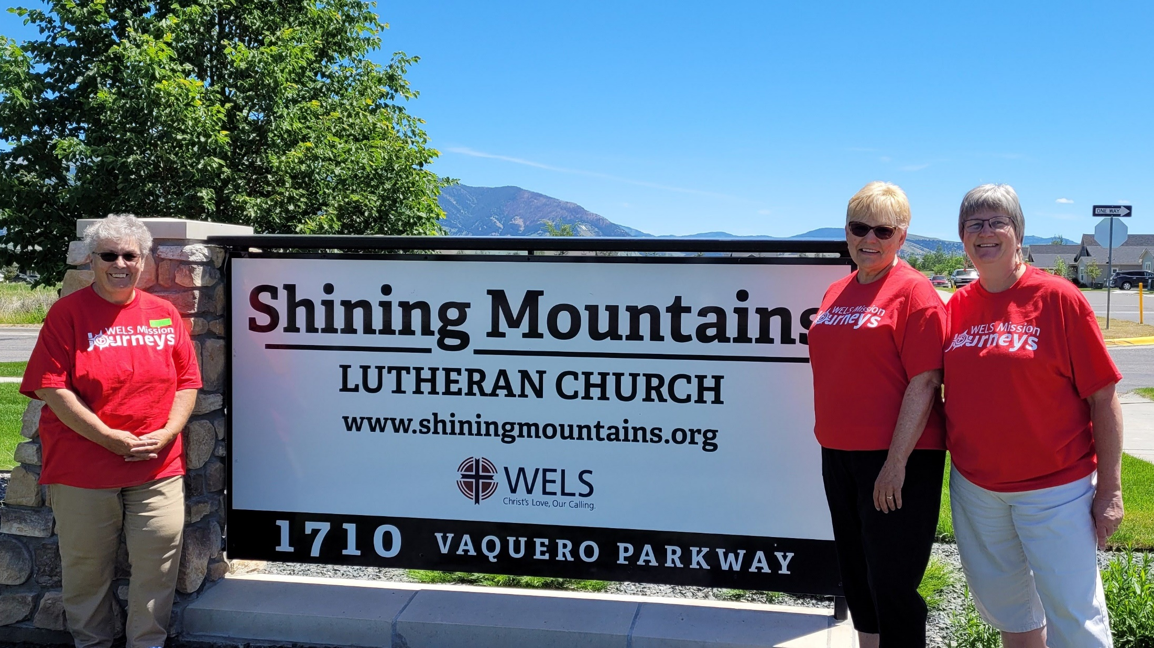
Mission Journey to Bozeman, Montana
Northwest WI LWMS Circuit
Notes:
Three ladies from the Northwest Wisconsin LWMS circuit (Hali Dessecker, Mickey Bates, and Alaine Sonnenberg) assisted Shining Mountains Lutheran Church in Bozeman, Montana with their Summer Bible Camp June 21-25, 2021.

Slide 41

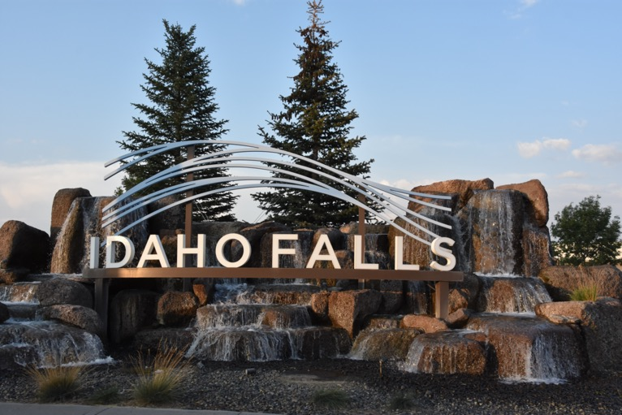
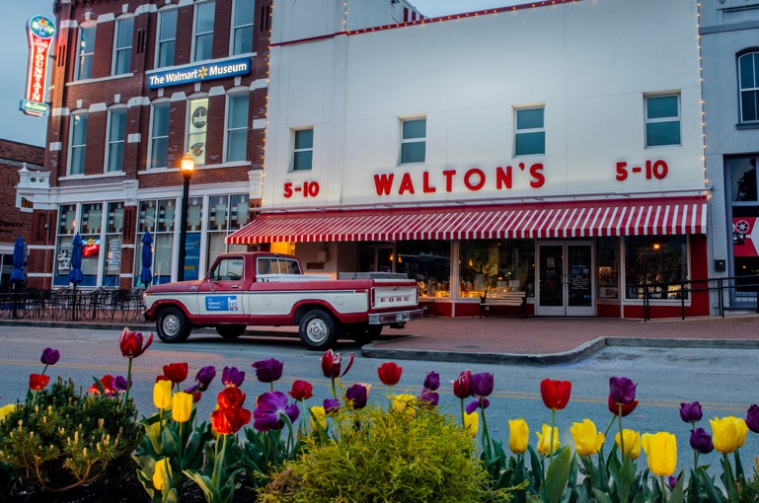
Long-term Volunteer Opportunities
Idaho Falls, ID
Bentonville, AR
Notes:
Mission Journeys, under the leadership of WELS Home Missions, is starting a pilot program to give more individuals the opportunity to share their faith through a long-term volunteer opportunity. Mission Journeys wants to place mission-oriented individuals in strategic locations to assist in forming and developing quality core groups, the building blocks in starting new home missions. A core group is the local group that does the work of meeting, praying, outreach, planning, and evangelism.
We’re looking for individuals that love Jesus and can communicate that love with other people. They’ll need patience, flexibility, and a spirit of adventure. This would be a tent ministry, where the individual would have a job outside of the ministry to support themselves. This could include remote work, a local job, or some combination. Mission Journeys, as a part of this pilot project, will work with the individual for possible financial assistance in moving or other expenses.
Current opportunities include:
Idaho Falls, Idaho: Idaho Falls is located on the western side of Teton National Park. Idaho Falls is a fast-growing area and a hub for the surrounding area. The core group consists of three families.
Bentonville, Arkansas: Bentonville is the home of Walmart, a corporation investing heavily in the community to provide a higher quality of life. The economy is booming for jobs in all job markets. The core group consists of four families.
WELS Home Missions provides each location with a proven plan on starting. Each location has a home mission counselor to assist in planning and coordinating ministry ideas. The core groups also worship with a pastor twice a month. This pilot program is designed to give an individual with a heart for missions the opportunity to work on the ground floor of a mission start.
For additional information, please contact Mission Journeys Coordinator, Shannon Bohme, at shannon.bohme@wels.net.

Slide 42

Notes:
Speakers: District Mission Board members, Home Missionaries, Mission Counselors, and other Home Missions representatives are willing and able to present on the 100 missions in 10 years initiative at your next church Mission Festival, LWMS circuit rally, school assembly, or small group gathering. Contact your local District Mission Board OR fill out a request at wels.net/speaker-request to find a speaker for your event this fall.
Facebook: Follow us on Facebook at fb.com/WELSMissions.
E-Mails: Subscribe to weekly Missions Blogs and quarterly Missions Update E-Newsletters at wels.net/subscribe.
Faces of Faith: The 5th annual edition of Faces of Faith is now available. This is a great overview of the work we’re doing in Home, World, and Joint Missions, and you can learn more about the 100 missions in 10 years initiative in this magazine.
It is available online and by request at wels.net/facesoffaith. Any congregation OR LWMS circuit is welcome to request up to 50 copies of the magazine, and we are also offering large home and world mission maps (24” x 36”) free of charge. Note – Faces of Faith is automatically sent to any congregation hosting a Mission Festival.

Slide 43

Notes:
Taste of Missions was held on Saturday, June 11, 2022, at Wisconsin Lutheran Seminary in Mequon, Wis. We kicked off the day by commissioning 6 new missionaries during a special worship service: Keegan Dowling and Benjamin Foxen (One Africa Team), Conifer Berg (London and the U.K.), Samuel Lor (Campus Ministry in Minneapolis, Minn.), Joel Prange (Amazing Grace, Dickinson, N.D.), and Thomas Welch (Campus Ministry in Houghton, Mich.). After fellowship and some ethnic food samples from food trucks, afternoon presentations began in the outdoor tent, including Home and World Missions Headlines, Moments with Missionaries video updates, and two Q&A panels.
View the recorded livestream presentations, extra Moments with Missionaries videos, and recipes and cooking tutorials at tasteofmissions.com! These would be great content to show at an upcoming Mission Festival, on your church’s social media account, or emailed out to members.
Save the date for next year’s event: June 10, 2023

Slide 44

Notes:
Pray. Ask God for more opportunities to reach those who don’t know Jesus Christ as their Savior from sin.
Share. Tell others about the work WELS is doing in the United States and around the world.
Discover. Subscribe to weekly Missions Blogs and quarterly Missions Update E-Newsletters at wels.net/subscribe and follow us on Facebook at fb.com/WELSMissions. Learn more at wels.net/missions or e-mail missionspromotions@wels.net with questions.
GIVE – Visit wels.net/give or mail checks with your preferred mission designation (e.g. Home or World Missions) in the memo field to:
WELS, Attn. Gift Processing
N16W23377 Stone Ridge Drive
Waukesha, WI 53188

Slide 45
All to God’s Glory!
“After this I looked, and there before me was a great multitude that no one could count, from every nation, tribe, people and language, standing before the throne and before the Lamb.”
Revelation 7:9

