Slide 1
Home Mission Monthly Statistics Form
Instructions
9/27/2016

Slide 2
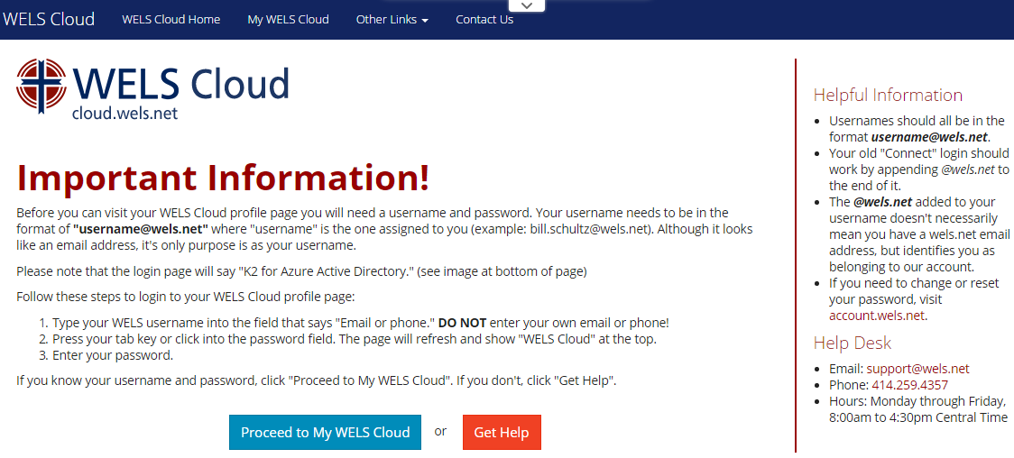
How to access the form?
cloud.wels.net/me
Select “Proceed to My WELS Cloud” button

Slide 3
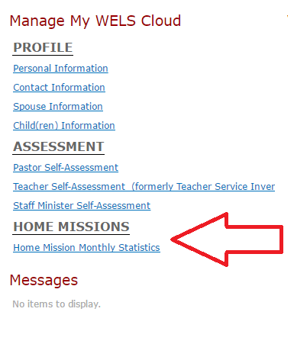
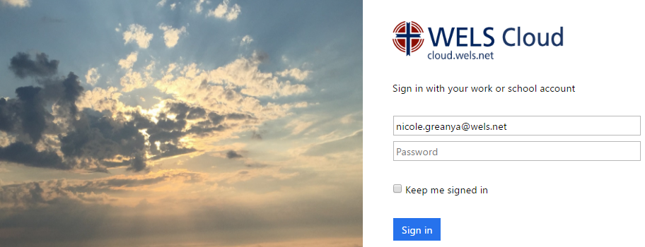
How to access the form?
Log in with WELS Cloud account
Select link on My WELS Cloud page
Direct link to statistics form is available on request for non-home mission pastors

Slide 4
Church selection
Enter Zip code
Select LOOKUP button
Choose your congregation
Select CONTINUE button
Same as Congregational Statistics Form and CMO Form

Slide 5
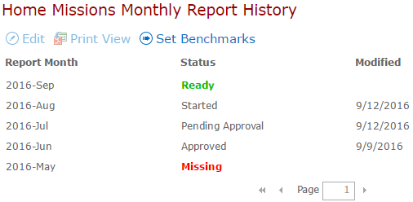
Welcome page
Church name and location in header
Instructions
History with status
Ready
Started
Pending Approval
Approved
Missing

Slide 6
Benchmarks timeline
By Fiscal year
Submit and approve from May 1st – April 30th
Example: Benchmarks for the 2016-2017 fiscal year may be submitted and approved from May 1, 2016 – April 30, 2017.
Example: Benchmarks for the 2017-2018 fiscal year may be submitted and approved from May 1, 2017 – April 30, 2018.
Comment from July 1st – June 30th
Example: Pastors may submit comments on the stats form for the 2016-2017 benchmarks for report months July 2016 – June 2017.
Example: Pastors may submit comments on the stats form for the 2017-2018 benchmarks for report months July 2017 – June 2018.
Benchmark reminder from May 15th – June 15th
Only approved benchmarks appear on the statistics form

Slide 7
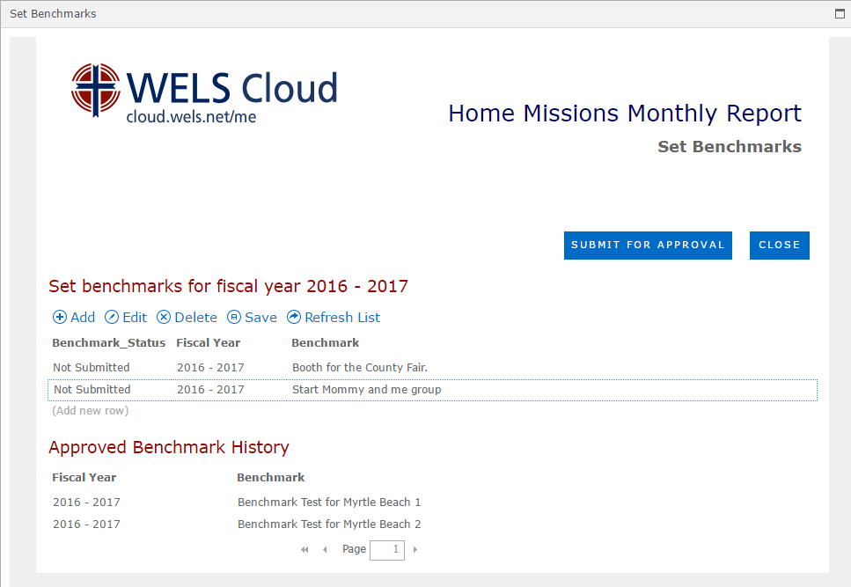
How to set Benchmarks
Select Set Benchmarks toolbar button (always available)
Approved History
Add and save
Submit for approval
On submit, a notification email is sent to district mission board chairman for them to review and approve

Slide 8
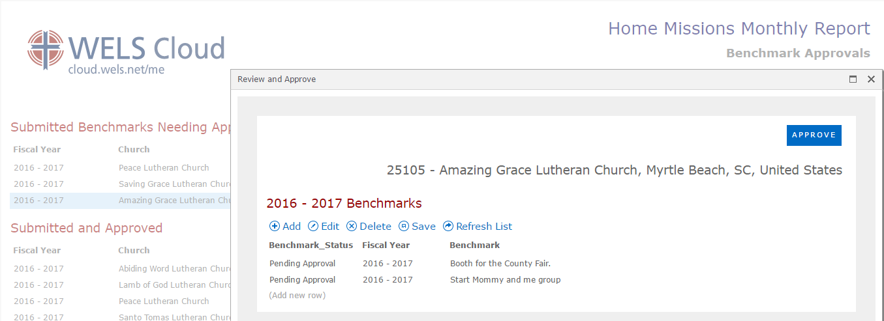
Benchmarks approval
Update and save
Add and save
Approve

Slide 9
Monthly statistics form
Report month subtitle
Church name and location
Breadcrumbs
Print View button opens new tab in browser
Save button saves all information on all tabs but ignores required fields
Review & Submit button validates and saves all information on all tabs and goes to review & submit page
Tabs

Slide 10
Personal Contacts
Note on every tab: “Data reported should reflect only the Home Mission site. It may be especially challenging, but still very important, to report Home Mission data accurately and consistently when the mission is part of a multi-site congregation.”
Pastor and Laity Questions
E-news and Social Media - optional
Comments – on every tab – optional
Previous Month – only approved data from the month prior

Slide 11
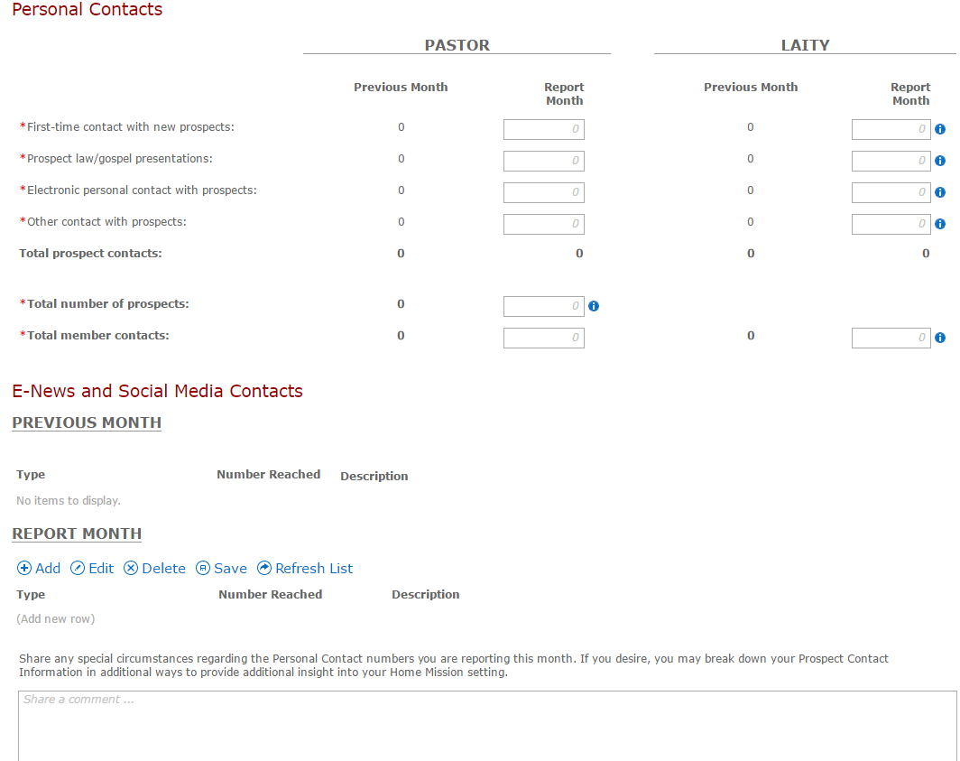

Slide 12
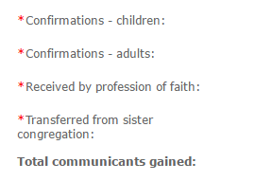
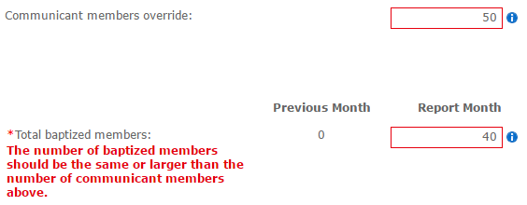
Membership
Communicant Membership Changes
Other Membership Statistics
Red asterisk for required fields
All number fields are required with the exception of “Communicant members override”
Validation: Total baptized membership must be greater than total communicant membership.

Slide 13
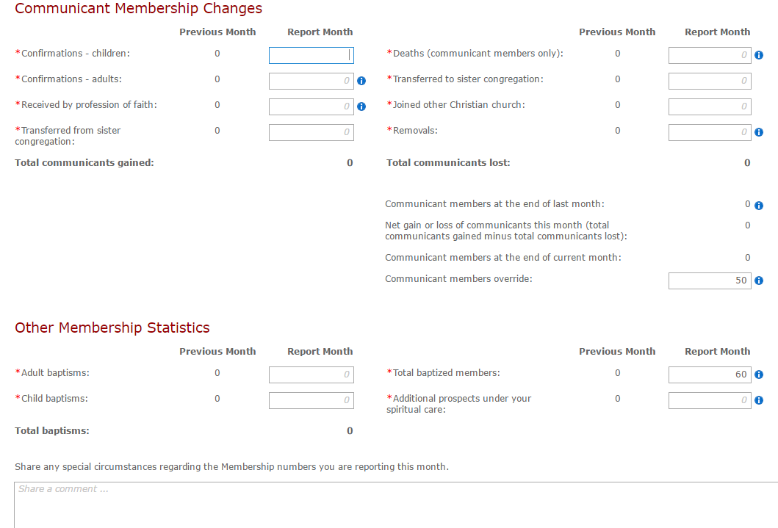

Slide 14
Attendance
Worship
Bible Study
Previous button – returns to the previous tab
Next button – saves current tab and goes to the next tab

Slide 15
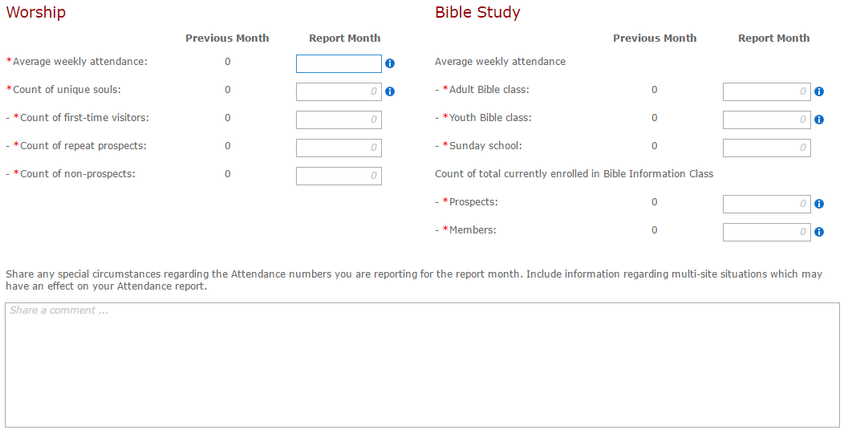

Slide 16
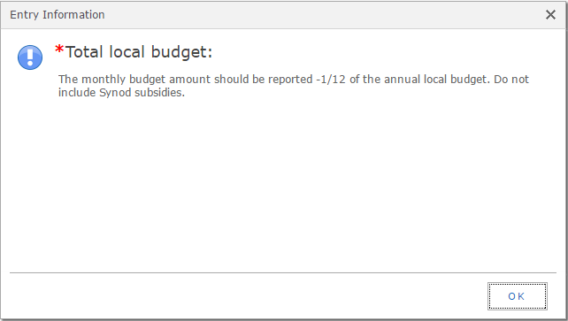
Finances
Income and Expense
CEF loan balance(s) – refreshed at the beginning of each month
Info Icons

Slide 17
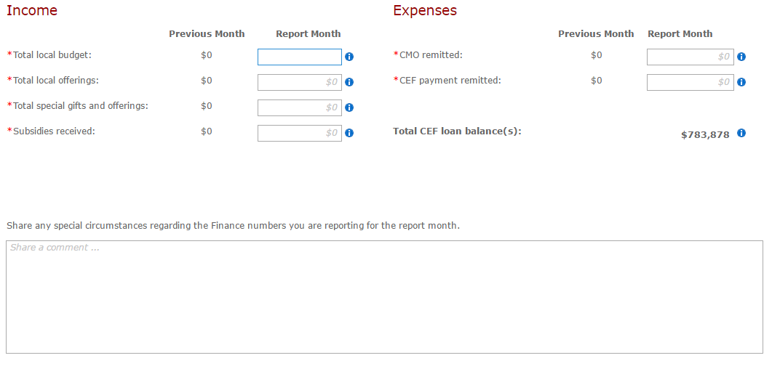

Slide 18
Narrative
Benchmarks comments for current fiscal year - optional
Share the rest of your story - optional
Use this area to detail goals, results, highs, lows, joys and challenges which occurred in your mission setting during the report month. You may include links to blog posts, photo galleries, online videos, etc. which include additional information about mission happenings.
Organize your comments into one of several categories
Education
Elders
Facilities
Fellowship
Member care
Outreach
Stewardship
Worship
Other
File upload - optional
Attach relevant files, if desired.
Acceptable file formats are .doc, .docx, .xls, .xlsx, .pdf, .jpg, .txt, .zip.
Maximum file size is 5 MB

Slide 19
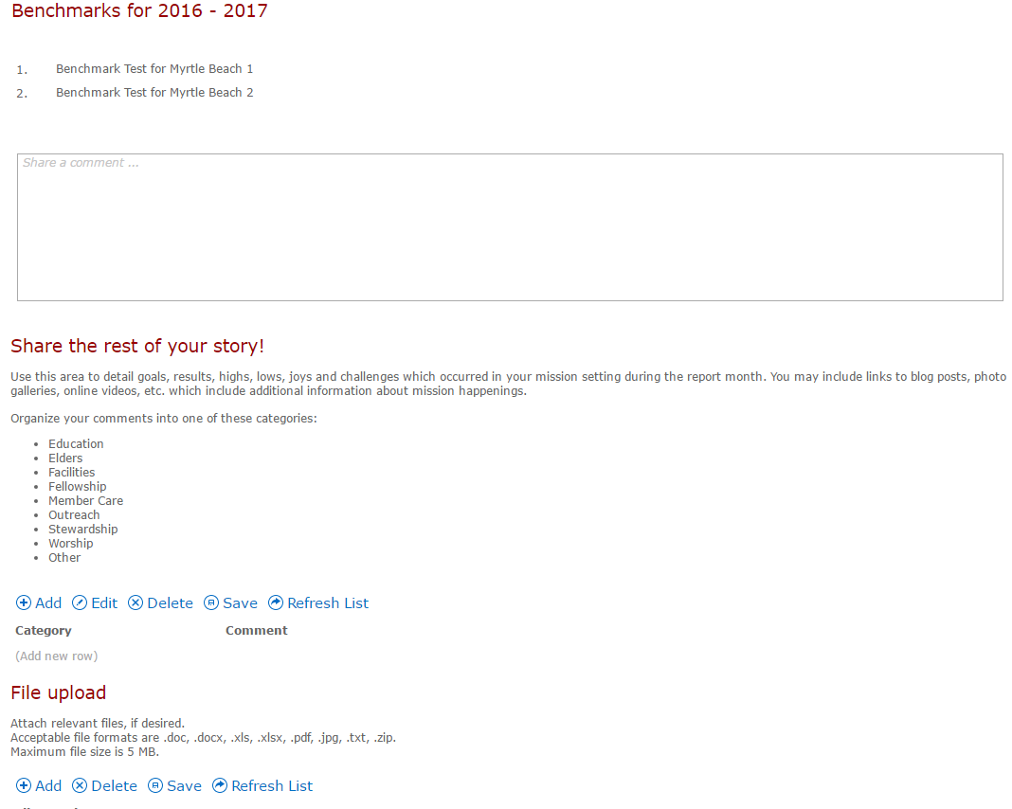

Slide 20
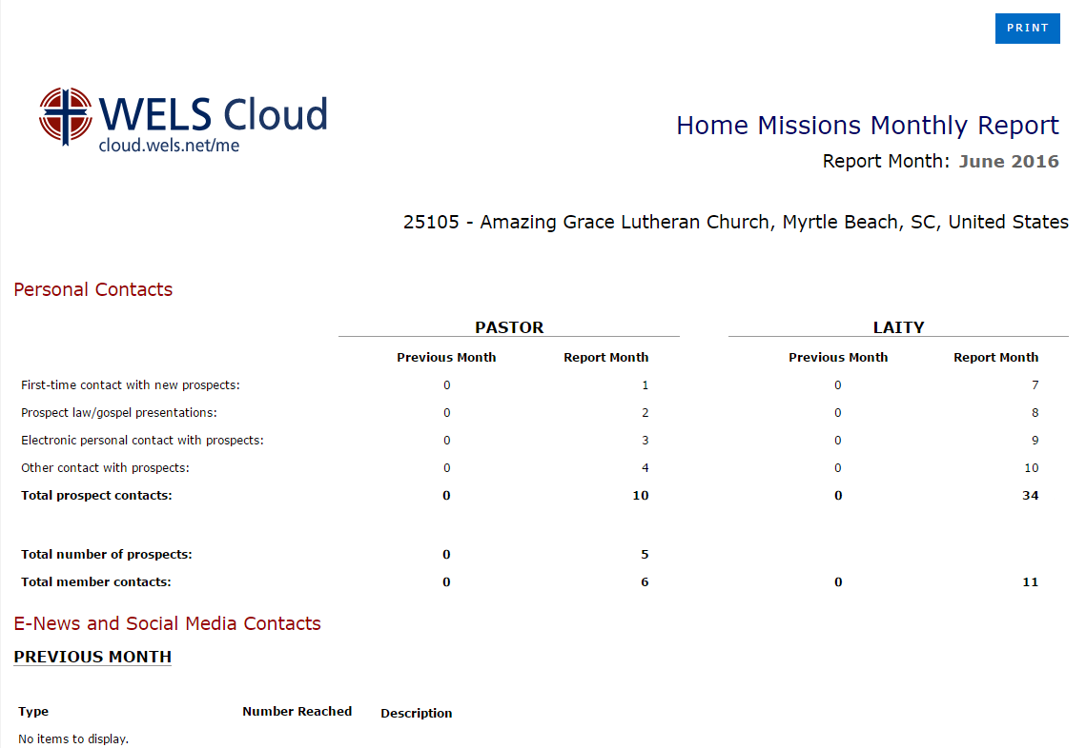
Print View
All tabs on a single page
Print button at top opens browser print dialog screen
Print View is available from the following locations
Welcome page – all statuses
Tabbed Form
Review & Submit Page
Thank You Page

Slide 21
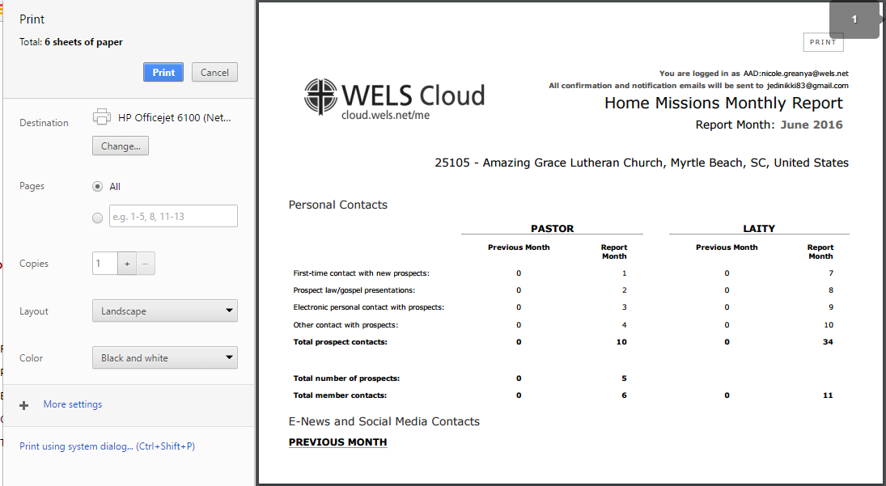
Browser Print Dialog

Slide 22
Review & Submit
Print View
Extra Note: Please check your entries here. If corrections need to be made, select the "Back to Form" button on the left. When you are done, select the "Submit" button on the right.
BACK TO FORM button returns to the tabbed form
SUBMIT button submits stats for approval and goes to a thank you page

Slide 23
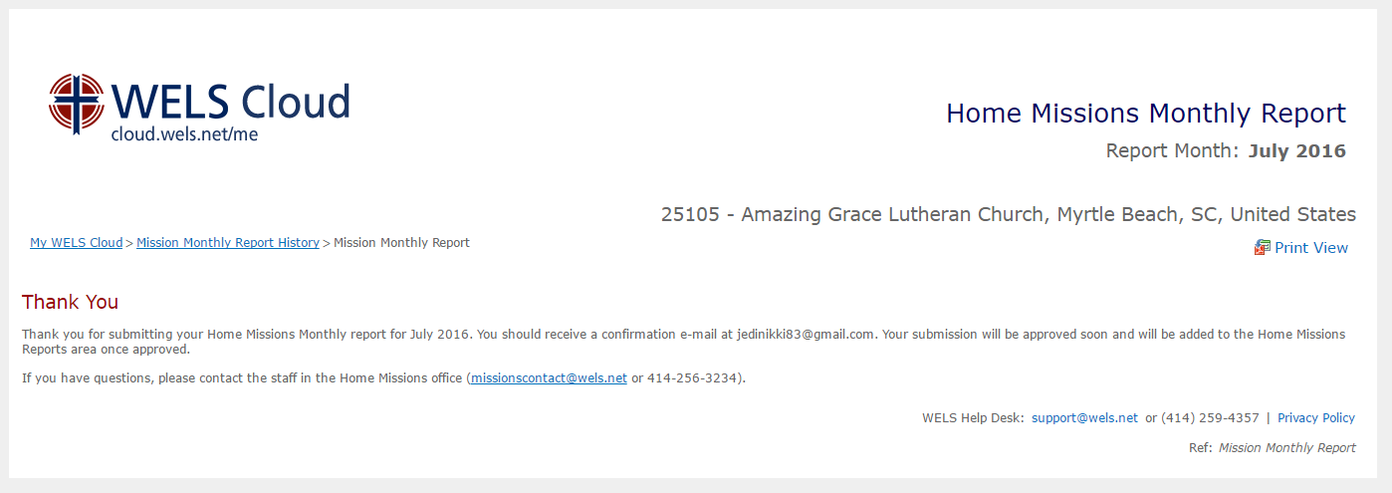
Thank you page

Slide 24
Confirmation Email
Confirmation email sent to the primary email address of the user logged in
Hello, Thank you for submitting your Home Missions Monthly report for July 2016 for Amazing Grace Lutheran Church, Myrtle Beach, SC, United States (25105). Your submission will be approved soon and will be added to the Home Missions Reports area once approved. If you have questions, please contact the staff in the Home Missions office (missionscontact@wels.net or 414-256-3234).

Slide 25
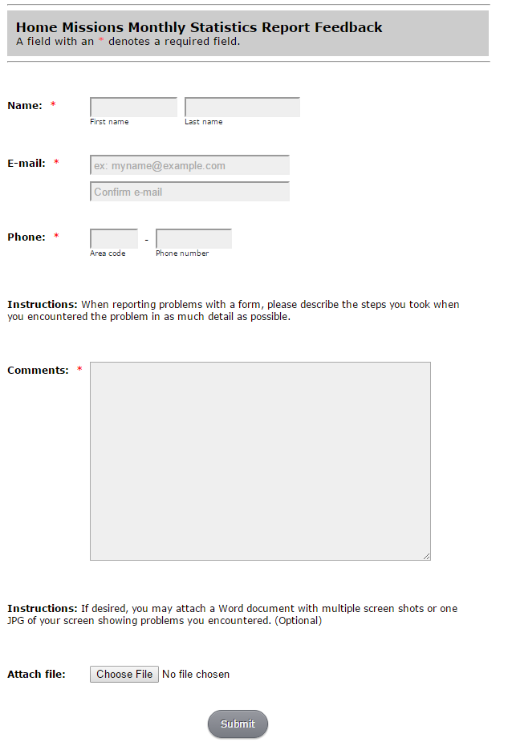
Feedback
Some great feedback was received from our beta testers
You too can provide feedback
Feedback form will be left open for several months

