Slide 1
Notes:
WELS Missions—made up of Home, World, and Joint Missions—seeks to share Christ’s love with the lost across the globe. Home Missions supports 134 congregations in the United States, Canada, and English-speaking West Indies, and assists hundreds of other congregations with their campus ministry programs. World Missions conducts gospel outreach in 44 countries and is exploring outreach opportunities in 18 prospective new mission fields. Joint Missions oversees any mission opportunity that is a combination of Home Missions, World Missions, and Ministerial Education. This includes diaspora (people-group) ministries, cross-cultural ministries, the Pastoral Studies Institute (PSI), and new programs like WELS Mission Journeys.

Slide 2
Notes:
WELS Missions—made up of Home, World, and Joint Missions—seeks to share Christ’s love with the lost across the globe. Home Missions supports 134 congregations in the United States, Canada, and English-speaking West Indies, and assists hundreds of other congregations with their campus ministry programs. World Missions conducts gospel outreach in 44 countries and is exploring outreach opportunities in 18 prospective new mission fields. Joint Missions oversees any mission opportunity that is a combination of Home Missions, World Missions, and Ministerial Education. This includes diaspora (people-group) ministries, cross-cultural ministries, the Pastoral Studies Institute (PSI), and new programs like WELS Mission Journeys.

Slide 3
Notes:
WELS World Missions conducts gospel outreach in 44 countries and is exploring outreach opportunities in 18 prospective new mission fields. World Missions brings the light of God’s Word to the world through evangelism efforts, church planting, training national workers for ministry, and providing religious materials in foreign languages through Multi-Language Productions (MLP).
49 world missionaries partner with almost 500 national pastors to conduct outreach and train more than 380 students for service in Christ’s kingdom.
World Mission supports mission work:
on Native American reservations, where the gospel has been shared on the Apache reservations in Arizona for more than 125 years and exploratory mission work is beginning on other reservations throughout North America;
in Africa, where missionaries partner with national church bodies in six countries and are exploring outreach in at least seven more countries throughout the continent;
in Asia, where the two missionary teams have joined together to equip, encourage, and empower others to bring the good news of Jesus Christ to 1.8 billion unreached souls;
in Latin America, where hundreds of thousands of people are being reached through Academia Cristo online courses and more than 40 individuals are being trained to plant a church;
in Europe, where missionaries partner with national churches to train the next generation of church leaders and bring the true gospel to countries without a strong Lutheran presence;
and through Multi-Language Productions, which has produced materials in more than 56 languages and reaches tens of thousands of English-speakers in more than 30 different countries through the TELL online training platform.
Mission Partners in 44 countries + the Apache Reservation in Arizona;
Mission Partners = Working with church bodies in fellowship with WELS; support could come in the form of financial assistance, a full-time missionaries residing in the country and working with the national church, theological training provided by WELS Pastoral Studies Institute (PSI) etc.
Exploration Mission Work in 18 prospective new mission fields
Exploratory Mission Work = promising contacts reaching out to WELS for fellowship or other areas of assistance (theological training, pastoral support etc.), and visits to the area when possible
World Mission Map available on the WELS Missions Resource Center: https://missions.welsrc.net/download-missions/promotions-toolkit/

Slide 4
Notes:
God’s grace opened doors to an unprecedented mission opportunity in communist Vietnam.
In 2011, leadership from the Hmong Fellowship Church (HFC) in Vietnam invited WELS pastor Bounkeo Lor to train their church leaders in the truth of the gospel. Since then, Lor and other WELS representatives have made trips to Hanoi, Vietnam, to train approximately 60 church leaders at a time. The HFC was a church body of 55,000 members in 2011. In the years WELS has provided training, the HFC has grown from 55,000 to over 138,000 members and formed many new churches.
The message of free grace received from Jesus Christ replaced the HFC’s old law-based preaching and brought peace to the Hmong Fellowship Church—church leadership stabilized as a result. In 2018, the communist government in Vietnam noticed this positive change and invited WELS to build a theological education center in the capital city of Hanoi. WELS is currently the only protestant church with official government permission to work with the Hmong in Vietnam. The Lord is opening a door to reach the more than two million Hmong people who live in Vietnam and the surrounding countries.
Learn more at wels.net/vietnamhmongoutreach.

Slide 5
Notes:
Vietnam is a long way from here, as are India, Malawi, Albania, and Argentina. Even Florida is quite a hike if you live in California. It is hard to talk as neighbors if you live in Texas and I live in Wisconsin. Yet the missionaries we send to these faraway locations crave and need our connection and support.
We can offer our missionaries support, and we benefit too! Learn about the different ways you can connect with our missionaries, pray for our Lord to keep these families safe and at peace as they carry out their work, and consider supporting their ministry this Christmas season by giving a gift at bit.ly/WorldMissionsGift.

Slide 6
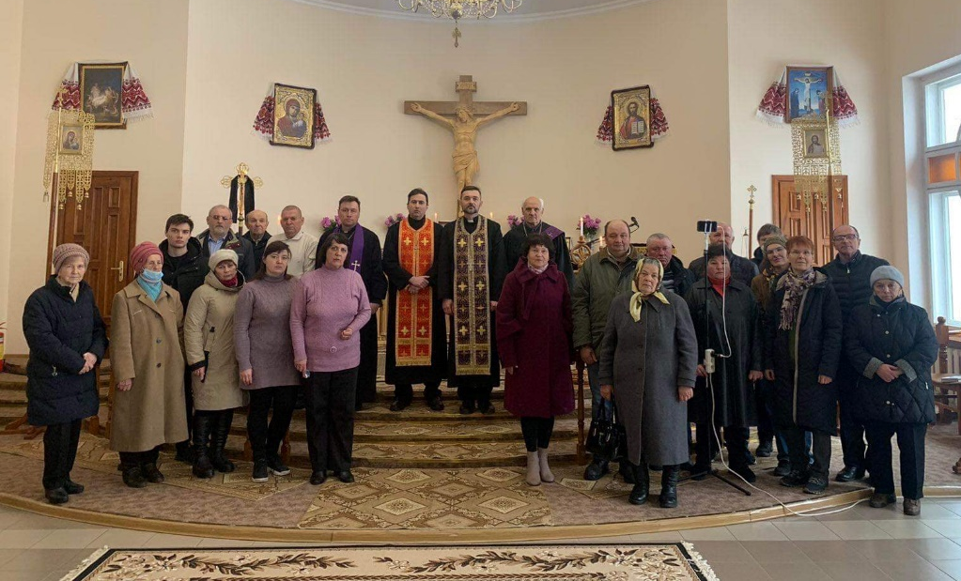
Notes:
WELS members are giving generously to help relieve the suffering in Ukraine from the war. These gifts provide aid to and through members of the Ukrainian Lutheran Church (ULC), WELS’ sister church in Ukraine.
WELS World Missions and WELS Christian Aid and Relief have sent some of these donations to Direct Relief, an organization that is able to provide immediate medical aid and supplies where they are needed most, including to help refugees in Poland. Gifts have also been sent to the Ukrainian Lutheran Church. Most of these gifts are sent directly to pastors or churches who help people buy food, heating fuel, gasoline, medications, and basic needs. In some areas, prices of certain essential products and food have nearly quadrupled. While these gifts do help ULC members, they are also used to help any who they are able to help. Many people need aid, and our churches try to meet these needs as best they can.
WELS communicates regularly with the leadership from the Ukrainian Lutheran Church and provides updates on how the war is affecting the members in Ukraine. Most ULC congregations continue to hold worship, either in person or online, proclaiming the hope they have in Jesus. The church body’s bishop was even able to offer a brief devotion on National Radio that included reading John 3:16.
Visit wels.net/ukraine for additional updates as they become available.

Slide 7
Notes:
Multi-Language Productions (MLP) has created more than 2.9 million video, audio, print, and online training resources in 56 languages to date. They have also introduced a new online Bible-based training platform called TELL (Think, Evaluate, Learn, and Lead), to bring the gospel to English-speakers around the world. With the Lord’s blessing, the TELL Network will allow for the creation of new TELL platforms in additional languages in the future.
Fast Facts:
The TELL app has been downloaded over 125,000 times.
There are 32,000 active users on the TELL appl.
250+ students have enrolled in live TELL group classes
There are 30+ countries represented in the TELL student body.

Slide 8
Notes:
London is one of the most diverse and important cities in the world. Since the 1980s, the WELS European chaplaincy program has held monthly services in London for WELS-connected believers in the area. In recent years, many members from WELS’ sister churches around the world have been moving to the U.K. For example, more than 20 percent of members and leaders from WELS’ partner church in Hong Kong have already moved to the U.K., with more on the way.
In response to this opportunity, WELS World Missions has planted a new mission field in the U.K. Rev. Michael Hartman has accepted the call and Rev. Conifer Berg was assigned to begin serving the group already gathering in London, connect with contacts from other sister church bodies, and launch outreach efforts. With the Lord’s blessing, it is the prayer this mission work could provide a springboard for further in the U.K., made up of England, Wales, Scotland, and Northern Ireland, and the entire continent of Europe.
Learn more at wels.net/London.

Slide 9
Notes:
WELS Home Missions plants new churches and assists mission-minded congregations in the United States, Canada, and English-speaking West Indies. Home Missions currently supports 134 congregations with financial subsidy or district mission board/mission counselor assistance, with 29 of those being cross-cultural mission congregations. Home Missions also provides over 30 campus ministries with financial support, while assisting hundreds of other congregations that serve college students around the United States and Canada.
Home Mission Map available on the WELS Missions Resource Center: https://missions.welsrc.net/download-missions/promotions-toolkit/

Slide 10
Notes:
Start 100 new home mission churches in 10 years. That’s 10 missions each year, 10 new dots on the map throughout North America. During the same time, we want to support 75 enhancement grants to help existing congregations reach more souls, often in other cultures. It’s an aggressive plan. To some, it might seem unachievable. Can our synod do this? Do we have the manpower, money, and ministry resources?
We trust that God will bless our efforts. This initiative isn’t as much about planting more churches but about sharing the gospel of Jesus Christ. It’s about aggressively reaching lost souls. It’s about Christ’s mission to his church. You know that mission: “Go and make disciples of all nations.” But consider the words that Jesus spoke right before that: “All authority in heaven and on earth has been given to me.” Look at the one who commissioned us. He is the one who said to the wind and waves, “Quiet, be still,” and to the paralyzed man, “Get up, take up your mat and walk,” and to Lazarus, “Come out.” He is the one who died, rose from the dead, and descended into hell proving and proclaiming his victory. Death was put to death. The devil defeated. The powers of sin destroyed.
This is the Jesus who has commissioned us. This is the Jesus who rules over his church on earth. This is the Jesus who has equipped us! This initiative is about aggressively and confidently doing the work that he has called all of us to do.
There are still many out there waiting to be found and reached. They just don’t know it yet. So let’s support this. Let’s do our part to get after it, trusting that God is able to do immeasurably more than all we ask or imagine.
Learn more at wels.net/100in10.

Slide 11
Notes:
Start 100 new home mission churches in 10 years. That’s 10 missions each year, 10 new dots on the map throughout North America. During the same time, we want to support 75 enhancement grants to help existing congregations reach more souls, often in other cultures. It’s an aggressive plan. To some, it might seem unachievable. Can our synod do this? Do we have the manpower, money, and ministry resources?
We trust that God will bless our efforts. This initiative isn’t as much about planting more churches but about sharing the gospel of Jesus Christ. It’s about aggressively reaching lost souls. It’s about Christ’s mission to his church. You know that mission: “Go and make disciples of all nations.” But consider the words that Jesus spoke right before that: “All authority in heaven and on earth has been given to me.” Look at the one who commissioned us. He is the one who said to the wind and waves, “Quiet, be still,” and to the paralyzed man, “Get up, take up your mat and walk,” and to Lazarus, “Come out.” He is the one who died, rose from the dead, and descended into hell proving and proclaiming his victory. Death was put to death. The devil defeated. The powers of sin destroyed.
This is the Jesus who has commissioned us. This is the Jesus who rules over his church on earth. This is the Jesus who has equipped us! This initiative is about aggressively and confidently doing the work that he has called all of us to do.
There are still many out there waiting to be found and reached. They just don’t know it yet. So let’s support this. Let’s do our part to get after it, trusting that God is able to do immeasurably more than all we ask or imagine.
Learn more at wels.net/100in10.

Slide 12
Notes:
Pray: This is no small thing. Pray that the Lord of the church would provide workers. Pray for our WELS Home Missions leaders, our home missionaries, and our worker training schools as they recruit and train future missionaries. Pray that the Lord provides us with the financial support needed to do the work.
Get Involved: If you see nearby mission opportunities, talk with your district mission board to see what you or your congregation might do to get involved in this synod wide church planting effort. Encourage young men and women in your church to consider full-time ministry. Ask your pastor to keep our synod’s work in your congregational prayers and provide updates on a regular basis.
Give: You know the grace of our Lord Jesus Christ. He was rich, yet he became poor so that through his poverty we might become rich (2 Corinthians 8:9). God’s generosity has resulted in the riches of forgiveness, peace, joy, and hope. Let that move you to give generously to your local congregation, to your synod through your church, and to this initiative.
Encourage people to check out the website: Learn more and stay up to date on progress at wels.net/100in10.

Slide 13
Notes:
We confidently ask you to consider giving generously to this amazing opportunity to expand our efforts to share the saving gospel right here in our own backyard. This is a BIG challenge. An impossible one you might say. But we prepare and we plan, and we ask God to bless it. Trusting in the Lord, we boldly move forward knowing God will bless us and his kingdom.
You can support this effort by giving a gift online at wels.net/100in10gift; through the QR code on the slide; sending a check with the 100 Missions in 10 Years in the memo line to WELS, Attn: Gift Processing, N16W23377 Stone Ridge Drive, Waukesha, WI 53188; or through appreciated assets (e.g., stock) or from your IRA by calling 800-827-5482. Thank you for your support!

Slide 14
Notes:
WELS Campus Ministry, a ministry of WELS Home Missions, provides resources, support, and encouragement to WELS congregations that serve college students around the United States and Canada. These congregations are vital in connecting college students with fellow Christians, strengthening their faith with the gospel message, and encouraging them to share that faith with other college students. The WELS Campus Ministry Committee currently provides over 30 campus ministries with financial support and assists hundreds of other congregations in their campus ministry outreach.
If you are entering college or are in college already, please sign up with WELS Campus Ministry so we can share your information with your local campus pastor and send/e-mail you free copies of Meditations devotions and Forward in Christ magazine. Learn more and sign up at wels.net/college.

Slide 15
Save the date!
June 10, 2023
Notes:
Save the date for Taste of Missions on Saturday, June 10, 2023!
This family-friendly event will be held at Wisconsin Lutheran Seminary in Mequon, Wis., AND online. We will kick off the event by commissioning new missionaries in a special worship service. Sample ethnic cuisine from different food trucks while enjoying fellowship and presentations from home and world missionaries alike. View displays, participate in outdoor family-friendly activities, and ask questions about the ups and downs of mission work during panel discussions.
Keep an eye out on our website for details as they’re released: tasteofmissions.com. Hope to see you there!

Slide 16
Notes:
Just a few reminders of the many ways to stay connected with WELS Missions throughout the year:
Speakers: The WELS Missions office can help you find a speaker for your next church Mission Festival, LWMS circuit rally, school assembly, or small group gathering. Epiphany is a great time to host a mission festival. Speakers are generally more available, and the season is fitting as we are reminded that Christ was born to save all nations, as represented by the Magi who came to worship Jesus after his birth. If you would be interested in having a world missionary present at your congregation, consider requesting a speaker for the summer months (April-August). World missionaries are often in the United States on furlough during that time and available for speaking engagements. Request a speaker at wels.net/speaker-request.
Facebook: Follow us on Facebook at fb.com/WELSMissions.
E-Mails: Subscribe to weekly Missions Blogs and quarterly Missions Update E-Newsletters at wels.net/subscribe.
Faces of Faith: The 5th annual edition of Faces of Faith is now available. This is a great overview of the work we’re doing in Home, World, and Joint Missions, and you can learn more about the 100 missions in 10 years initiative in this magazine.
It is available online and by request at wels.net/facesoffaith. Any congregation OR LWMS circuit is welcome to request up to 50 copies of the magazine, and we are also offering large home and world mission maps (24” x 36”) free of charge. Note – Faces of Faith is automatically sent to any congregation hosting a Mission Festival.

Slide 17
Notes:
Download a digital copy of the magazine, read bonus stories that didn’t make it in the magazine, and request copies for your congregation or LWMS circuit (limit 50) at wels.net/facesoffaith

Slide 18
Notes:
WELS Mission Journeys provides an opportunity for all WELS members to walk together in the Great Commission. Through church- or school-based volunteer trips to WELS mission fields at home and abroad, members have the opportunity to engage in Christian service. Pre-trip training led by a Mission Journeys team leader equips volunteers to have significant impact during their trip. While volunteering, the learning and sharing of outreach ideas will allow teams to explore how they can use their God-given abilities to engage in outreach activities in their home congregation upon their return home. With the Lord’s blessing, these trips will inspire a lifelong journey of service and outreach for all who volunteer.
Three Unique Program Steps:
Pre-trip training: Through pre-trip training, you will develop a spiritual plan for your earthly mission journey. Teams receive training materials that provide opportunities for spiritual growth, team building, and enhanced cultural understanding.
During Trip: Your Mission Journey will provide you with a new perspective on the urgency of sharing the Gospel. With everything centered on our Savior, you will develop meaningful relationships with your team, host congregations, and even members of the community you witness to.
Post-Trip Outreach Event: Your team will have the opportunity to lead an outreach activity or event in your community through your local congregation. This will allow your team to take what you’ve learned and apply it back home, continuing to walk together in the Great Commission.
Learn more at wels.net/missionjourneys.

Slide 19
Notes:
1.) Always thank the congregation and individual people for their past support.
Thank you for your past Congregational Mission Offerings (CMO); these gifts provide us with a solid foundation for our planning.
Thank you for your past personal, “special gifts” above and beyond your congregations’ CMO; these special gifts help us reach more people with the love of Jesus.
2.) What can I do to help TODAY?
Pray for God’s blessing for those who serve and those who still need to hear the Good News.
Share with your friends, family, co-workers, neighbors and talk about the work we are doing.
Subscribe so you can continue to get updates and hear about the incredible work being done.
GIVE – Your Congregation can give a special gift: Please make sure to send in your thank offering to the CMM with the preferred designation.
Individuals - Please prayerfully consider how you can be a part of spreading the gospel through a special gift above and beyond your CMO. If the Holy Spirit moves your heart, this postcard gives you all the information you need on how and where to give. If you would like to give to the overall work of missions, please give to World or Home Missions respectively. If you have a special designation such as …the topic of the speaker’s presentation (example: Africa Outreach) please note that when you send in your gift. You can give a gift online, just go to wels.net/give OR mail check with your preferred designation.
3. Share this postcard with someone you know that has a heart for missions after you have considered your gift.

Slide 20
Notes:
Let us know what you thought of this presentation! Visit surveymonkey.com/r/MissionsEventAttendees to fill out our survey.

