Slide 2

In the same way, the gospel is bearing fruit and growing throughout the whole world—just as it has been doing among you since the day you heard it and truly understood God’s grace.
Colossians 1:6
Notes:
The Scripture focus for “Grace—Hmong outreach in Vietnam” is Colossians 1:6: “In the same way, the gospel is bearing fruit and growing throughout the whole world—just as it has been doing among you since the day you heard it and truly understood God’s grace.”
This verse reminds us of the magnificent grace God has freely given to all of us as Christians. The Holy Spirit has used the message of grace through our Savior Jesus Christ to change the hearts and lives of our Hmong brothers and sisters in the faith in Vietnam, just as he has done in our hearts. There are so many in Vietnam who need to hear the good news of salvation from sin through Jesus. As Christians we seek to share the gospel message with all ends of the earth, to build up Christ’s church.

Slide 3
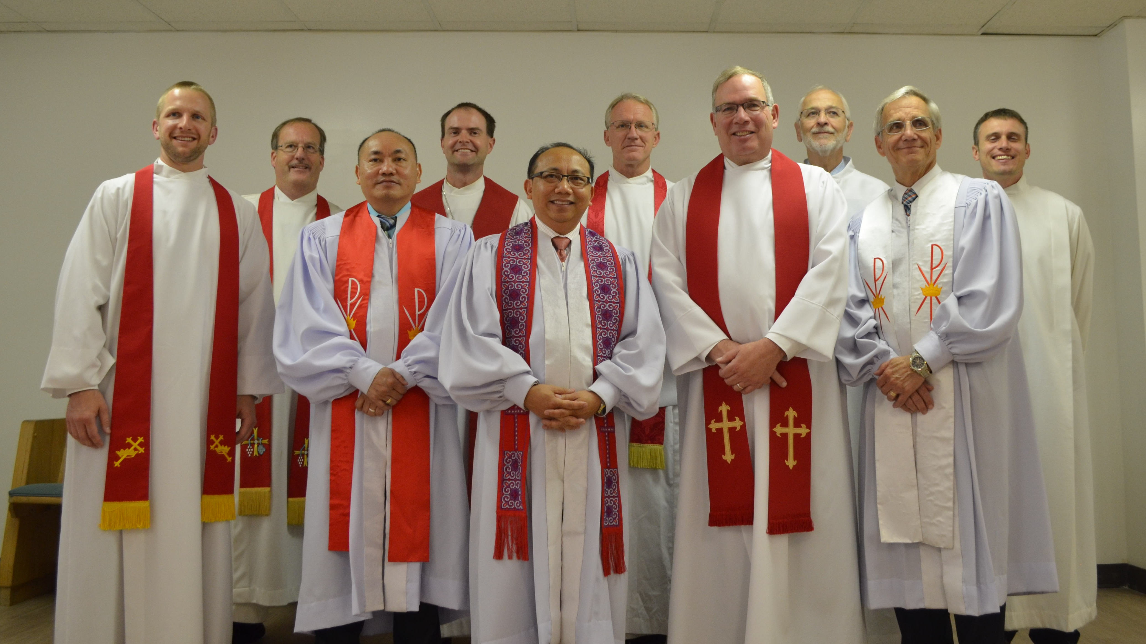

Rev. Bounkeo Lor: Originally a WELS pastor from Grace Hmong Lutheran Church in Kansas City, Kansas
Notes:
Pictured: Rev. Bounkeo Lor’s installation as Hmong Asia ministry coordinator at Grace Hmong in May 2017. Lor is pictured center with the purple on his stole. Left of Pastor Bounkeo Lor is Pastor Daniel Lor, Bounkeo’s brother and current pastor at Trinity Hmong Lutheran Church in Manitowoc, WI. Pastor Daniel Lor presided Bounkeo’s installation service.
Bounkeo Lor grew up in a refugee camp in Thailand with this family. They had little education, no chance to see the outside world, no freedom, and little food. But they did have a strong Christian family. Rev. Lor’s father was a pastor for more than 20 years in Thailand.
After realizing that many Hmong people were still in the hands of the devil, four Lor brothers (Bounkeo, Ger, Dewid, and Daniel) decided they wanted to study for ministry to bring the gospel to Hmong people around the world. The brothers each received a bachelor of theology degree from a Southern Baptist seminary in 2002, and shortly after began studying with the Pastoral Studies Institute (PSI) in 2004. All four graduated in May 2007. The four brothers were assigned to serve the following ministries:
Bounkeo: Rock of Ages Lutheran Church – Kansas City, MO (later transitioned to lead pastor at Grace Hmong Lutheran Church in Kansas City, Kansas)
Daniel: LaCrosse WELS Hmong Ministry
Dewid: Hmong Missionary in Thailand
Ger: St Andrew Lutheran Church – Sacramento, CA
Today, Rev. Bounkeo Lor serves as Hmong Asia ministry coordinator for the WELS Global Hmong Committee. Daniel Lor took a call to serve Trinity Hmong Lutheran Church in Manitowoc, WI, and Ger Lor is now lead pastor at Grace Hmong Lutheran Church in Kansas City. Dewid Lor is currently living in Kansas City and translating training materials into Hmong through Multi-Language Publications (MLP) for the work in Vietnam.

Slide 4
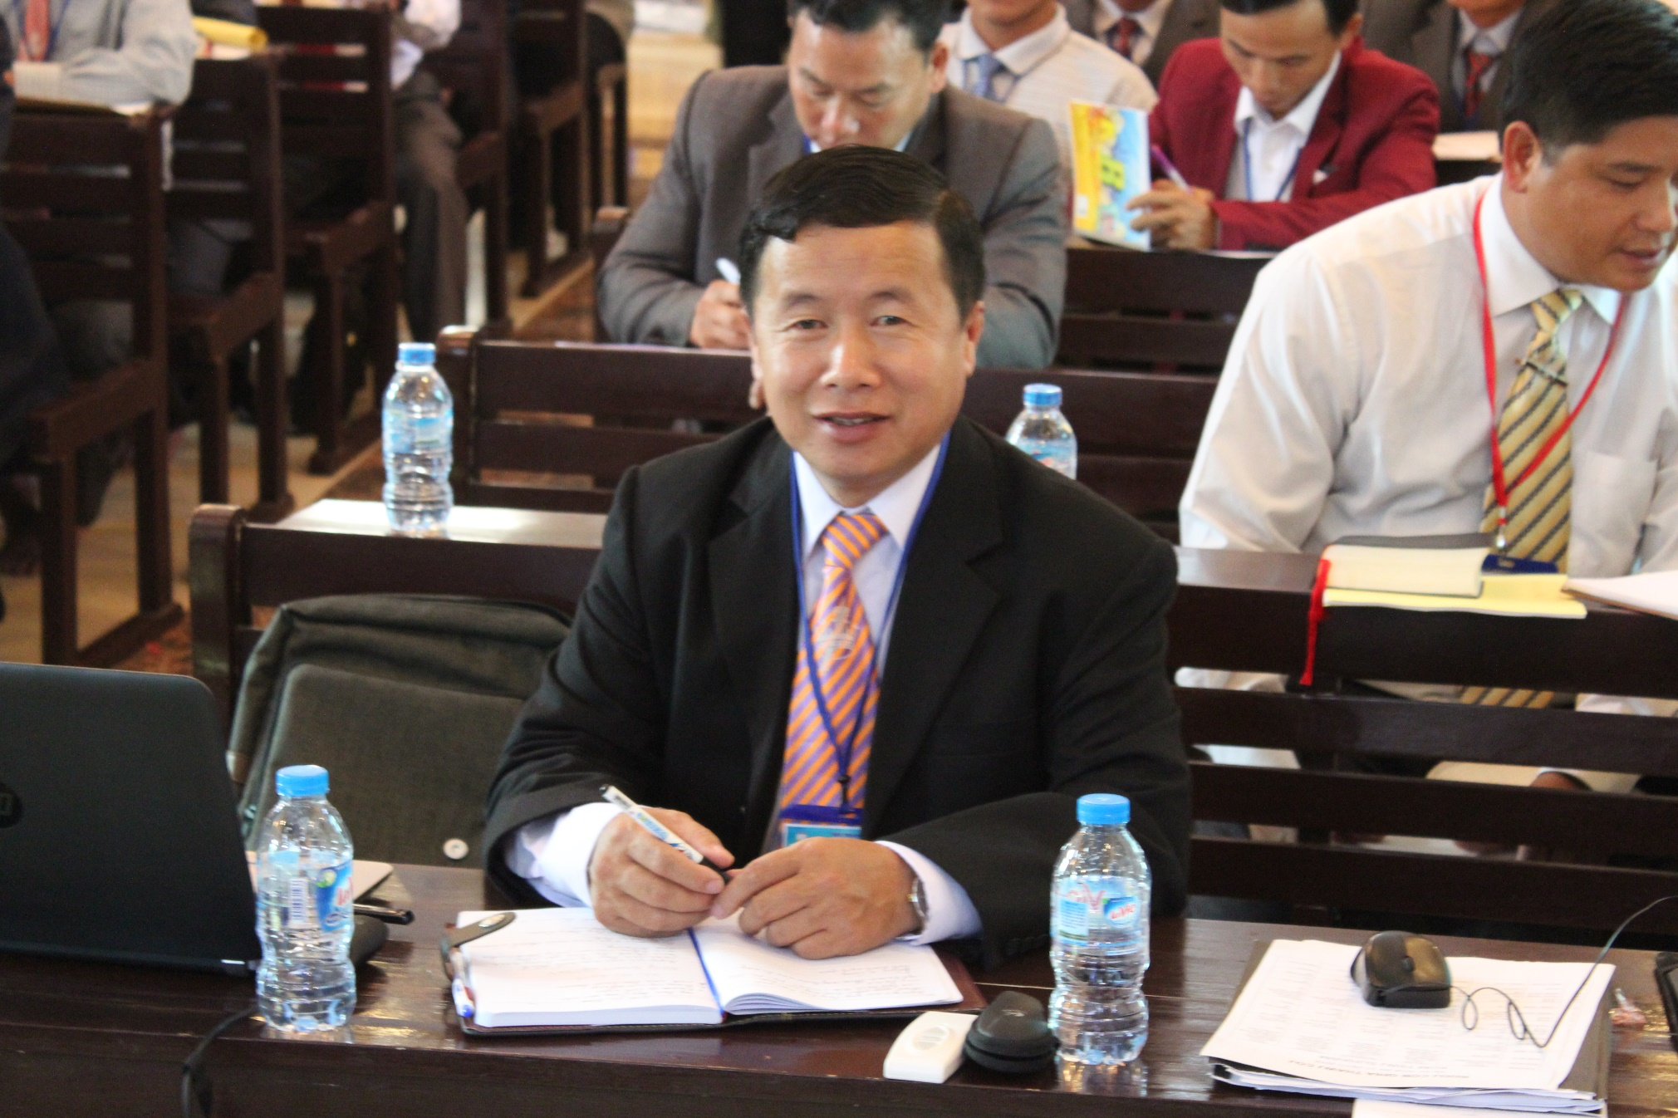

Where it all began
Zang Lou (pictured), a leader within the Hmong Fellowship Church in Vietnam, reached out to Lor and requested theological training after viewing an online sermon in 2011.
Notes:
The clear proclamation of law and gospel and the message of pure grace through Jesus Christ was something he had never heard before . . . and he wanted to learn more. That same year, Zang Lou invited Lor to come to Vietnam to train the HFC in the truth of the gospel.

Slide 5
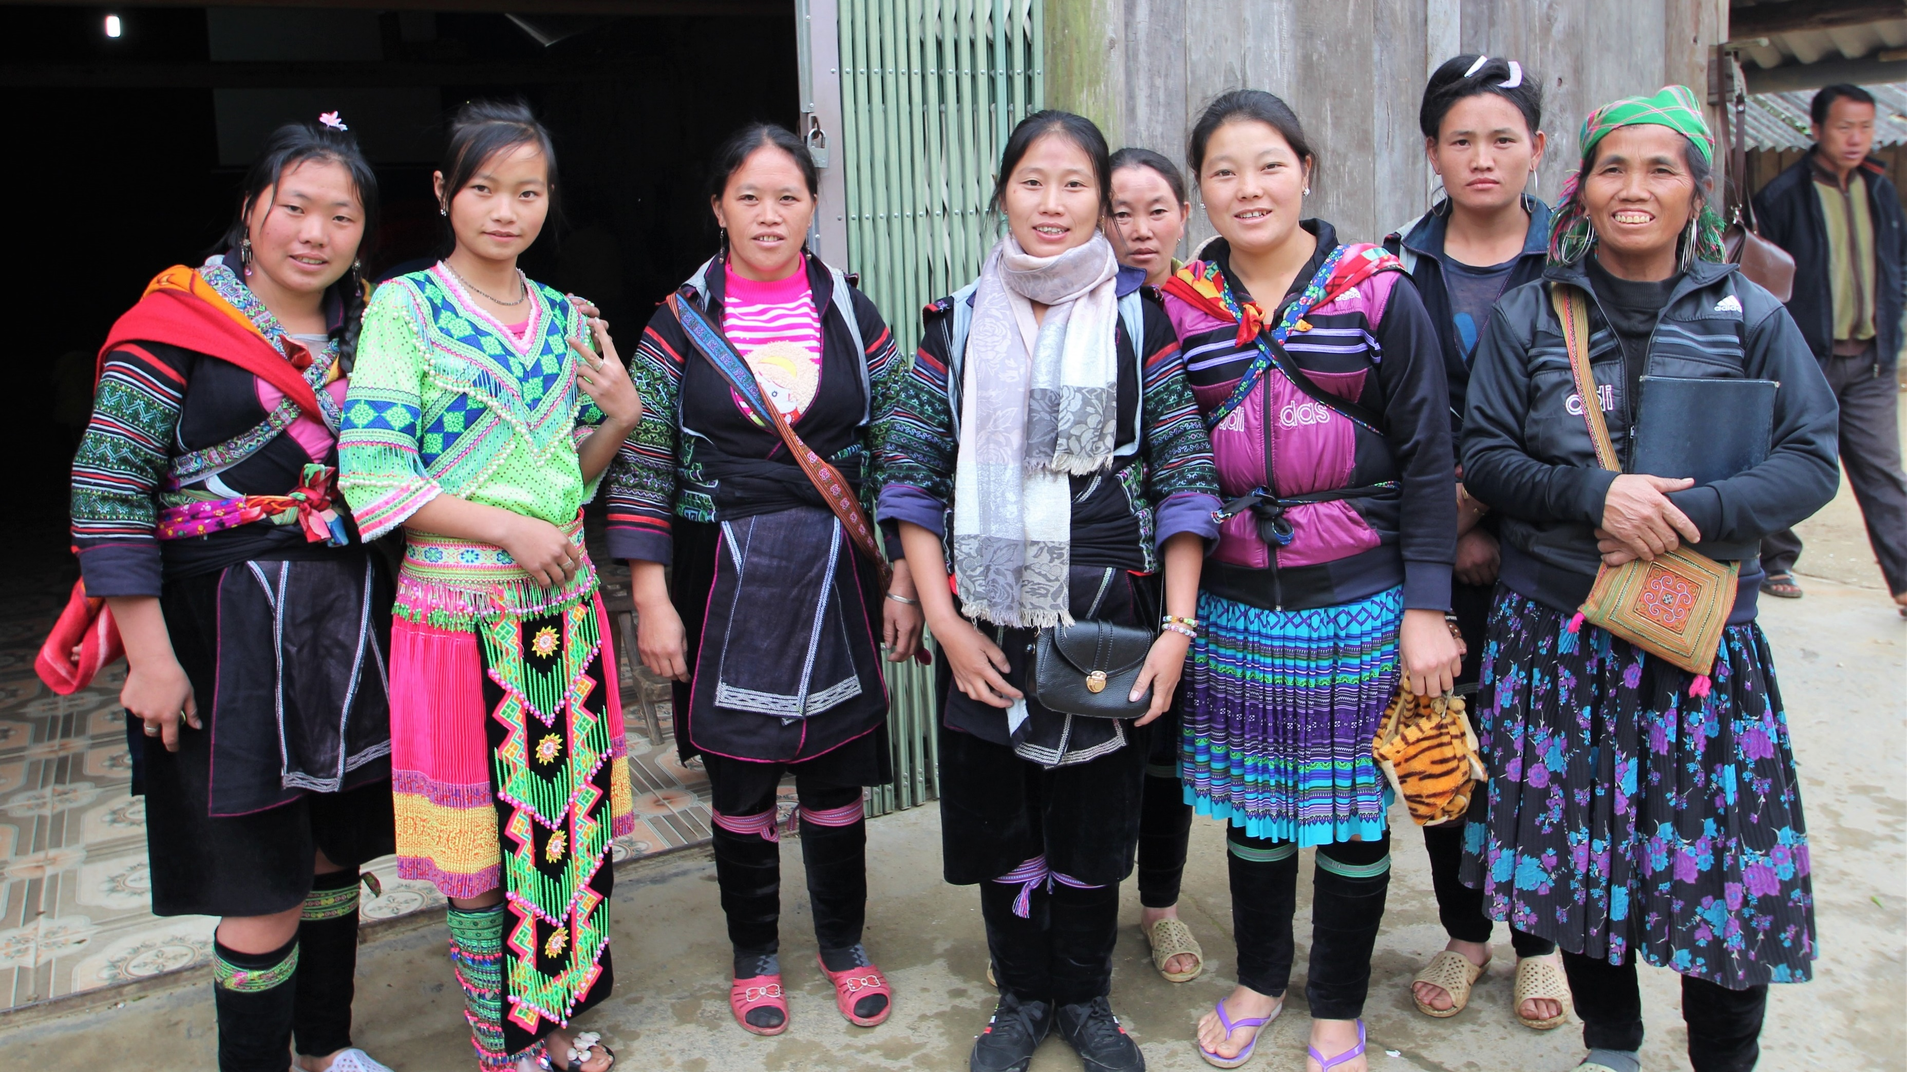
In 2011, the Hmong Fellowship Church (HFC) had 55,000 members scattered throughout Vietnam
Notes:
Pictured: HFC members after attending church in a rural part of Vietnam

Slide 6

Most HFC members reside in rural areas, relying on farming to provide for their families
Notes:
Pictured: A typical rice field in Vietnam

Slide 7
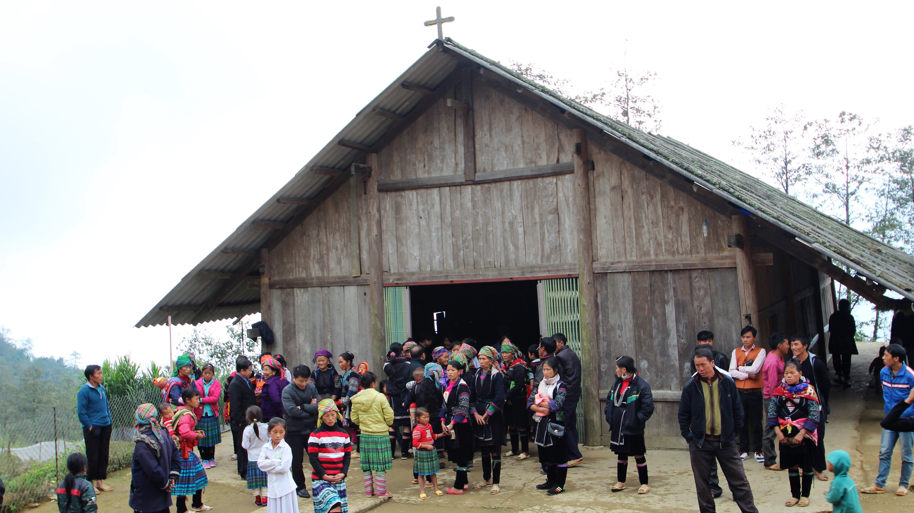
Many HFC members heard about Christianity through radio broadcasts and materials in the 1990s
Notes:
When the current chairman of the HFC requested training from the Christian Mission Alliance (CMA) church when he first became a Christian, he was turned down. They handed out a few Bibles and then sent them home.
Other Vietnamese churches, Korean missionaries, and even Hmong pastors who came from the United States provided training, but each of these groups and individuals came and did the training based on what they wanted to accomplish. All the HFC learned were rules to follow, good works that must be done, and how to live good lives to please God. They would go to training from these churches, but among the HFC there was no stability, no peace, and no gospel. They had no unity among the churches because they all interpreted the Bible based on their own ideas or the various things they had learned.

Slide 8
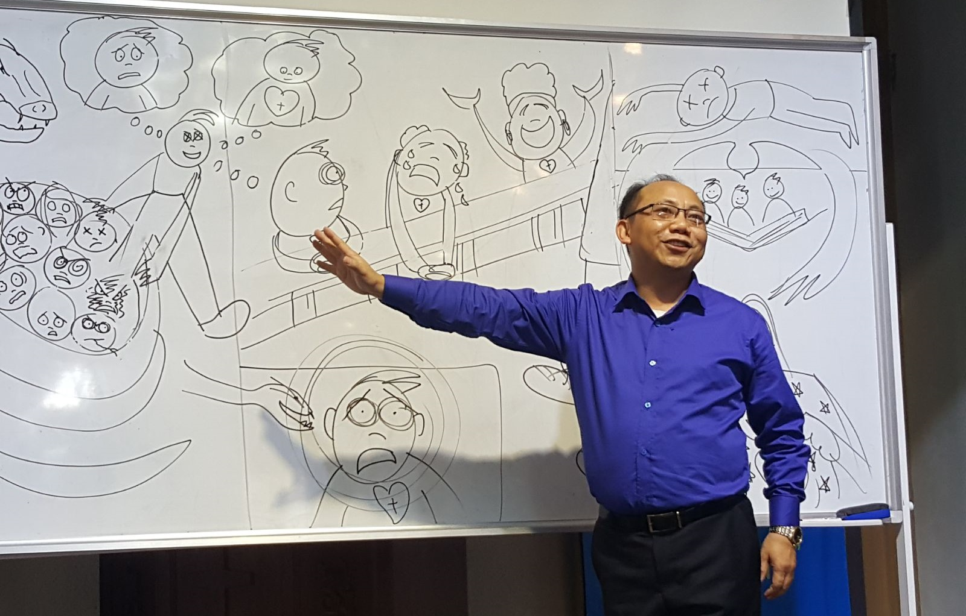
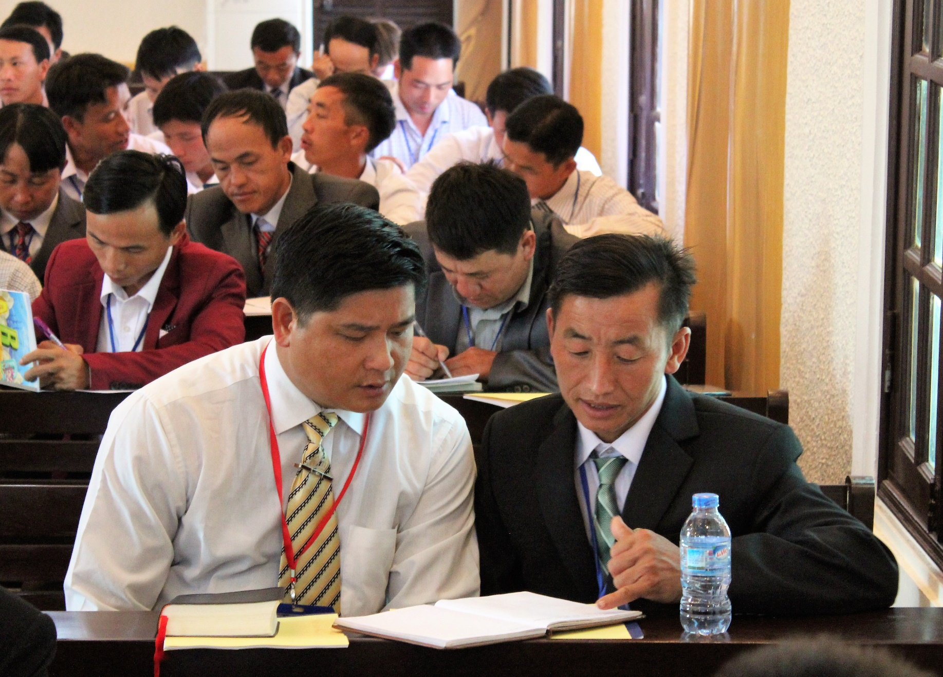
Most HFC church leaders had only received one or two days of theological training before WELS arrived
Notes:
Before WELS began providing training, a few pastors that served in leadership roles within the HFC had received six weeks of theological education from the Vietnamese Fellowship Church (VFC), one of the official Christian church body recognized by the Vietnamese government. Many of the other leaders and all rural pastors had only received one or two days of training.

Slide 9
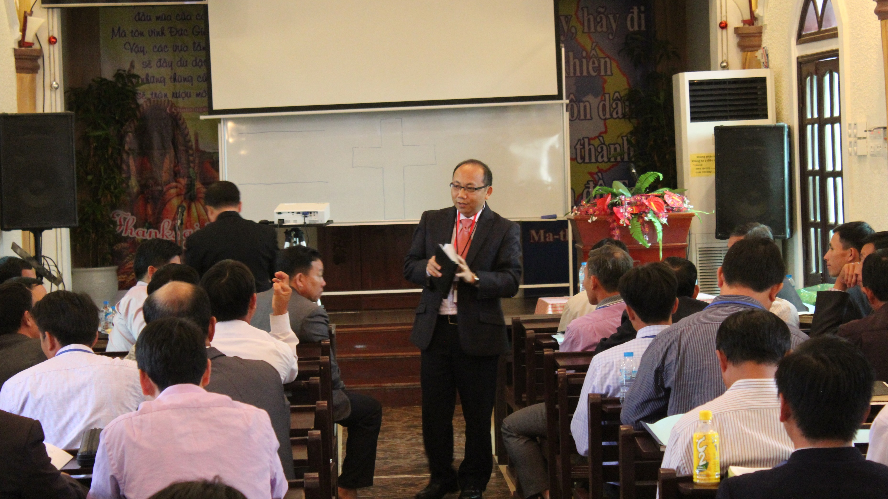
Rev. Lor visited Vietnam for the first time in 2012.
Since then, he has visited over 24 times.
Notes:
2012: Lor makes the first of his training trips to Hanoi.
2014: Lor is accompanied by an Anglo pastor on a training visit to Vietnam. The HFC leaders draft a letter to WELS leadership asking for additional training.
2015: WELS Missions begins full financial support of the Hmong outreach effort in Vietnam.

Slide 10
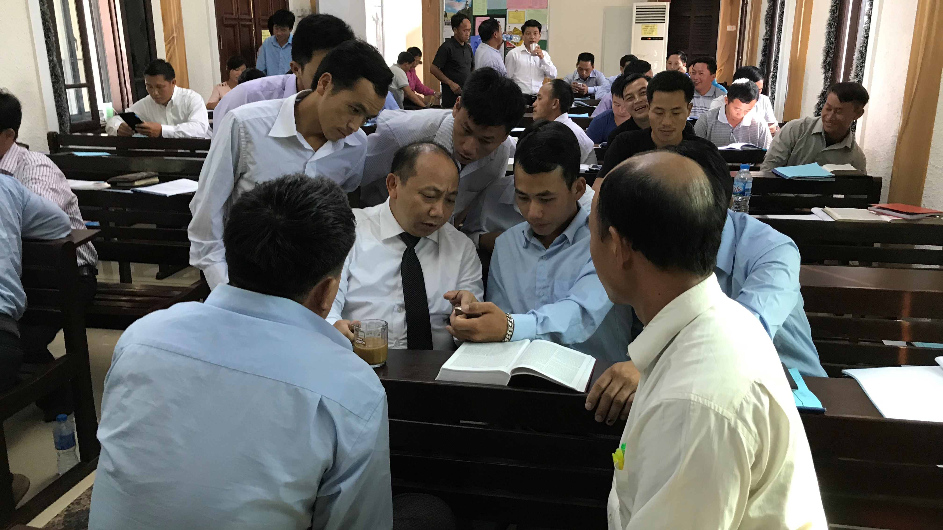
The HFC is thirsty for the gospel
60 leaders attend each training session in Hanoi

Slide 11
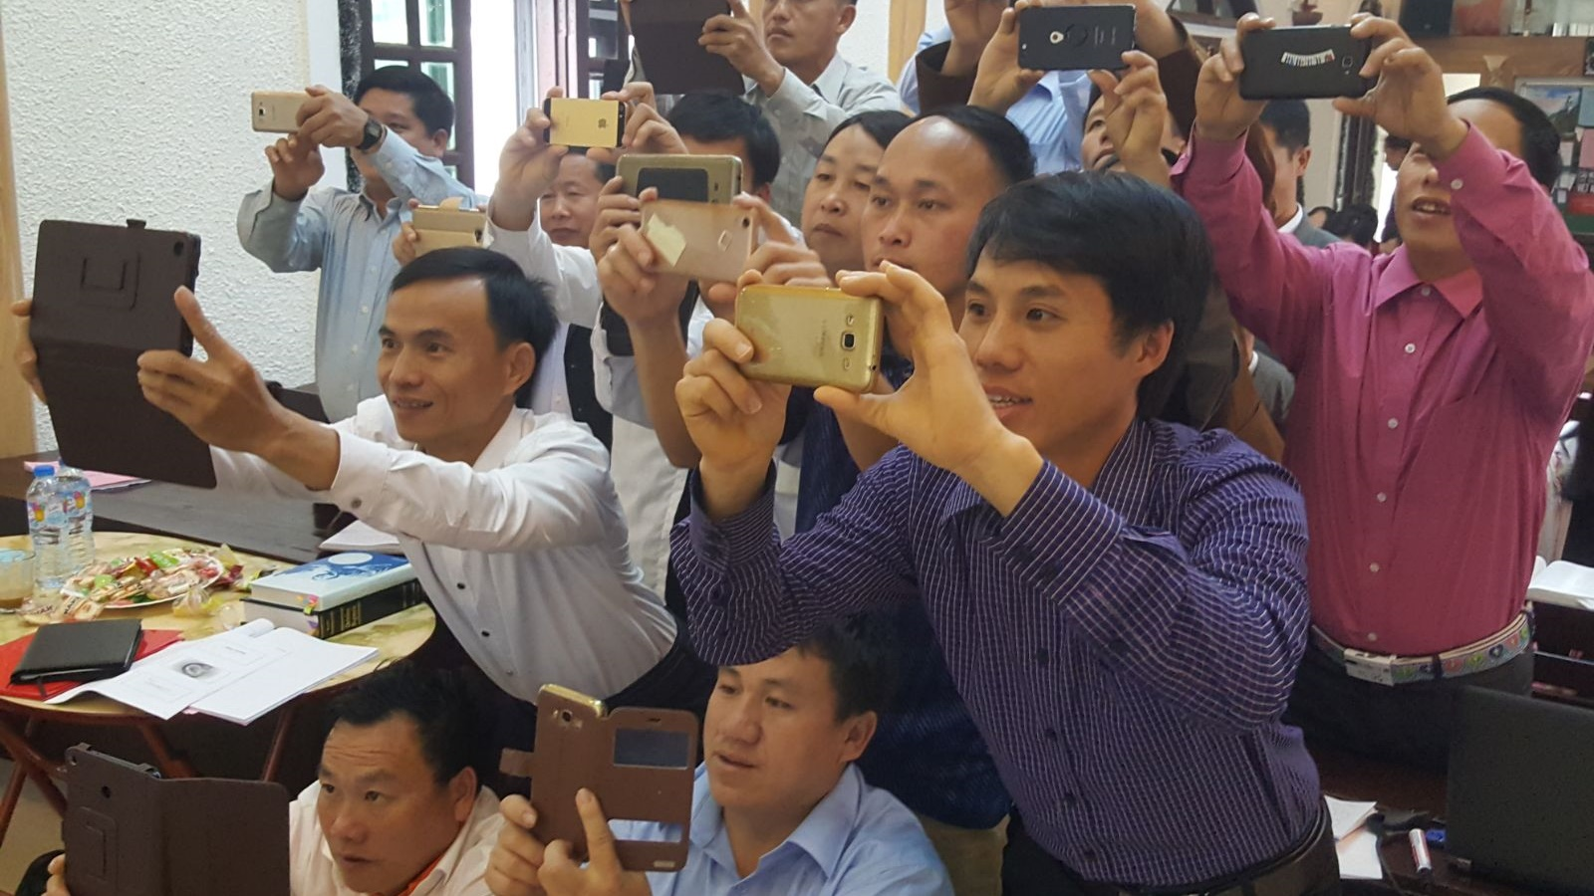
These 60 leaders take what they have learned back to their rural congregations
Notes:
Pictured: HFC leaders take photos of a whiteboard with Pastor Lor’s training notes on it.
A large focus of the current WELS training is how to share what they have learned with their members. Multi-Language Publications (MLP) is also working with the HFC to develop materials they can use to train their members.

Slide 12
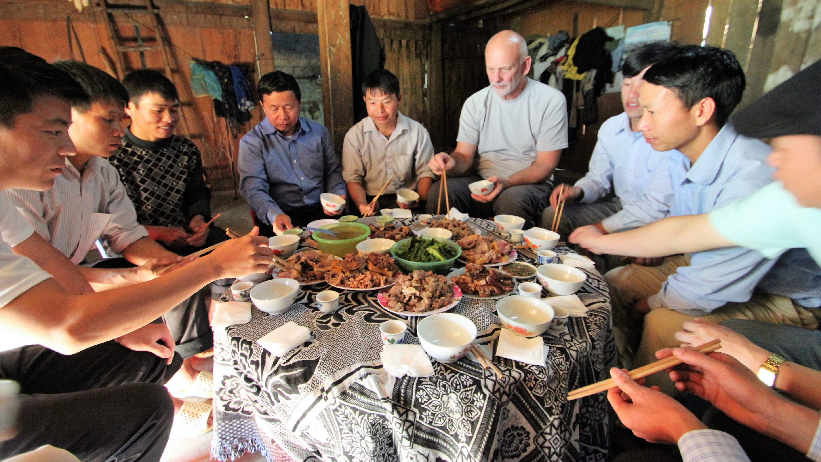
The Pastoral Studies Institute (PSI) was brought in to assist Lor in 2016
Notes:
Pictured: E. Allen Sorum, PSI Director, with a group of HFC leaders at dinner.
The Pastoral Studies Institute (PSI) of Wisconsin Lutheran Seminary, in partnership with WELS Joint Missions, guides and assists spiritual leaders around the globe through their pre-seminary and seminary training. The PSI connects with these spiritual leaders through WELS world mission work and through outreach to immigrants and refugees in the United States and Canada. They are able to evaluate and serve these international groups and synods that want support, training, and a connection to a church body that shares the gospel message in its truth and purity. The PSI also facilitates the opportunity for Wisconsin Lutheran Seminary professors to teach and consult on curriculum at seminaries and Bible Institutes around the world that are in fellowship with WELS.
In special circumstances, the PSI will also provide a flexible path to ministry for second-career students who are already active in their home congregation’s ministry and cannot relocate to attend Martin Luther College or Wisconsin Lutheran Seminary for their pre-seminary and seminary studies. The PSI’s distance learning approach is supported by the local pastor as mentor and “adjunct” instructor, and allows these men to complete their studies in their home setting.

Slide 13
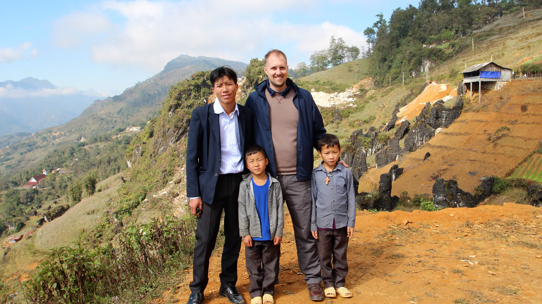
When PSI first visited in 2016, the HFC reported that their church had grown to 70,000 members
Notes:
Pictured: Rev. Jon Bare, International Recruitment Director from the Pastoral Studies Institute (PSI), with a rural pastor and his family.
Pastor Bare is working hand in hand with Pastor Lor to develop a training curriculum for the HFC.

Slide 14
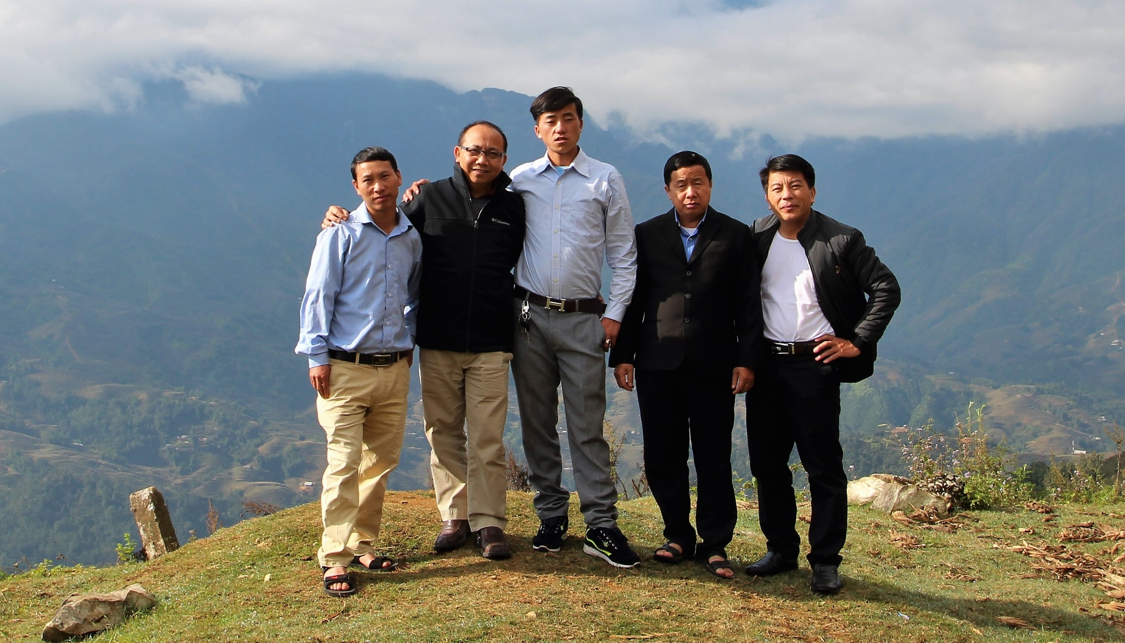
Lor was called to be full-time
Hmong Asia ministry coordinator in 2017
Notes:
Pictured: Rural HFC pastors with Lor (second from left) and Zang Lou (second from right)
Lor previously served Grace Hmong Lutheran Church in Kansas City, Kansas. From 2012-2017, Lor was conducting training in Vietnam and serving his congregation in Kansas City at the same time.

Slide 15
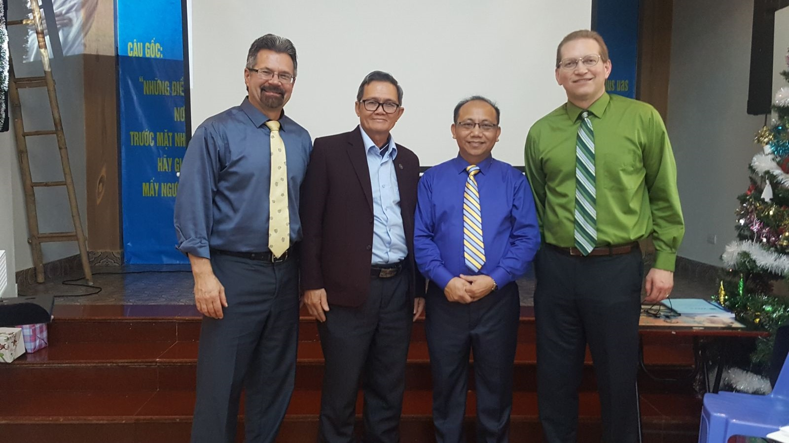
WELS Multi-Language Publications (MLP) was brought in to evaluate the types of materials needed by the HFC
Notes:
Pictured L to R: Rev. Terry Schultz (MLP Consultant), Rev. Huyen Huyenh Vu (Vietnamese Fellowship Church – VFC), Rev. Bounkeo Lor, Rev. Nate Seiltz (MLP Director)
Another trip is currently being planned by MLP for January 2019. WELS provides all of its training in Hmong, which is unique of Christian groups in Vietnam. Even when Anglo missionaries or pastor’s conduct training, Rev. Lor translates. All of the materials currently being used are written in or translated into the Hmong language.

Slide 16
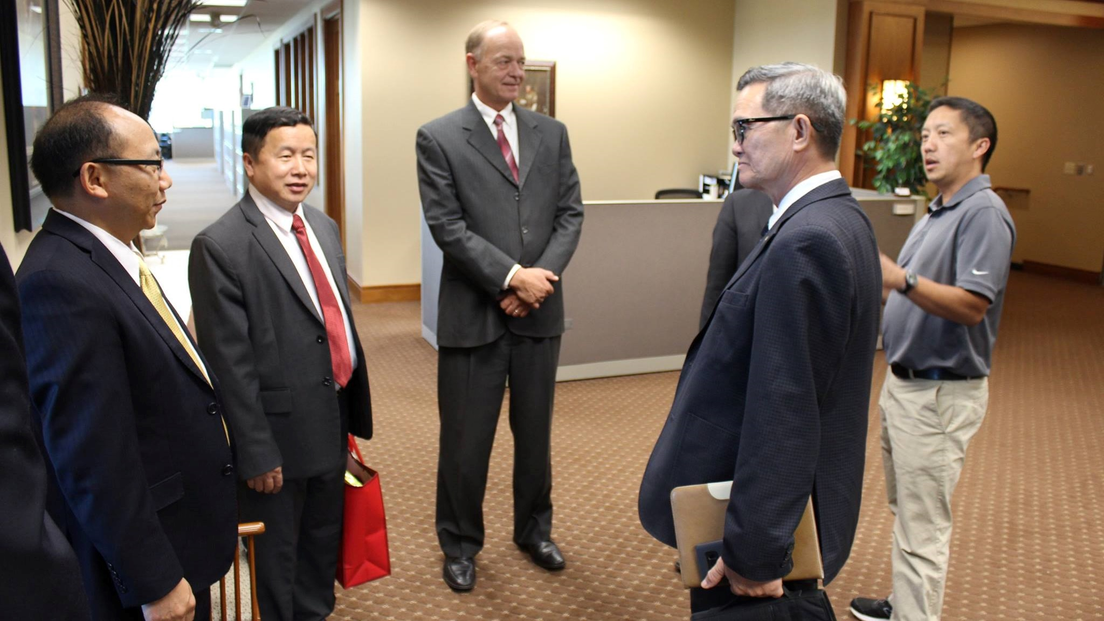
Members of the HFC and the Vietnamese Fellowship Church (VFC) traveled to the U.S. to learn more about WELS operations in August 2017
Notes:
Left to Right: Rev. Bounkeo Lor, Rev. Zang Lou (HFC), WELS President Mark Schroeder, Rev. Huyen Huyenh Vu (VFC), Mr. Jared Lor (CMM Employee)
The Vietnamese Fellowship Church (VFC) is the official Protestant church body recognized by the Vietnamese government. The VFC’s primary language is Vietnamese, so they welcome WELS efforts to train these Hmong-speaking church leaders of the HFC.
Leaders from the HFC travel to the United States to learn about WELS operations in August 2017. WELS welcomed them to the Center for Mission and Ministry in Waukesha, Wis., and Wisconsin Lutheran Seminary in Mequon, Wis., with other stops made along the way. This trip ensured the HFC and VFC leaders that WELS is a legitimate church body and passionate about the training efforts in Vietnam.

Slide 17
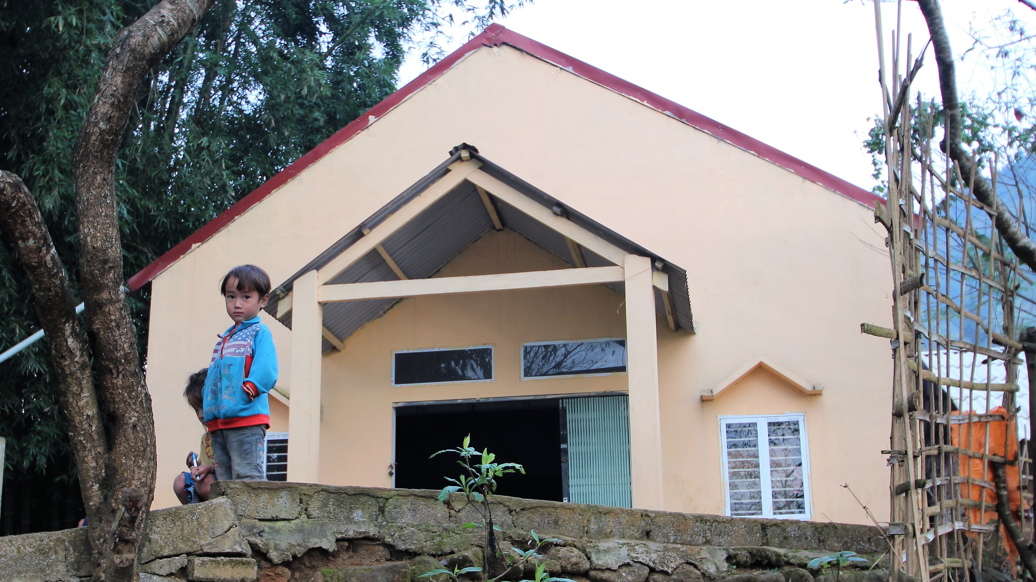
HFC leaders once fought over which man-made rules could earn people passage into heaven
Notes:
Due to their lack of training, pastors in the Hmong Fellowship Church held to a variety of interpretations of God’s word. Congregations and their pastors once fought over which man-made rules were god-pleasing and could earn people passage into heaven.

Slide 18
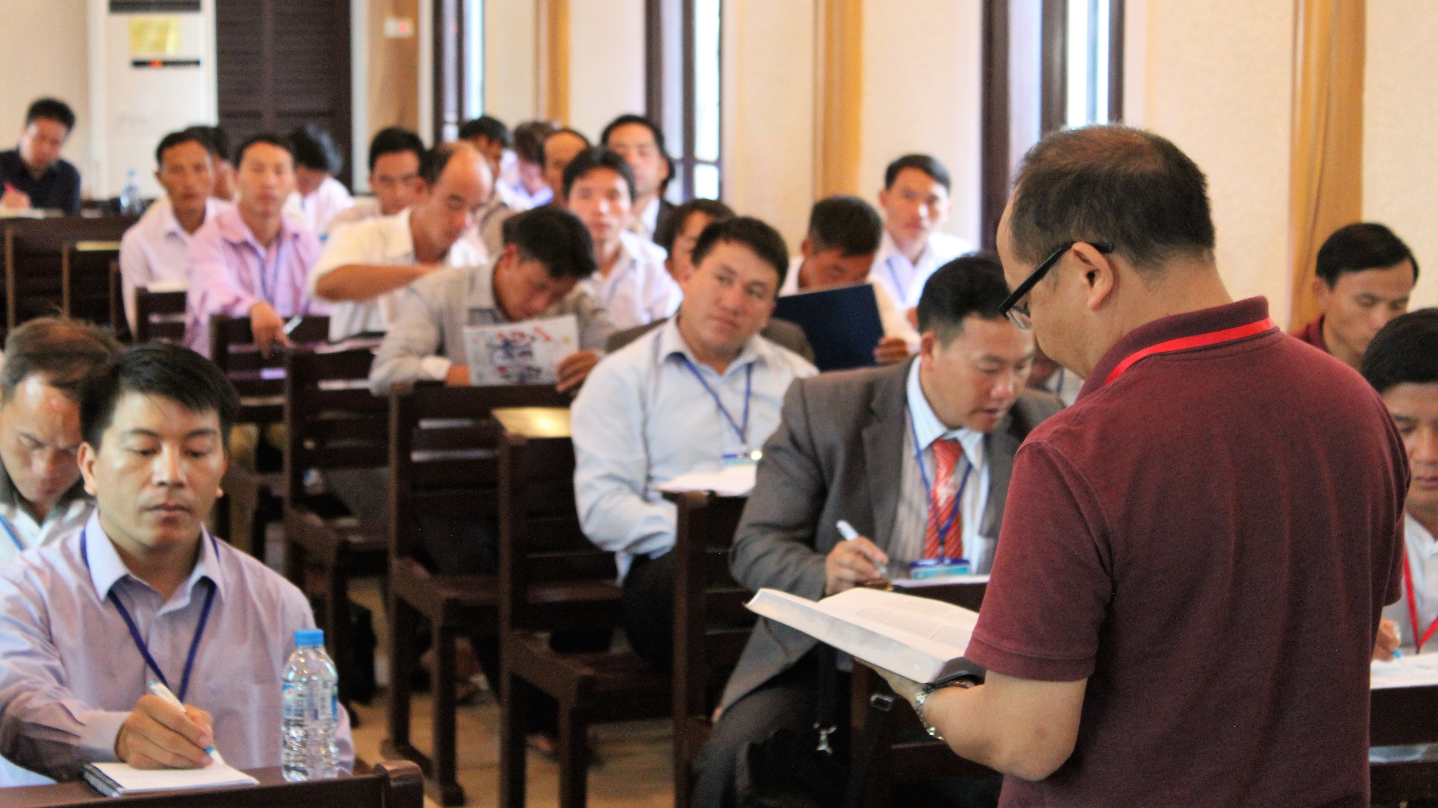
Now, the message of grace has brought peace to the Hmong Fellowship Church
Notes:
The freedom that comes from the gospel has changed the way they do ministry. The message of free grace received from Jesus Christ has replaced their old law-based preaching: Grace has brought peace to the Hmong Fellowship Church.

Slide 19
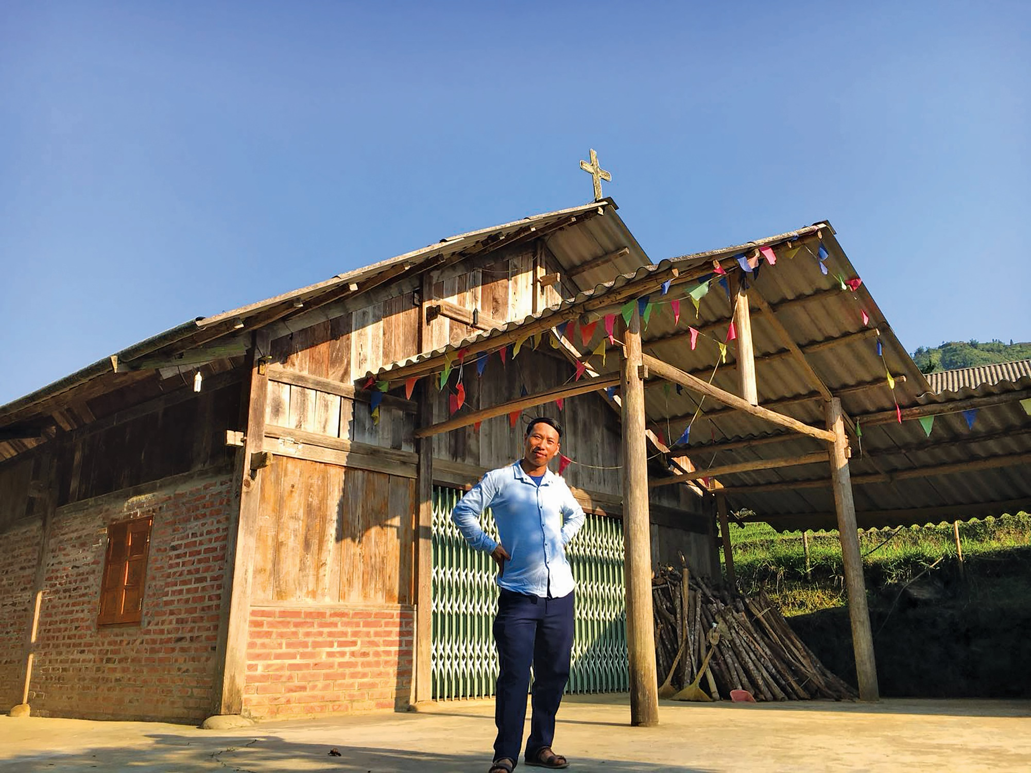
An incredible, unprecedented opportunity . . .
The communist Vietnamese government has invited WELS to build a theological training facility in Hanoi, Vietnam.
Notes:
The message of free grace received from Jesus Christ replaced the HFC’s old law-based preaching: Grace has brought peace to the Hmong Fellowship Church, and church leadership has stabilized as a result. The communist government in Vietnam has noticed this positive change and invited WELS to build a theological training facility in Hanoi, Vietnam. This invitation came in 2017.
This is an incredible, unprecedented opportunity for our synod. WELS is currently the only protestant church with official government permission to work with the Hmong in Vietnam. The Lord is opening a door to reach the more than two million Hmong people who live in Vietnam and the surrounding countries. However, this door can close at any time. Our WELS World Missions team is working quickly to ensure WELS is taking full advantage of the time the Lord has provided.

Slide 20
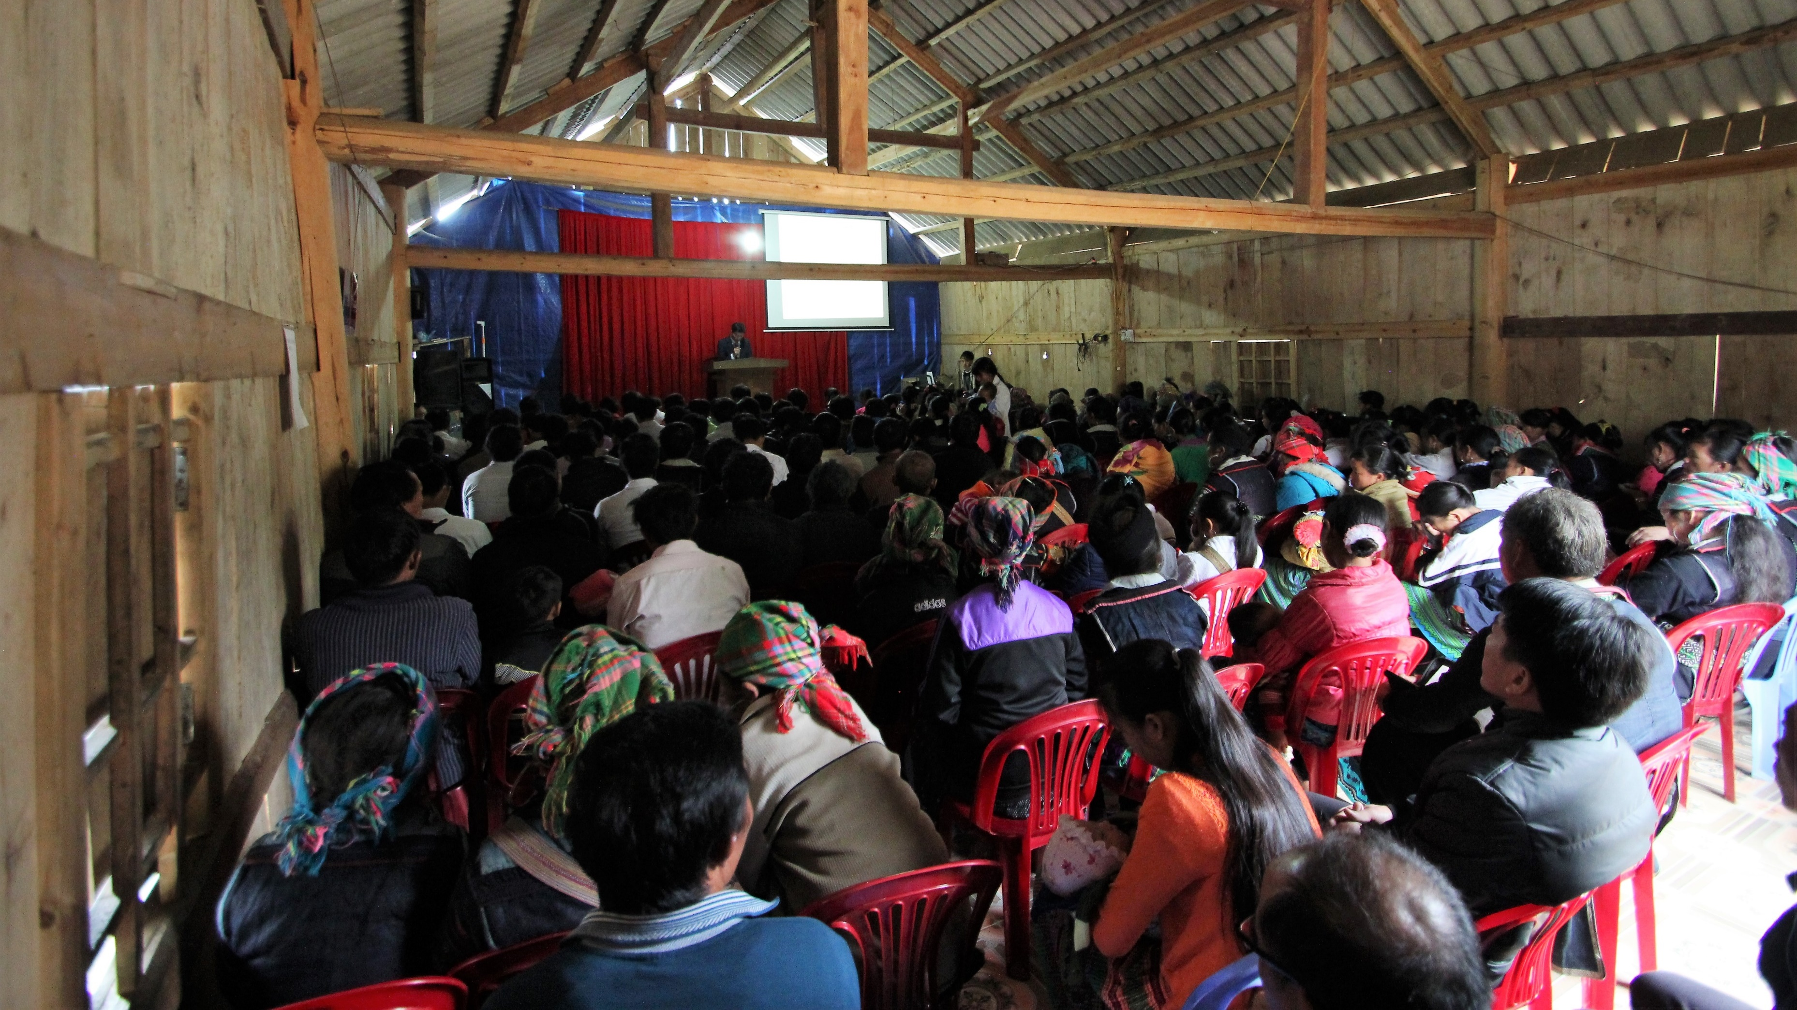
The Holy Spirit is working in the hearts of the Hmong people
The HFC now has more than 120,000 members
Notes:
In the years WELS has provided training, the HFC has grown from 55,000 to over 120,000 members and formed many new churches.
The HFC now has both physical and spiritual unity. Lutheran doctrine has brought peace and harmony to the people in the villages – and as a result, the members are sharing their faith and the churches are multiplying.
Pastor Ham, Chairman of the HFC, had this to say:
Personally, since I have been receiving training from the WELS, I see a change in myself as well. Before this, I taught and used my own authority in the church. At that time, I thought, “I’m the smart one – I’m the one with training, and I am the one with the authority. I can force my members to do the right thing.” But since I have been studying with the Lutheran Church, I have changed. I have reevaluated myself and how I taught in the past – and know that I have taught false teachings. The training made me value my members more – and know that they need the Gospel. I used to use the law to motivate my members. That was how I showed my authority. But since receiving this training, I now understand that the law won’t help the members. I started to share the Gospel and taught them to understand that the Gospel will motivate you to love and show care for each other. What I have noticed is that now my members respect me even more than they ever did when I only used the law, rules, and traditions to lead them.

Slide 21
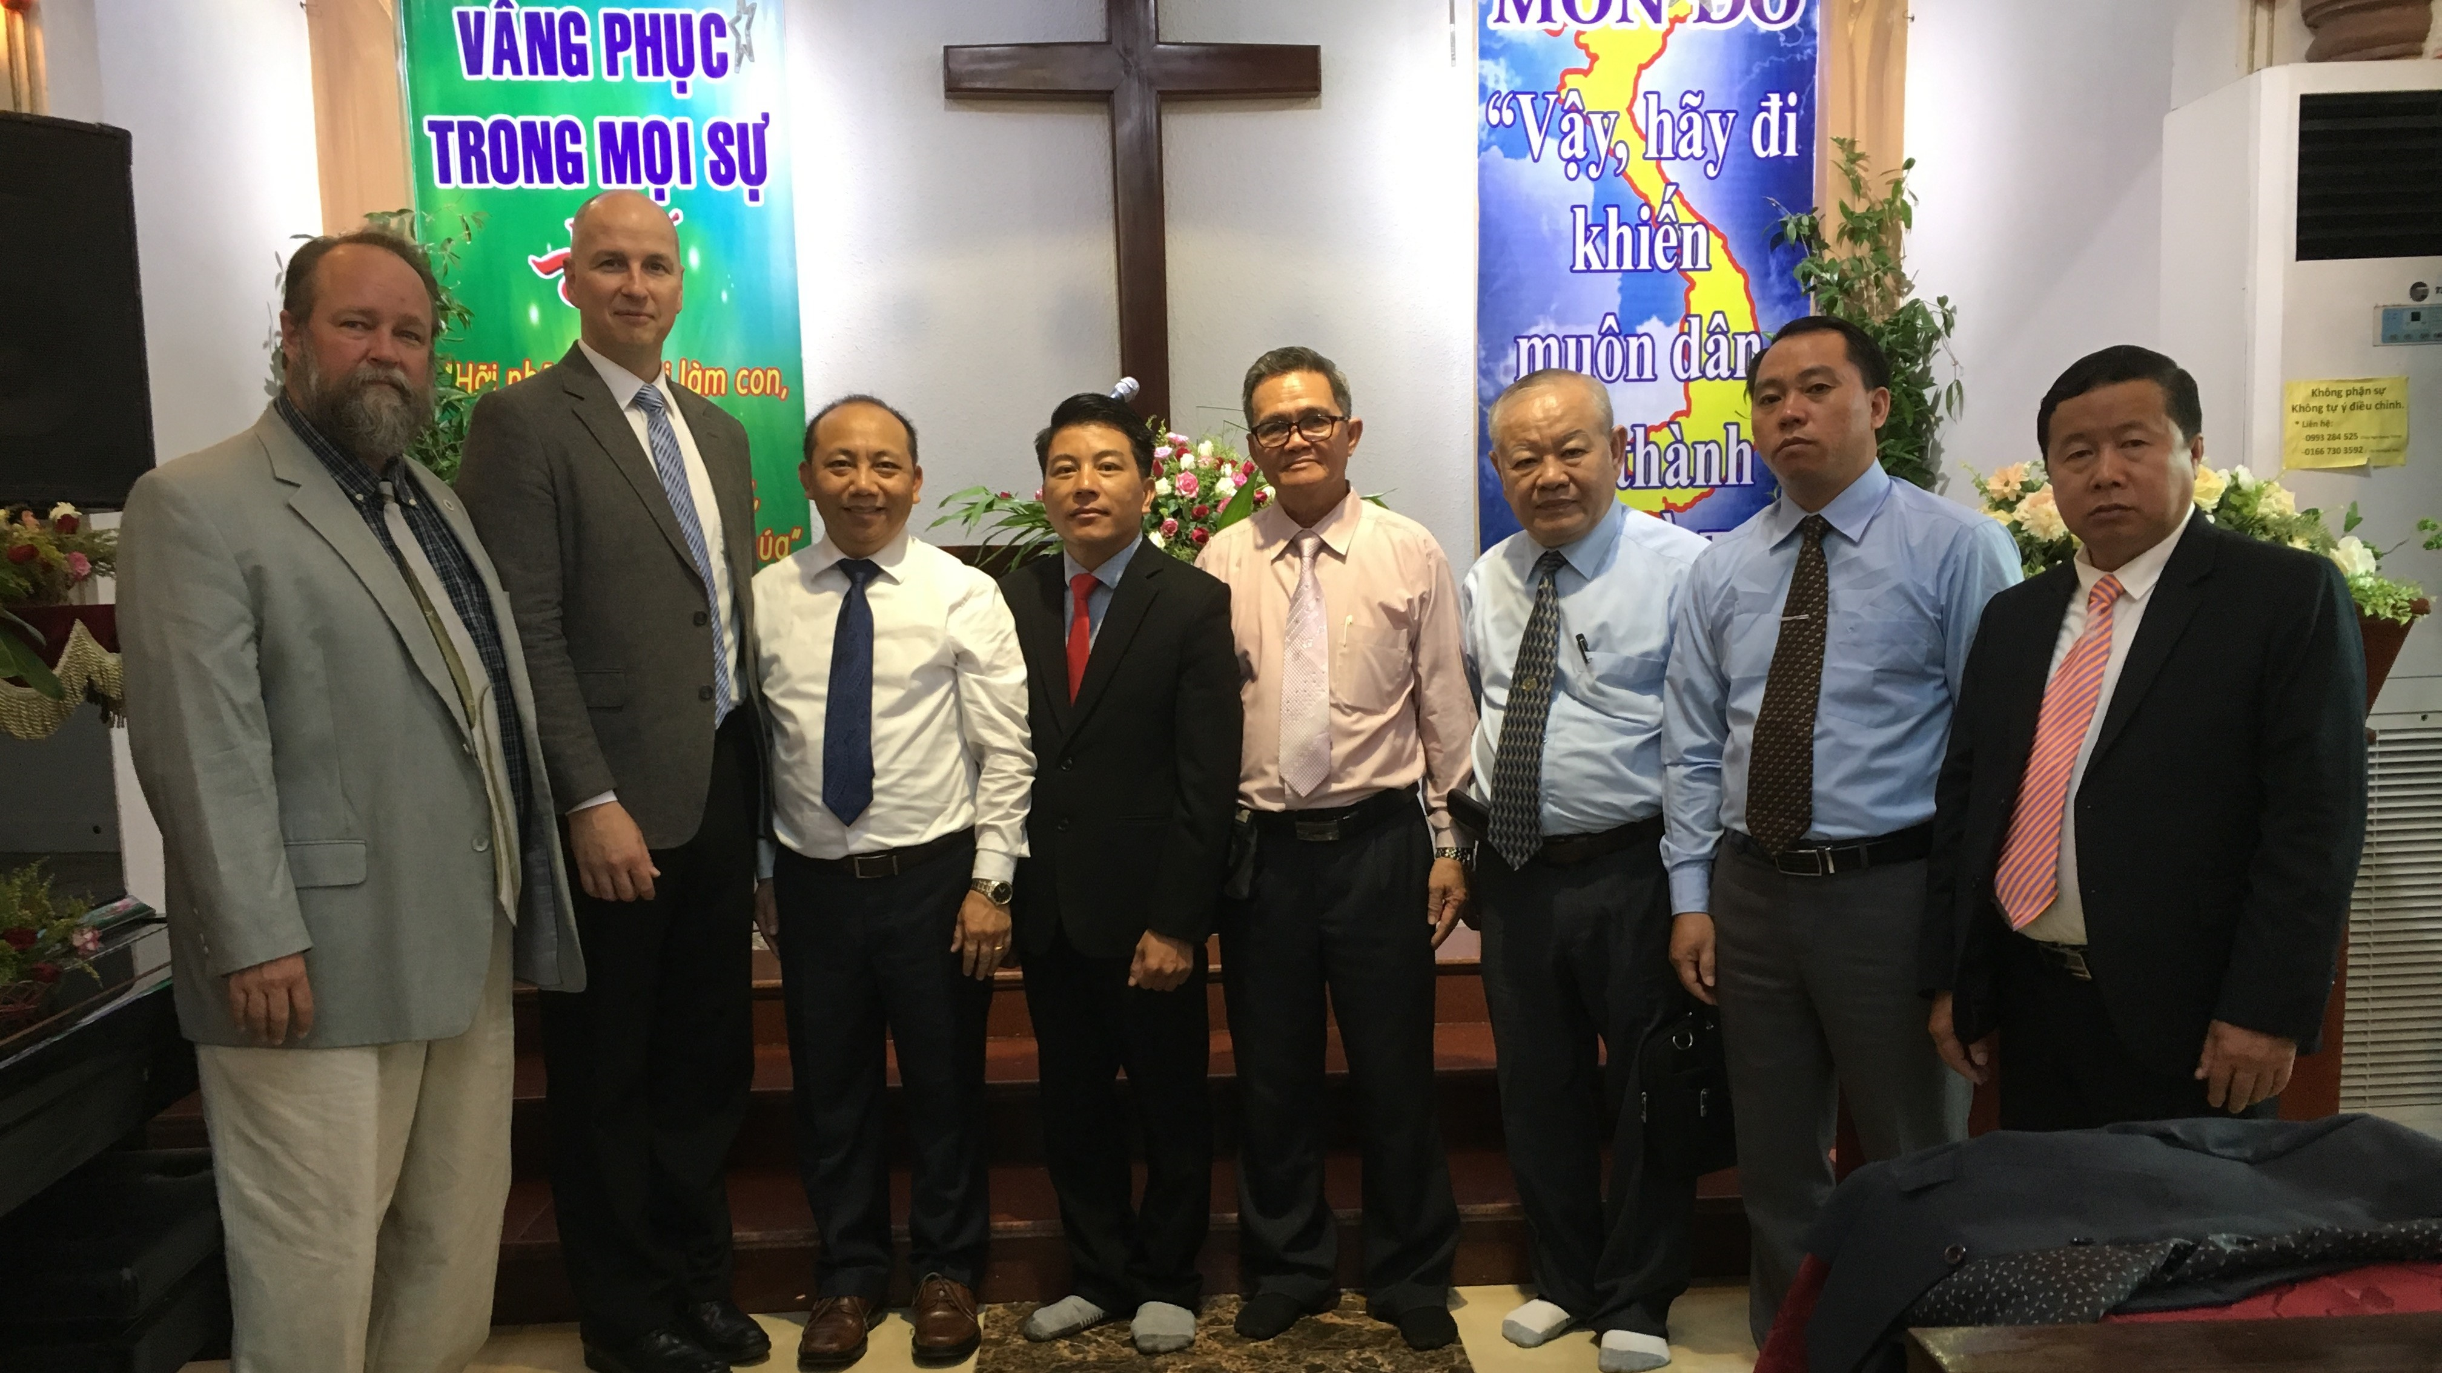
WELS Missions representatives visited Vietnam in 2018 to meet with HFC and VFC leadership and assess what is needed for a theological training facility
Notes:
Left to Right: Mr. Sean Young (WELS Director of Missions Operations), Rev. Larry Schlomer (WELS World Missions Administrator), Rev. Bounkeo Lor (Hmong Asia ministry coordinator), Rev. Pov Vaj (HFC), Rev. Huyen Huyenh Vu (Vietnamese Fellowship Church – VFC), Rev. Dinh Thien Tu (VFC Chairman), Rev. Ntsuabxwm Vaj (HFC), Rev. Zang Lou (HFC)

Slide 22
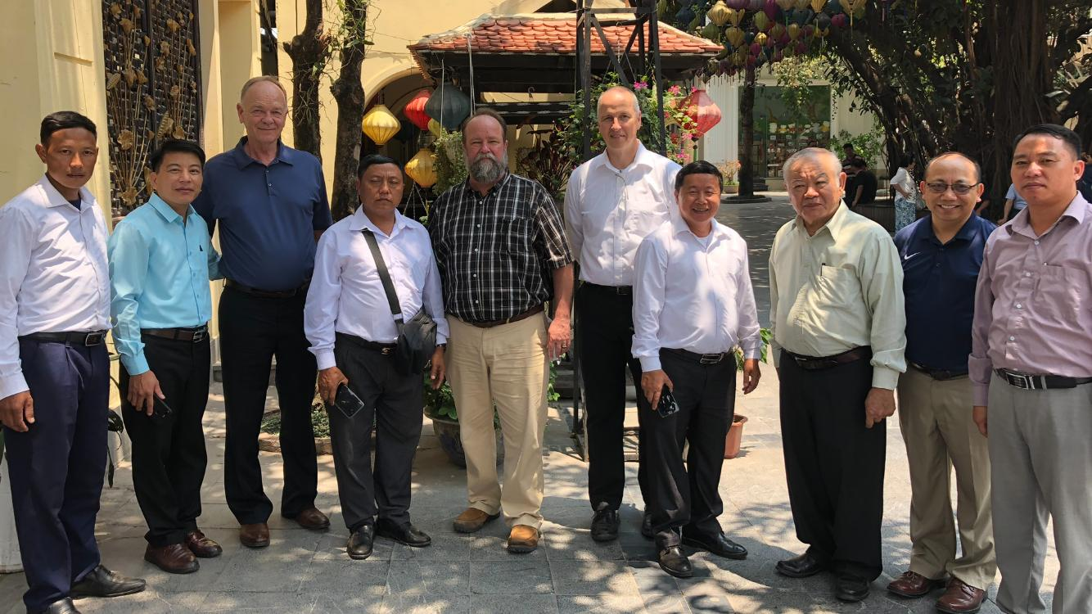
WELS President Mark Schroeder accompanied World Missions representatives to Vietnam in April 2019
Notes:
Left to Right: Hmong Fellowship Church (HFC) church leader, Rev. Pov Vaj (HFC), WELS President Mark Schroeder, Rev. Tsavxwm Ham (HFC Chairman), Mr. Sean Young (WELS Director of Missions Operations), Rev. Larry Schlomer (WELS World Missions Administrator), Rev. Zang Lou (HFC), Rev. Dinh Thien Tu (Vietnamese Fellowship Church – VFC Chairman), Rev. Bounkeo Lor (Hmong Asia ministry coordinator), and Rev. Ntsuabxwm Vaj (HFC).

Slide 23
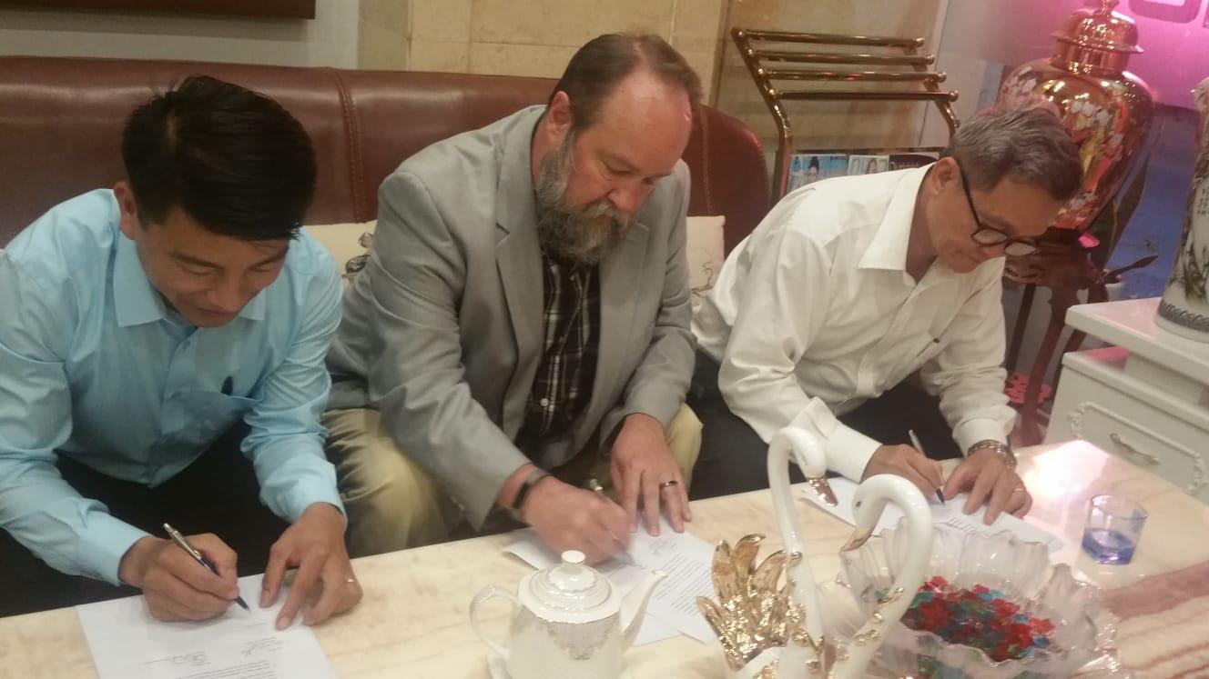
A huge step forward: A Memorandum of Understanding (MOU) was signed by WELS and Vietnamese Fellowship Church representatives in April 2019
Notes:
On April 24, 2019, WELS President Mark Schroeder, World Missions Administrator Rev. Larry Schlomer, and Director of Missions Operations Mr. Sean Young checked in after their first full day in Hanoi, Vietnam, with exciting news to report: After surveying the land chosen for the theological education center, a memorandum of understanding was signed by WELS and Vietnamese Fellowship Church (VFC) representatives confirming we can move forward with all land purchase, construction, and training plans.
This is a huge step forward as we continue to train the leaders of the Hmong Fellowship Church in the truths of the gospel.

Slide 24
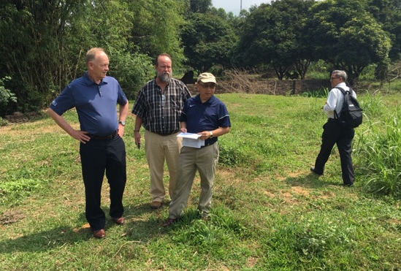
Surveying the land chosen for the theological training facility in Hanoi, Vietnam

Slide 25
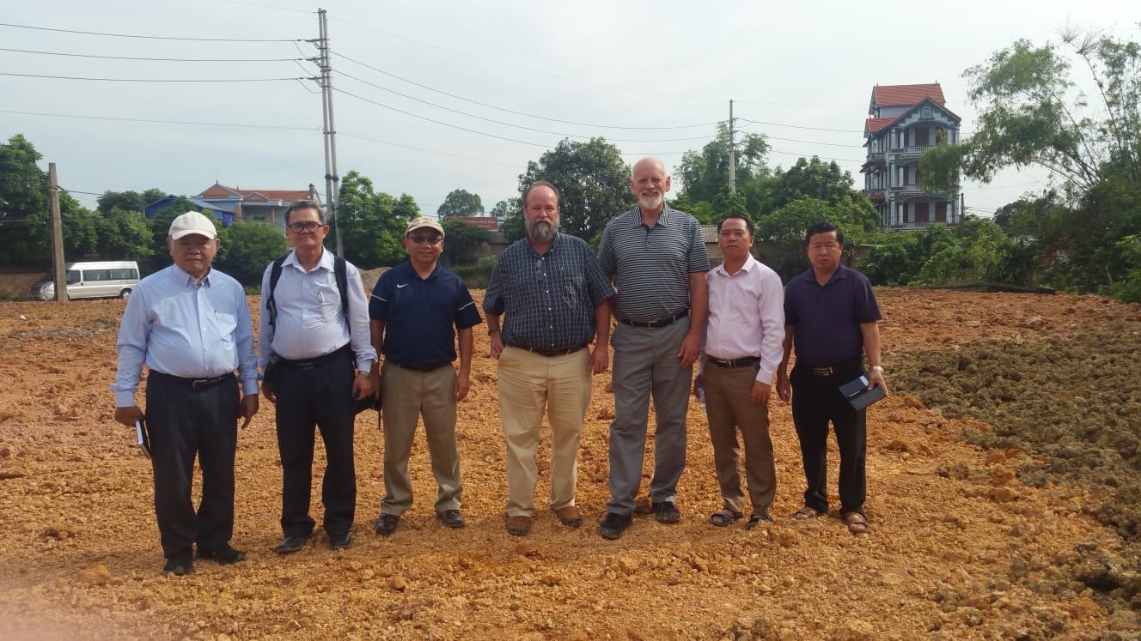
Land has been cleared and construction negotiations are currently underway

Slide 26
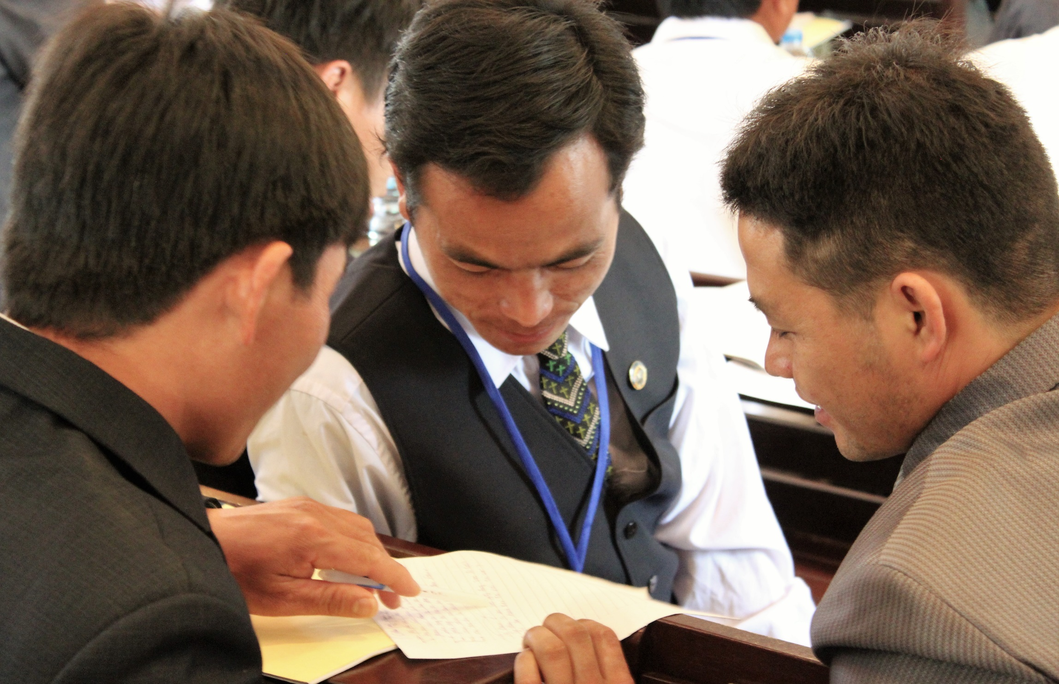
350 HFC pastors are ready to begin their seminary-level education
2,500 additional HFC leaders will receive catechism training through regional seminars and special courses held at the facility in Hanoi
Notes:
Thanks to WELS training efforts by Rev. Lor, visiting Anglo pastors, and the Pastoral Studies Institute (PSI), there are 350 HFC pastors who are ready to begin their seminary-level education. An additional 2,500 HFC church leaders will receive catechism training through regional seminars and special courses held at the facility in Hanoi. These courses will also train church leaders on how to instruct others within their rural congregations on the basic truths of the Bible. The goal is that all members of the HFC gain a basic knowledge of Bible doctrine, especially law and gospel, as quickly as possible.
The strength of the HFC’s current structure and organization will be a great benefit moving forward, as WELS Missions representatives are confident that what is taught to HFC pastors will be passed down to all the congregations by their own trusted leaders.

Slide 27
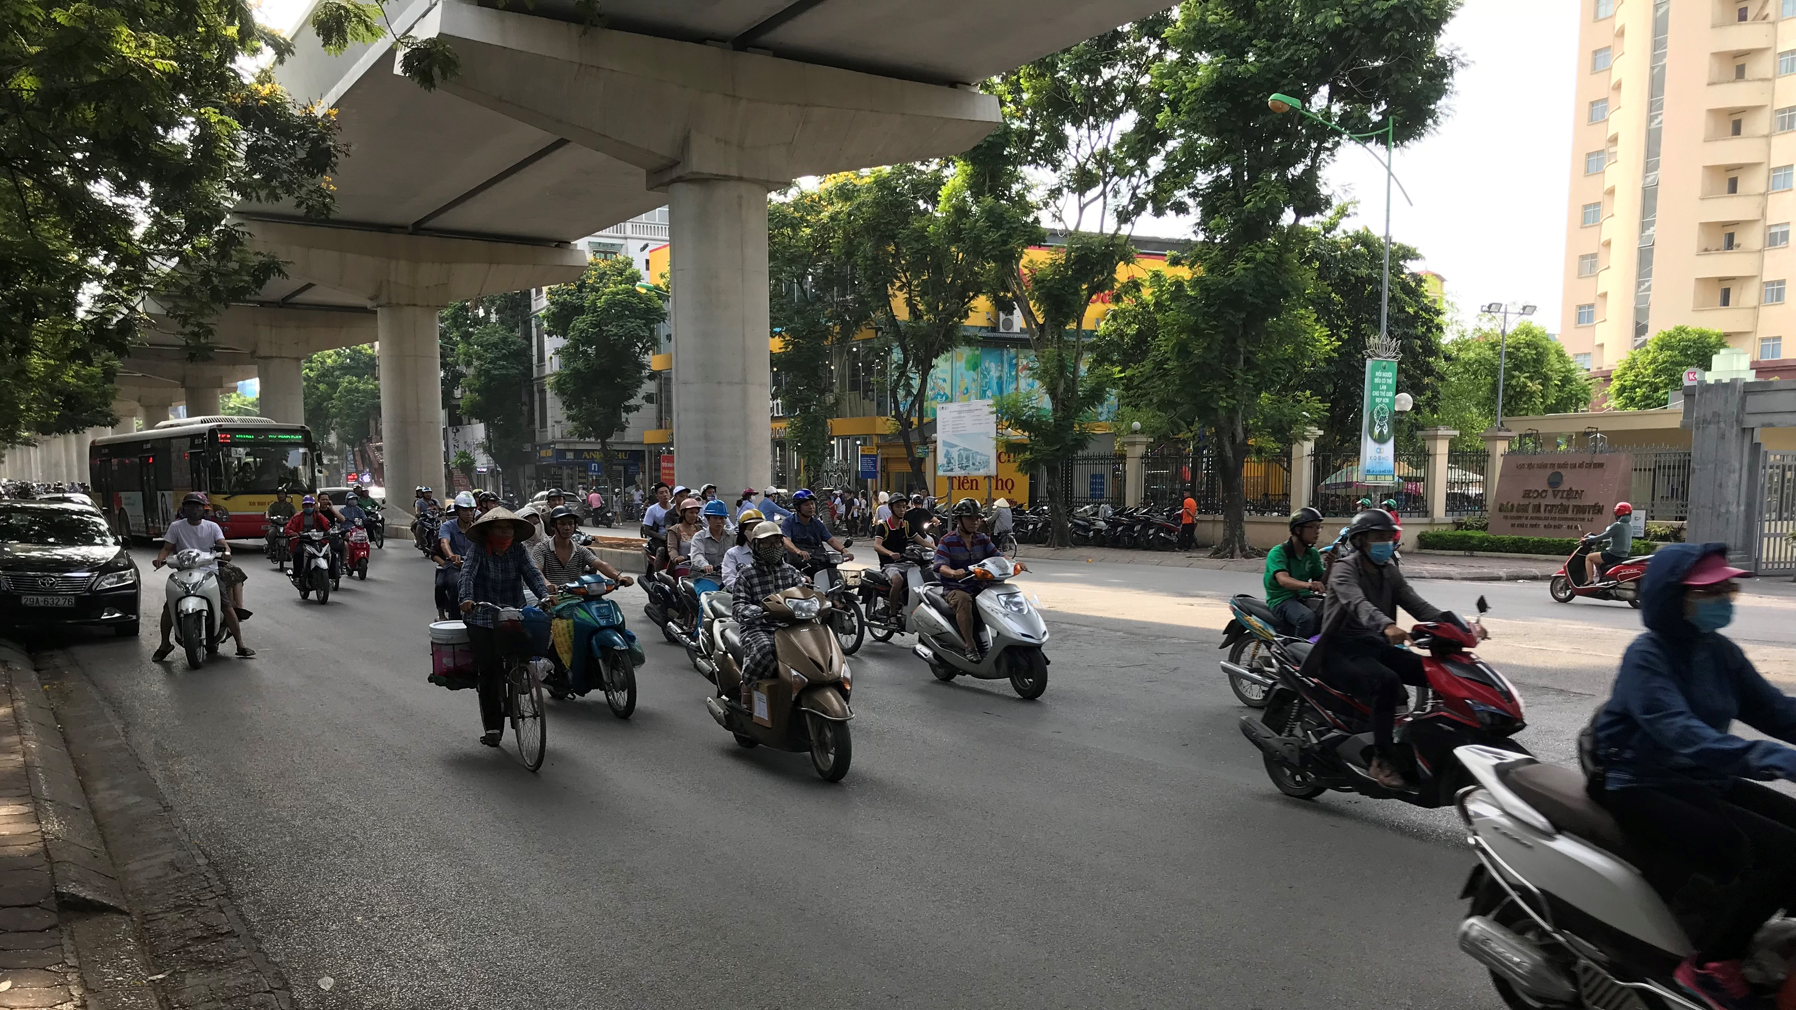
The theological training facility will be based in Hanoi, a central location for all HFC leaders
Notes:
Pictured: A typical city street in Hanoi
Land Purchase:
The Vietnamese government is allowing WELS to purchase land through the Vietnamese Fellowship Church in the capital city of Hanoi. This central location is ideal, as Hmong leaders travel from both the north and south to receive training.

Slide 28
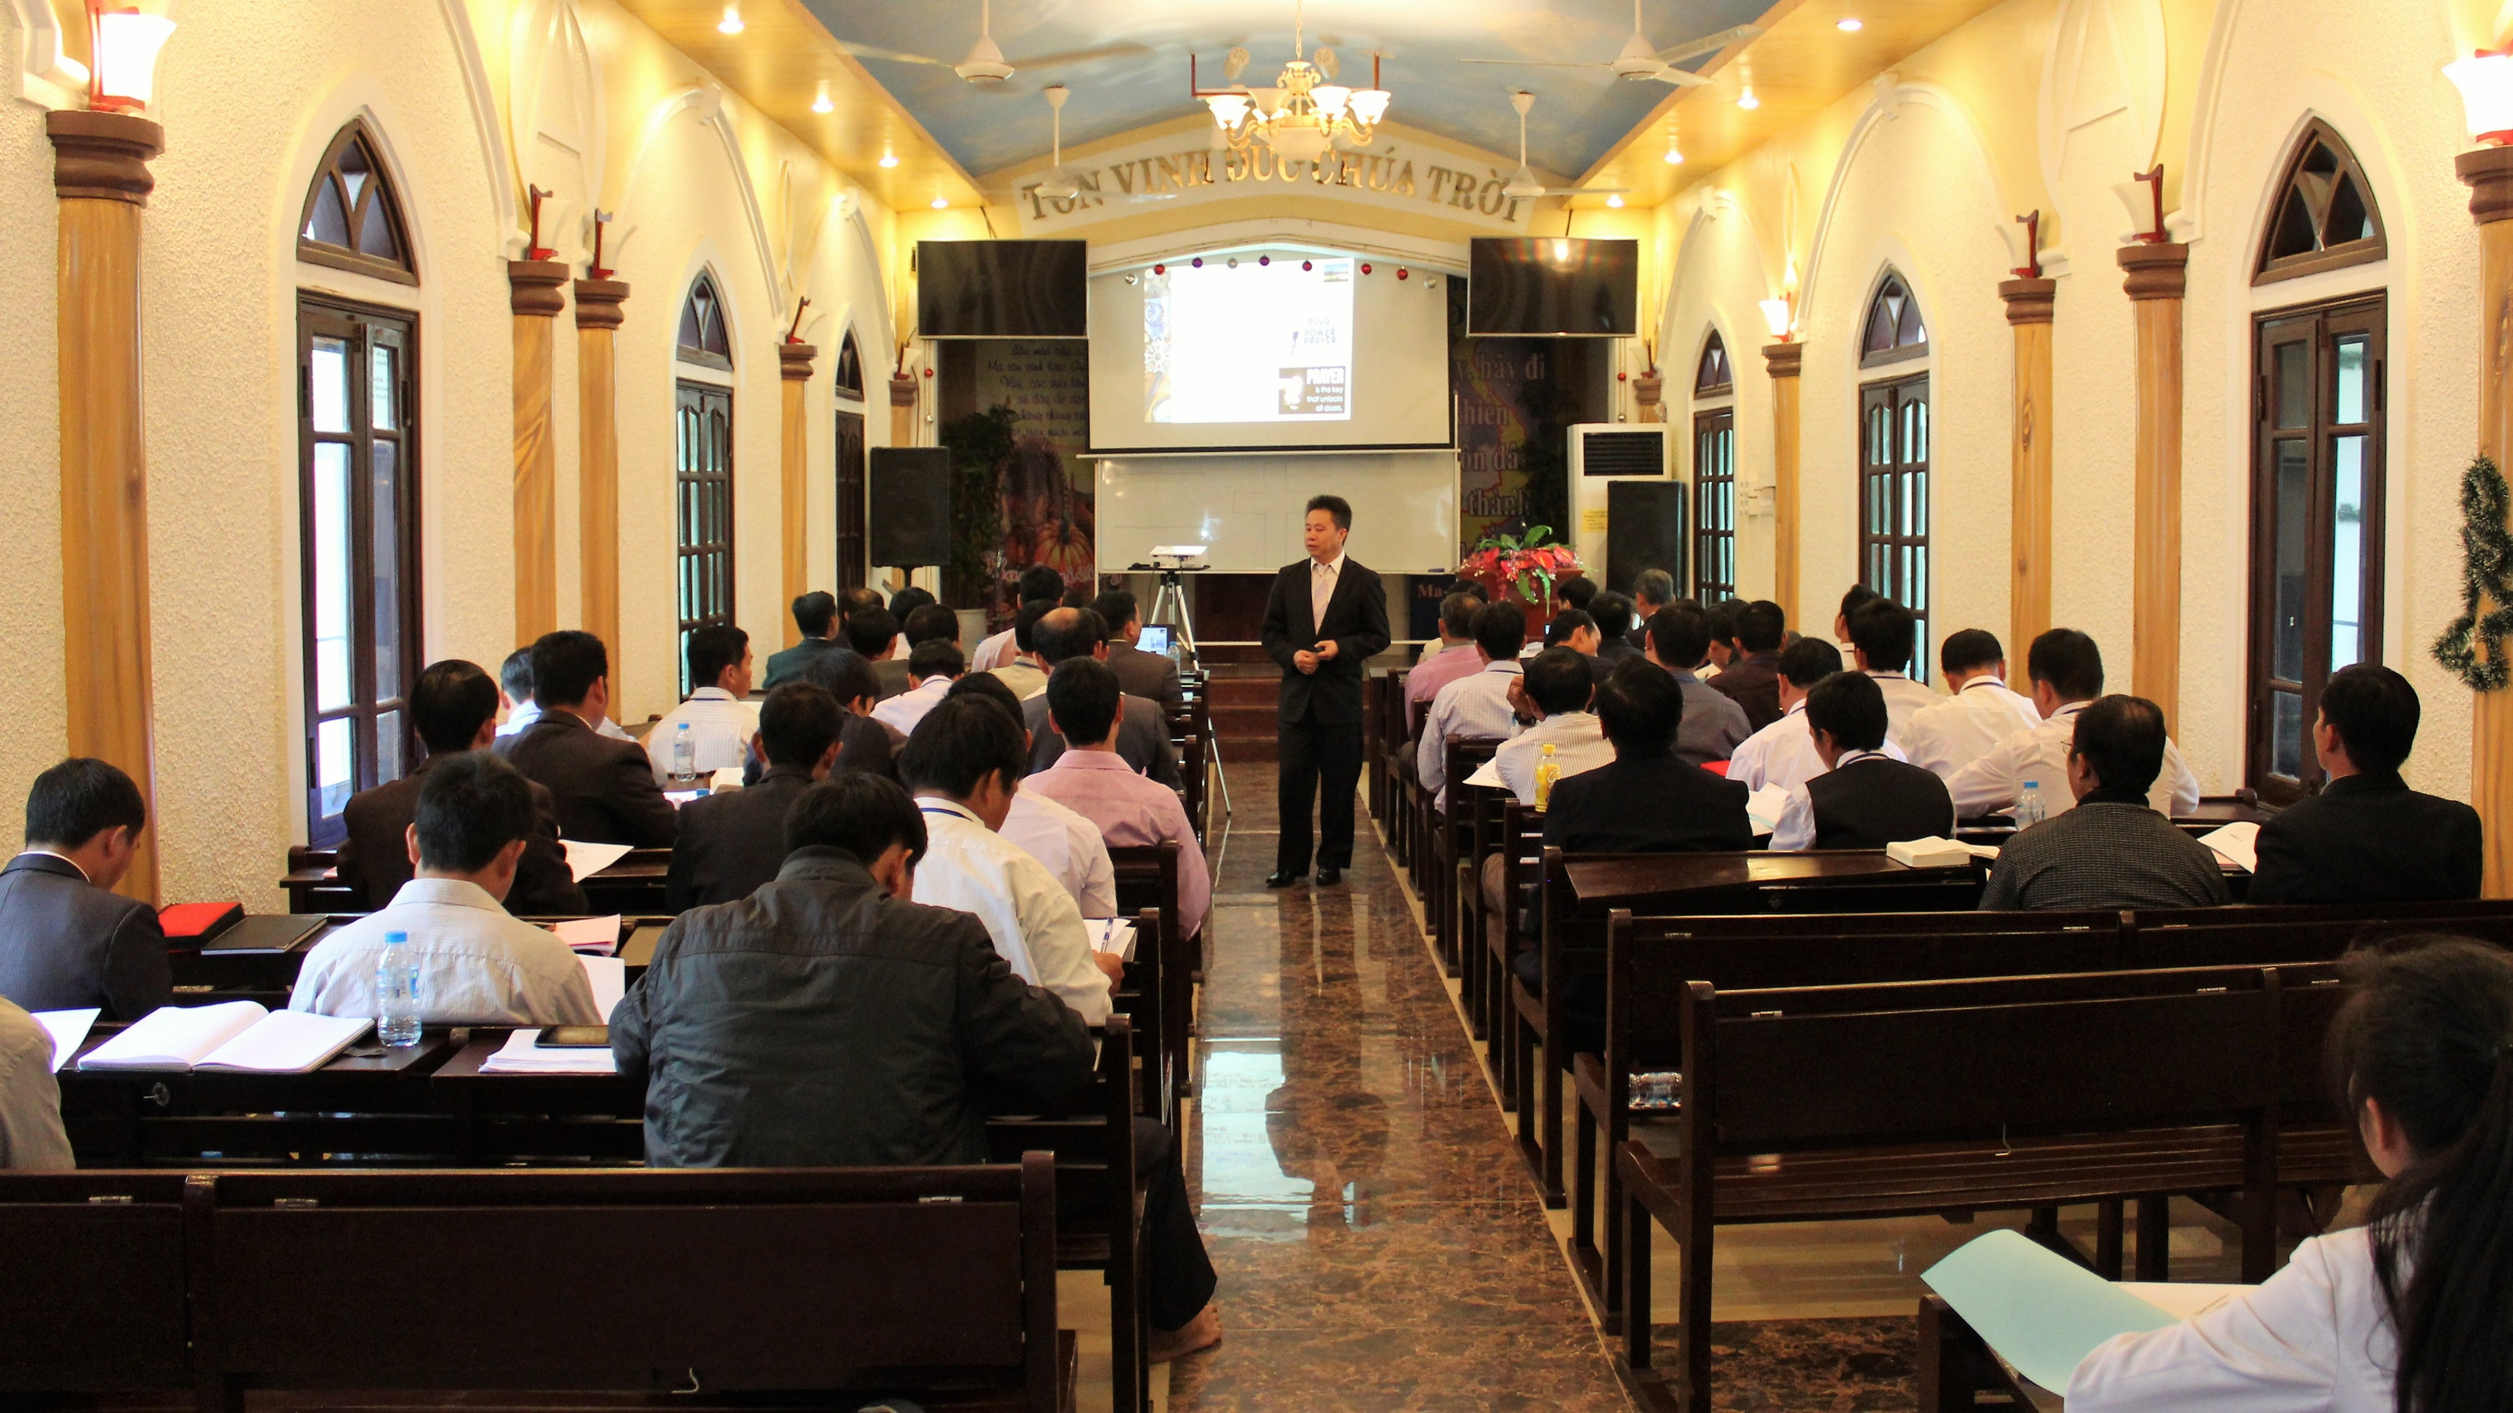
The new facility would include a worship space, dormitories and kitchen facilities for 60 people, ministry offices for leaders of the HFC, and classrooms
Notes:
Building Construction:
The current training being conducted is occurring in a chapel owned and operated by the Vietnamese Fellowship Church (pictured). By building a new facility specifically for the HFC, WELS would not need to compete for space with other VFC churches. The new campus would include a worship space, dormitories and kitchen facilities that can accommodate 60 students at a time, ministry offices for leaders of the HFC, and four other classrooms for training.

Slide 29
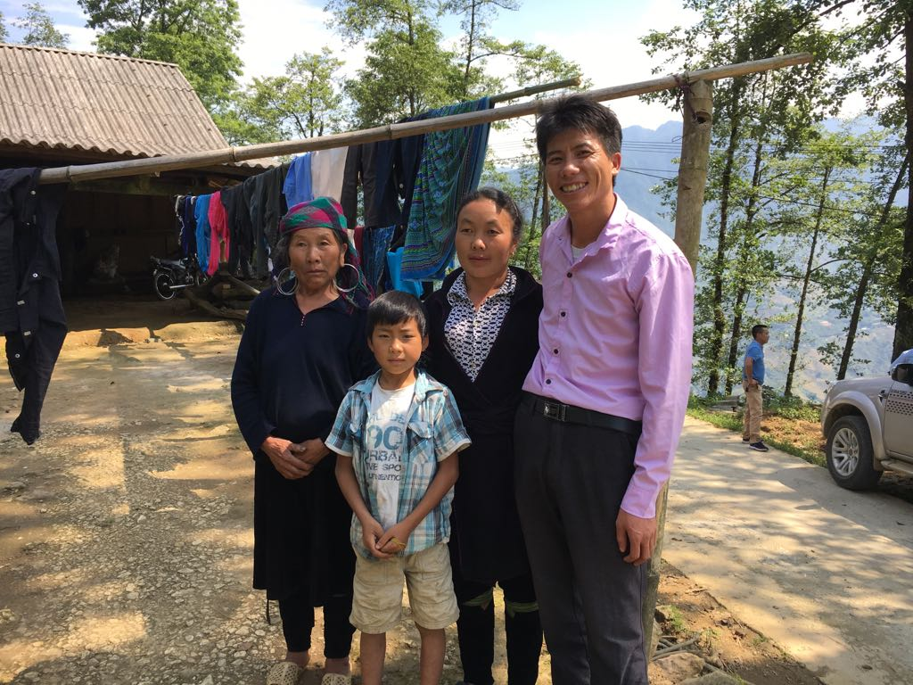
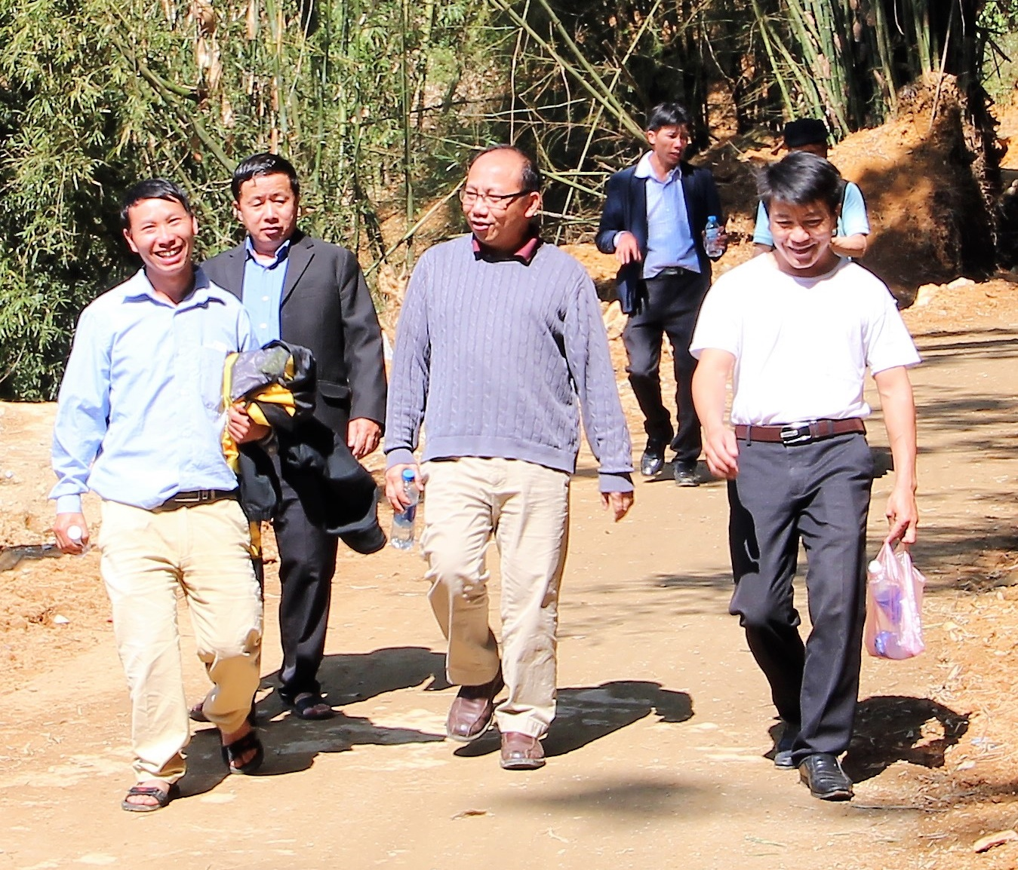
Operational costs will include salaries, living and travel costs for rural church leaders, and travel expenses for regional seminars throughout Vietnam
Notes:
Initial two years of operational costs: $1,000,000
These operational costs include $50,000 in one-time expenses needed to furnish the facility. Ongoing operational costs will include salaries for three resident WELS missionaries, five local leaders of the Hmong Fellowship Church who will be based in Hanoi, two translators, and six local administrative and facility support people. Other large ongoing expenses will be the living and travel costs for the hundreds of rural church leaders who will rotate through the training center on an annual basis, and the travel expenses incurred when top HFC leaders conduct regional seminars in the nine districts throughout Vietnam.

Slide 30
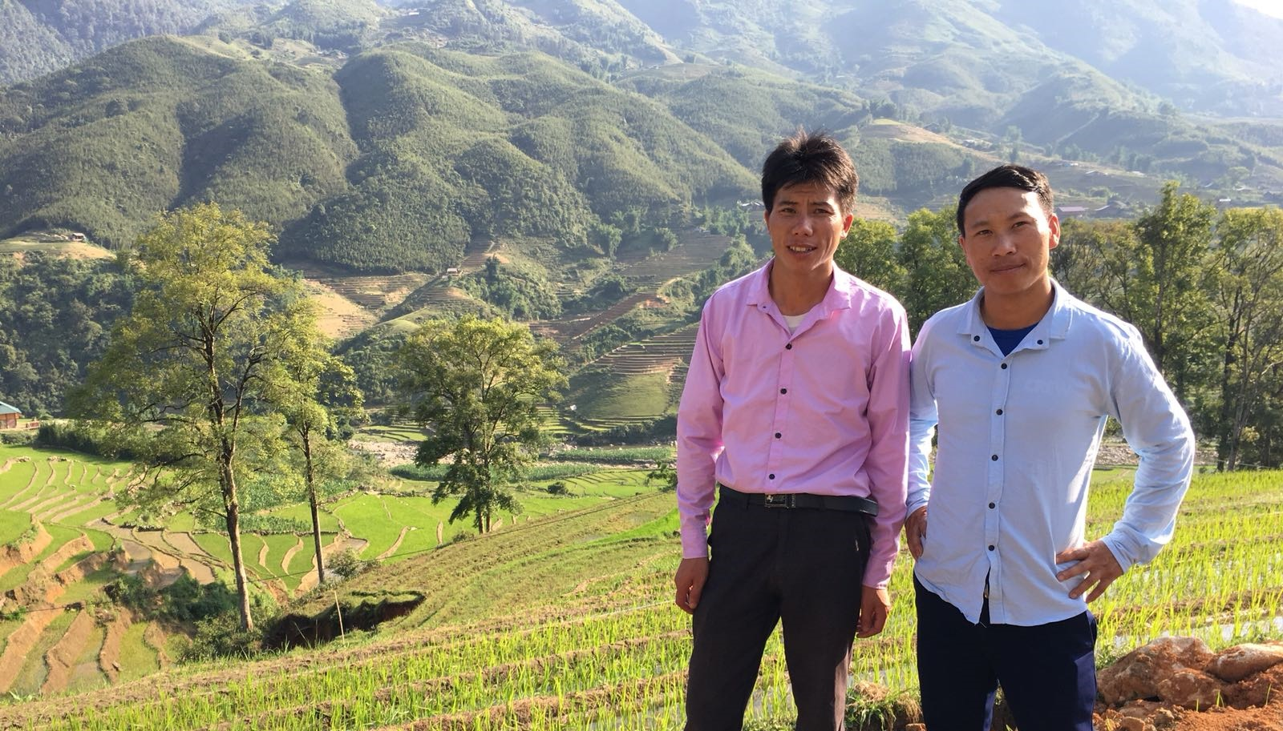
In December 2018, WELS began collecting a special offering to raise $2 million for the facility and operations
Notes:
Pictured: Two rural HFC pastors stand in front of their farm fields
This special offering will be taken December 2018 – June 2019. The goal of the “Grace—Hmong outreach in Vietnam” offering is to receive gifts totaling $2 million by June 30, 2019, to fund the land purchase, building construction, and the first two years of operational costs for a theological training facility in Hanoi, Vietnam.
Congregations may want to consider setting a goal for this special offering, which is envisioned to be in addition to their Congregation Mission Offerings (CMO):
Based on the WELS 2017 Statistical Report, if each congregation would set aside one percent of its annual offerings received for “Grace—Hmong outreach in Vietnam,” we would surpass the goal
The $2 million goal is roughly 10 percent of the $21 million committed as CMO subscriptions. Therefore, a congregation might consider a goal of 10 percent of the amount they have committed to WELS for their CMO.

Slide 31

Through the support and prayers of WELS members, WELS has surpassed its goal!
Notes:
Through the support and prayers of WELS members, WELS has surpassed its goal of receiving $2 million to support a theological education facility in Vietnam. This funding will pay for the land, building construction, and the first two years of operating expenses.
So far, land has already been purchased in Vietnam, and plans are being made for construction to begin on a new campus that will include a worship space, dormitories and kitchen facilities, ministry offices, and four classrooms. To date, more than 550 WELS congregations have given offerings to this campaign, and another 2,300 individuals and groups have offered special gifts or commitments.
For more information, visit https://wels.net/funding-secured-for-theological-education-facility-in-vietnam/

Slide 32
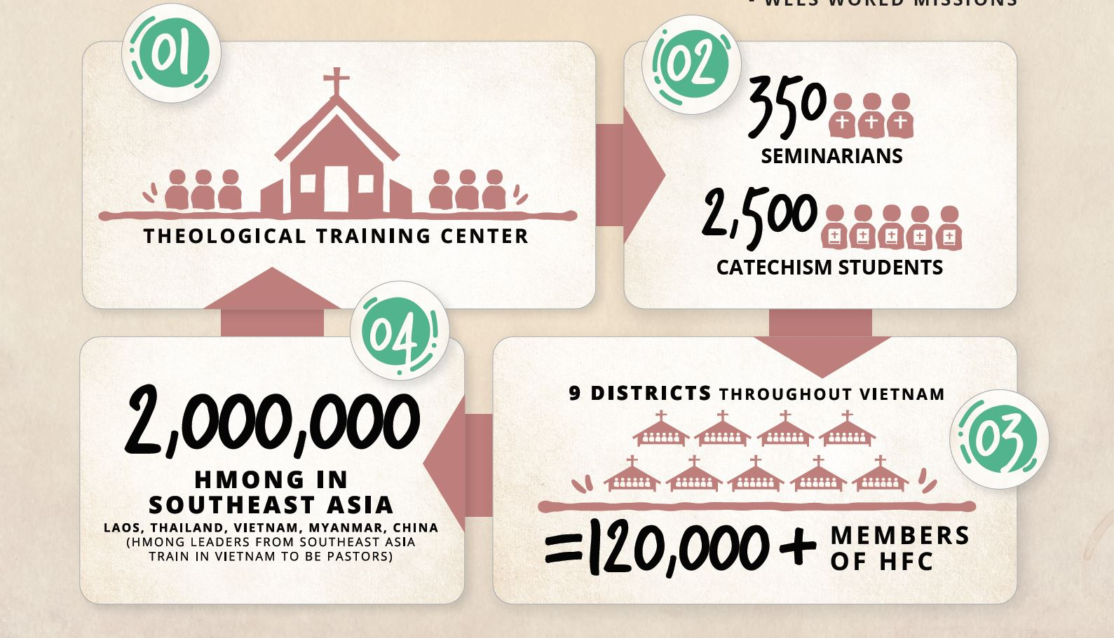
Notes:
This is just the! beginning. There are more than 120,000 members of the Hmong Fellowship Church in Vietnam and 2 million Hmong people throughout Southeast Asia. Imagine what the Holy Spirit can accomplish through the 2,800+ pastors and leaders who will be equipped to share the truth of God’s grace with their Hmong brothers and sisters. Rejoice with us as we watch the Holy Spirit change earthly lives and open the door to eternal life in Jesus for our Hmong brothers and sisters on the other side of the world

Slide 33
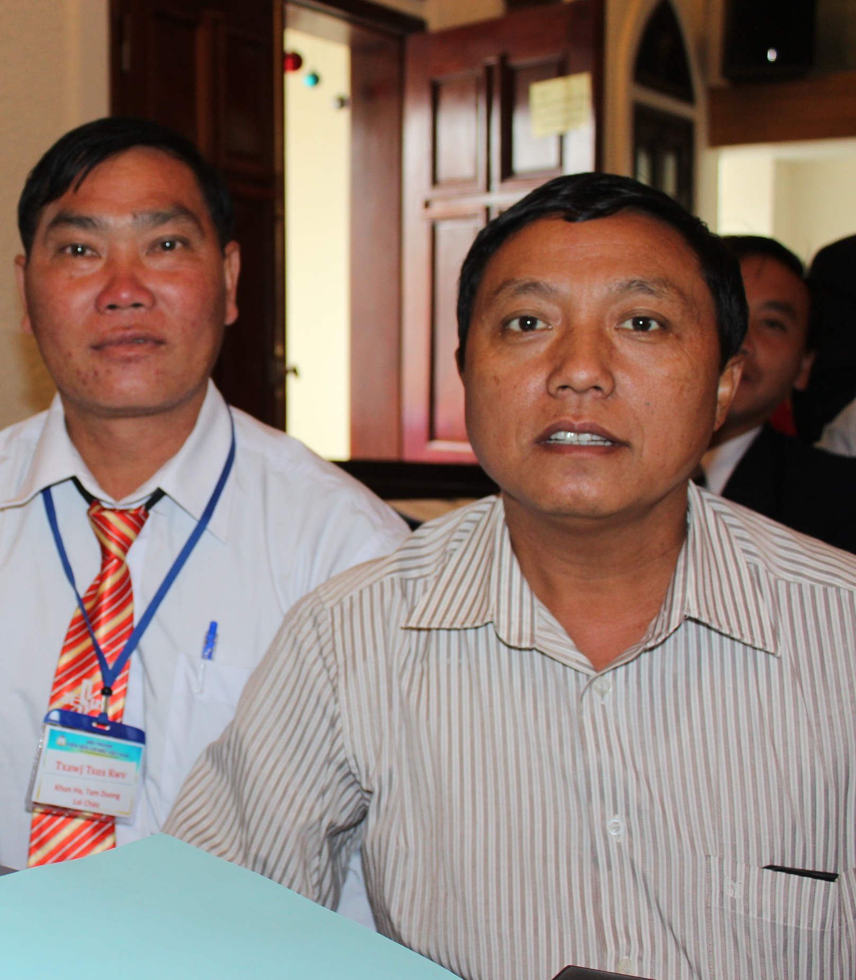
I don’t have anything to send to my WELS brothers and sisters in the US to even begin to show our gratitude or appreciation. All we can send is our ‘empty’ words of Thank You to you. But we are thankful. We trust that in the future the training will continue to equip leaders so that the gospel will spread to many more throughout Vietnam. Pray for us. Pray for our religious freedom in this country, especially for the Hmong in the rural areas. And pray that the many minority people will have the opportunity to hear the gospel and believe it.
Pastor Tsavxwm Ham, Chairman of the HFC
Notes:
Read Pastor Tsavxwm Ham’s full testimonial here: https://wels.net/pastor-ham/

Slide 34
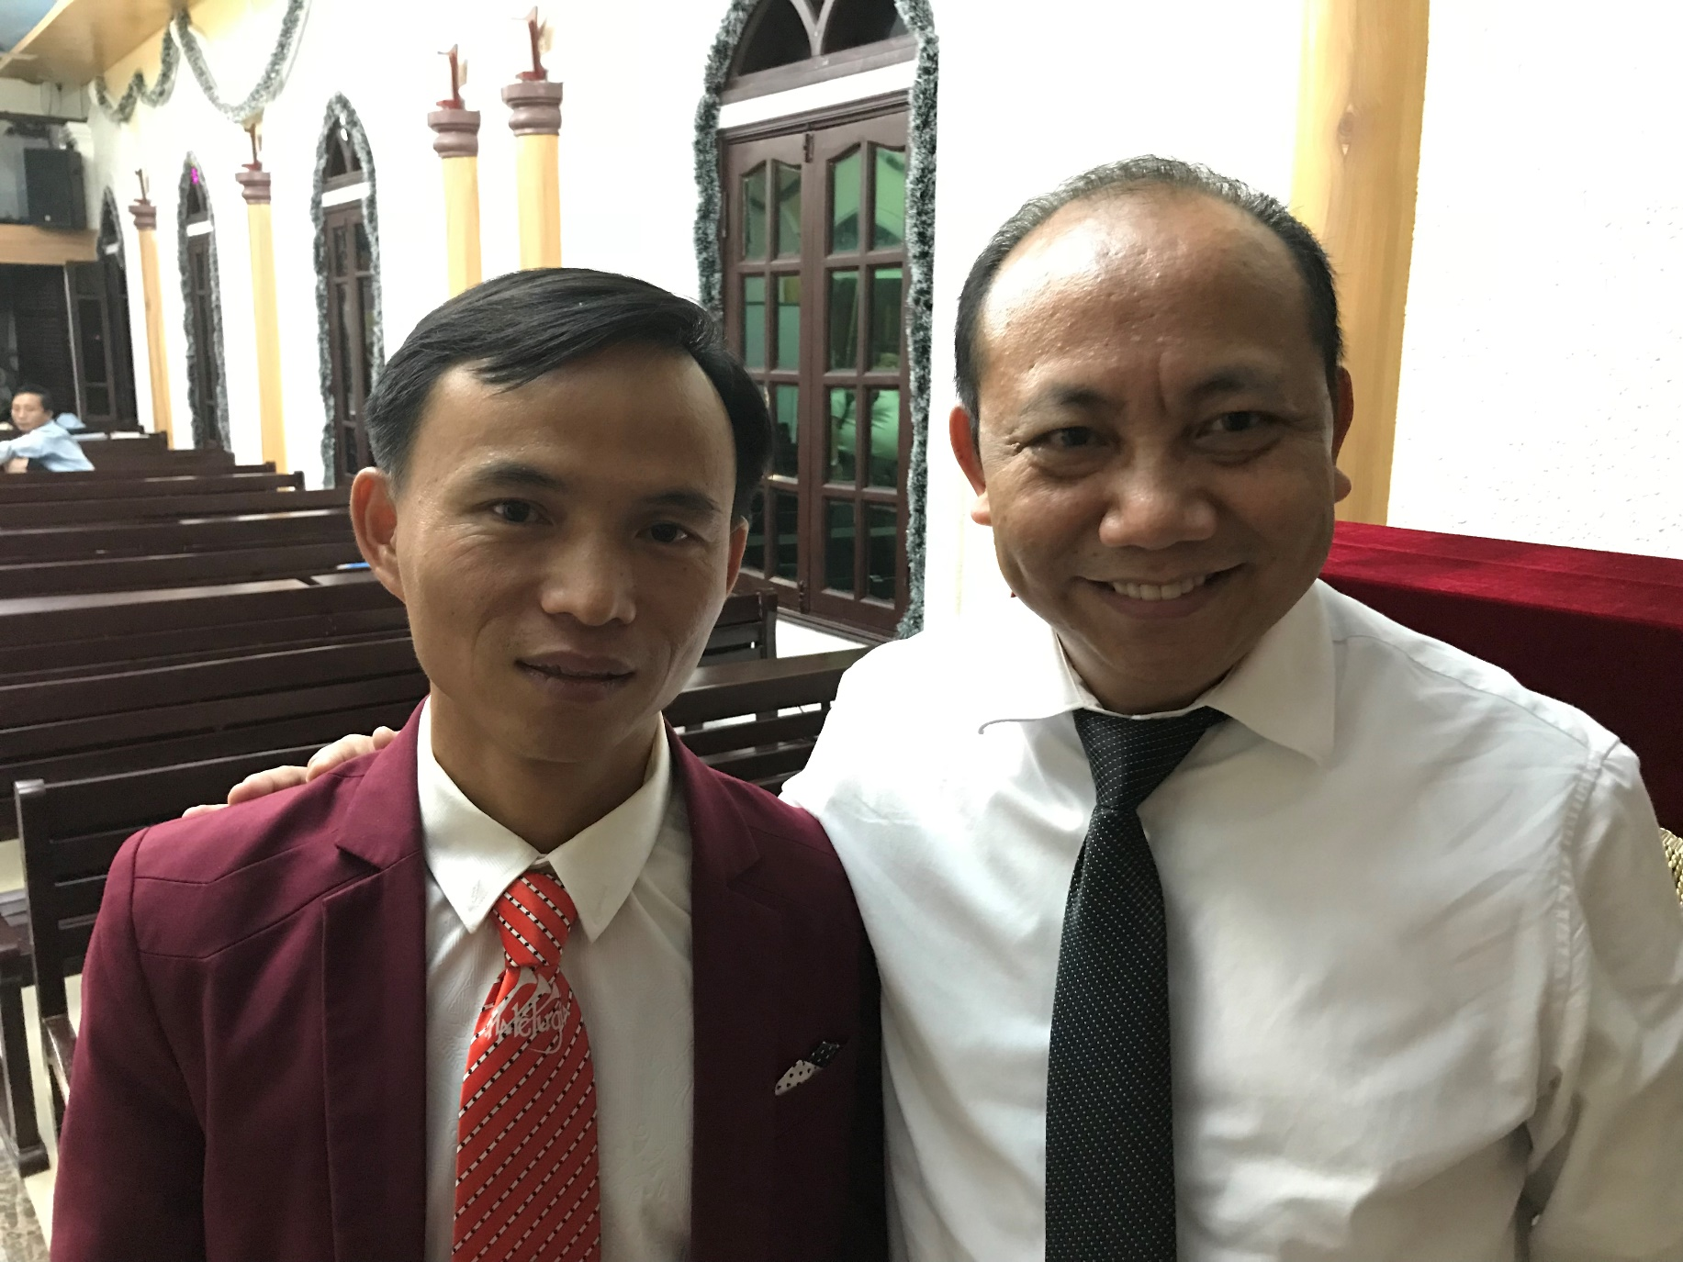
This training has changed me a lot as a pastor as well. Before the training I just preached the Law – I treated people with contempt. If I saw a member committing sin, I hated them. If they had addictions, I hated them. Now, as I look back, I see that I was a Pharisee at that time. Now, I hate that time of my life. But since I received the training from Pastor Lor and Professor Bare and the other pastors, I have learned to show compassion to the sinner. I have learned to show Christ to the sinner.
Pastor Vang, Shan Zhou Fu Church
Notes:
Pastor Vang (pictured on the left) with Rev. Bounkeo Lor
Read Pastor Vang’s full testimonial here: https://wels.net/pastor-vang/

Slide 35
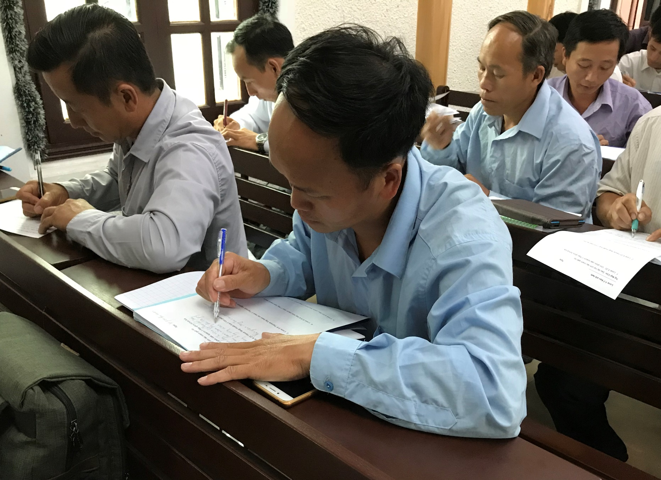
I had dreamed for training for a long time. Many members would come and ask me to share the Word of God with them, but I didn’t know how to do it. Since receiving training, I have grown in my confidence in what I believe and in sharing God’s word. We’ve stopped searching for theological answers and materials from other churches. We know we have the truth now – and we know where to find it!
Pastor Lau, Immanuel 1997 Church
Notes:
Read Pastor Lau’s full testimonial here: https://wels.net/pastor-lau/

Slide 36
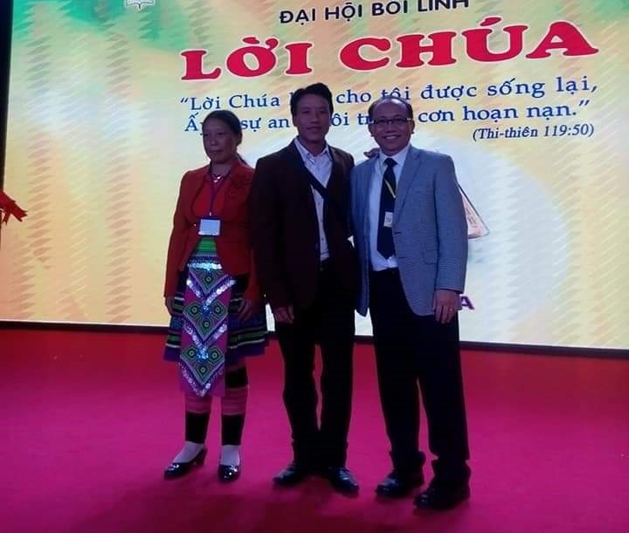
Pastor Lor, I apologize for being angry with you and even labeling you as a cult preacher. Now, I totally admit that sinners are saved by grace through faith in Christ alone. Throughout my ministry, I’ve tried so hard to please God with good works. I thought that I could be saved through them. But the harder I tried, the more distant from God I felt. The more guilty I felt. I also gave many rules to my members. After two years of studying with you, I have been moved by the Holy Spirit to believe that I am saved through faith in Christ alone
Pastor Fang
Notes:
Pastor Vang (pictured on the left) with Rev. Bounkeo Lor
Read Pastor Fang’s full testimonial here: https://wels.net/pastor-vang/

Slide 37

“I want to thank the Lutheran church for supporting the training. We don’t actually deserve to receive anything from the WELS—but they just give and support the training by sending professors and providing the financial ability for the training to take place. For that—I thank you.
Thank you so much. I will never forget you. You helped us to see the Word of God clearly. You have brought us the truth— and that has changed our lives.”
Pastor Vang, Shan Zhou Fu Church
Notes:
WELS member’s support will assist us as WELS’ shares the message of grace with even more Hmong people in Vietnam and the surrounding countries. Join us as we watch the Holy Spirit change earthly lives and open the door to eternal life for our Hmong brothers and sisters on the other side of the world.
Thank you for your prayers, gifts, and ongoing support through congregational mission offerings!

Slide 38
In the same way, the gospel is bearing fruit and growing throughout the whole world—just as it has been doing among you since the day you heard it and truly understood God’s grace.
Colossians 1:6

